Slide 1
Analysis of selected aspects of underground coal mining in Albania and Serbia
How can the infrastructure/resources of the active mines in Serbia and the closed mines in Albania be better utilised?
Aleksander Wrana
Aleksander Frejowski
UNECE Workshop on Mine Closure in Serbia and Albania
Tirana, Albania – 9.12.2022

Slide 2
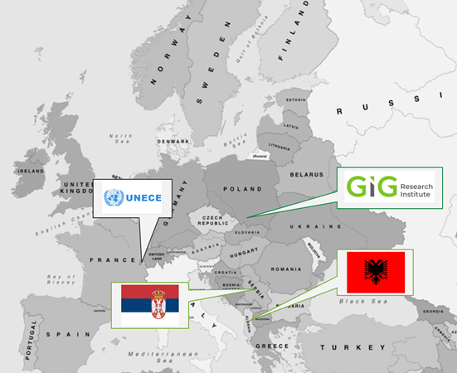
Analysis of selected aspects of underground coal mining in Albania and Serbia
The goal of the study is to provide a theoretical background for actions allowing to reclaim the coal mined land and mitigate mining and post-mining hazards in Albania and Serbia

Slide 3
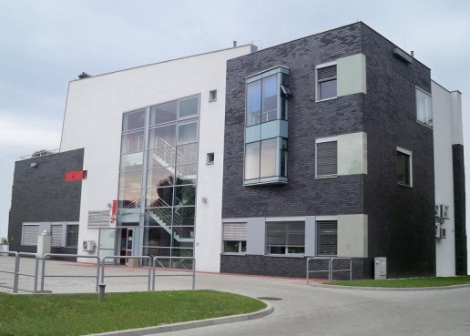
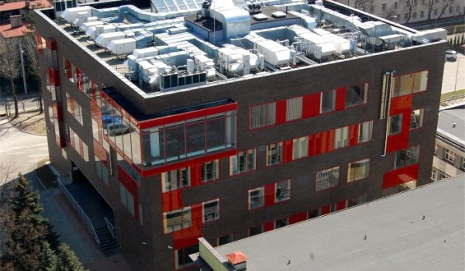
GŁÓWNY INSTYTUT GÓRNICTWA
(CENTRAL MINING INSTITUTE) IN BRIEF
Research Institute, established 1925,
Subordinates to the Minister of State Assets,
Employees (2021) – 472 people, including 11 professors, 17 assoc. prof. and 104 DSc,
Notifying Body No. 1453 of the European Union within the range of the directives: 2014/28/UE – for explosives for civil uses, 2014/34/UE – for electrical equipment for use in potentially explosive atmospheres (ATEX), 2006/42/UE – for machinery used underground, and within IECEx system that facilitates international trade in equipment and services for use in explosive atmospheres.
The Scientific Council holds full academic authorizations to grant the degree of doctor and doctor habil., and to apply for the title of professor in the field of Engineering and Technology - discipline of Environmental Engineering, Mining and Energy.

Slide 5
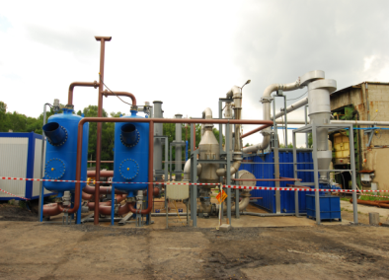
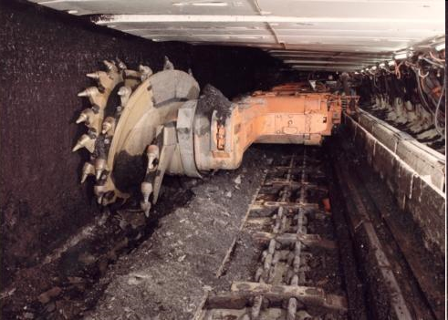
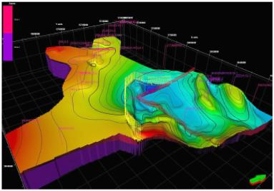
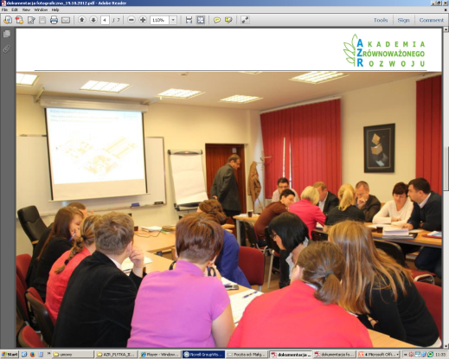
BASIC AREAS OF CENTRAL MINING INSTITUTE ACTIVITY
MINING AND GEOENGINEERING
ENVIRONMENTAL ENGINEERING
CLEAN COAL TECHNOLOGIES
OCCUPATIONAL SAFETY IN THE INDUSTRY
MATERIAL ENGINEERING
CERTIFICATION AND ATTESTATION
TRAINING AND EDUCATION

Slide 6
Analysis of selected aspects of underground coal mining in Albania and Serbia
Final study structure:
Introduction
Statement of the problem
Importance of proper mine closure and hazard identification
3. Current situation of coal mines in Albania and Serbia
Scale of coal extraction
Number of active mines and types of extraction methods employed
Number, types of inactive mines, and their closure status
Number and types of mines set for closure
The existing Governmental strategies on mine closure
4. General analysis of the local geological and mining conditions in Albania and Serbia
5. Identification of the problems related to mine closure
Ground water and surface water
Fugitive gases (e.g., methane, carbon dioxide)
Underground coal fires and fires in waste dumps
Monitoring of subsidence of mined lands and prevention of other ground surface movement
Monitoring and remediation of chemical pollutants that may leach from mine waste dumps

Slide 7
Analysis of selected aspects of underground coal mining in Albania and Serbia
6. Recommendations on addressing the identified problems
Management and remediation of ground water and surface water drainage systems
Prevention of air pollution from fugitive gases (e.g., methane, carbon dioxide)
Extinguishing and preventing underground coal fires and fires in waste dumps
Mined lands subsidence
Chemical pollutants from mine waste dumps
7. Analysis of a potential for repurposing mined land for future use
Potential uses of the reclaimed mined land by local communities and businesses
Costs and benefits of various options
8. Technical, principle-based guidelines for designing and implementing national programmes for an efficient, safe, and environmentally conscious mine closure
The proposed scope, structure, content, and objectives
Data and knowledge management
9. Conclusions

Slide 8
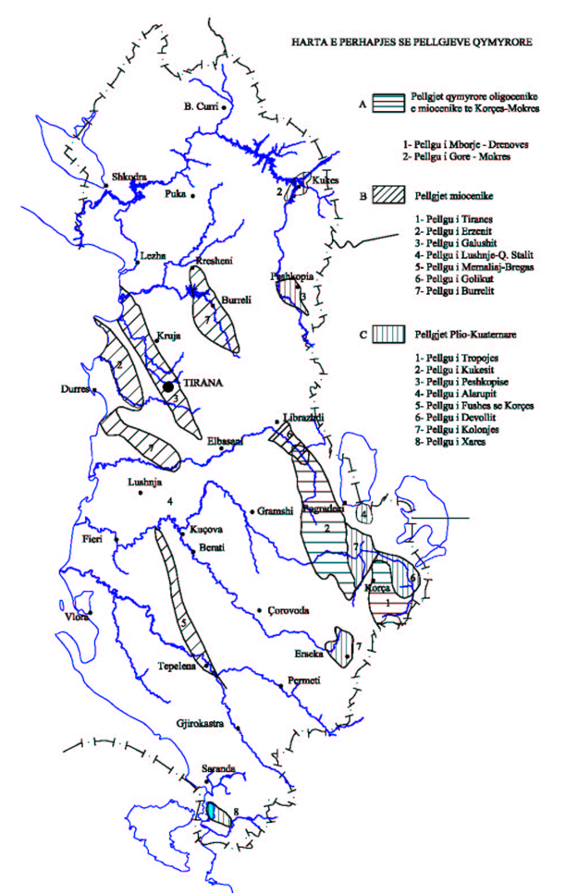
Current situation of coal mines in Albania
COAL GEOLOGICAL RESERVES IN CLOSED MINES IN ALBANIA
Nr | Name of Deposit | Start exploitation | Government Order for closing coal mines | No. of project (AKBN technical archive) | Production (Ton) | Geological reserves remained (Ton)
1 | Valias | 1978 | Nr.139 dt.20.03.1995 | Nr.2978 / 2001 | 3,515,178 | 49,186,000
2 | Mëzez | 1968 | Nr.824 dt.04.12.1996 | Nr.2978 / 2001 | 1,435,320 | 1,426,000
3 | Mushqeta | 1968 | Nr.550 dt.26.08.1996 | Nr.2978 / 2001 | 2,300,000 | 5,365,000
4 | Kërrabë | 1938 | Nr.101 dt.02.03.2001 | Nr.2748 / 2000 | 1,658,270 | 8,100,000
5 | Priska 2 | 1980 | Nr.550 dt.26.08.1996 | Nr.2978 / 2001 | 374,057 | 2,682,000
6 | Priskë | 1980 | Nr.101 dt.02.03.2001 | Nr.2978 / 2001 |  | 2,460,000
7 | Gërdec | 1978 | Nr.550 dt.26.08.1996 | Nr.2978 / 2001 | 293,200 | 297,000
8 | Manëz | 1967 | Nr.232 dt.15.05.1995 | Nr.2978 / 2001 | 1,317,000 | 1,281,000
9 | Mborje-Drenovë | 1930 | Nr.349 dt.07.07.2000 | Nr.2978 / 2001 | 1,100,000 | 3,698,000
10 | Selcë | 1984 | Nr.233 dt.15.05.1995 | Nr.2978 / 2001 | 253,563 | 125,000
11 | Babjen | 1984 | Nr.233 dt.15.05.1995 | Nr.2871 / 2003 | 75,236 | 478,562
12 | Krosnisht | 1978 | Nr.500 dt.13.08.1998 | Nr.2682 / 1999 | 1,342,174 | 496,000
13 | Qenckë | 1978 | Nr.349 dt.07.07.2000 | Nr.2682 / 1999 | 23,000 | 69,750
14 | Bezhan | 1972 | Nr.233 dt.15.05.1995 | Nr.2978 / 2001 | 1,068,519 | 7,714,000
15 | Alarup | 1959 | Nr.500 dt.13.08.1998 | Nr.2978 / 2001 |  | 1,600,000
16 | Pretushë | 1968 | Nr.233 dt.15.05.1995 | Nr.2809 / 2002 | 909,300 | 2,885,500
17 | Dardhas | 1972 | Nr.349 dt.07.07.2000 | Nr.2978 / 2001 | 1,076,100 | 6,087,000
18 | Vërdovë | 1978 | Nr.349 dt.07.07.2000 | Nr.2978 / 2001 | 900,000 | 2,300,000
19 | Potgozhan | 1985 | Nr.233 dt.15.05.1995 | Nr.2978 / 2001 | 105,000 | 10,869,700
20 | Homezh | 1986 | Nr.233 dt.15.05.1995 | Nr.2978 / 2001 | 1,377,951 | 8,174,500
21 | Memaliaj 1 dhe 2 | 1916 | Nr.268 dt.08.06.1999 | Nr.2978 / 2001 | 10,126,170 | 820,0000
22 | Memaliaj 3 | 1980 | Nr.29 dt.15.01.1996 | Nr.2978 / 2001 |  | 6,500,000
Sum |  |  |  |  | 29,250,038 | 129,995,012
Notes:
In Albania, there are currently no active state-owned underground coal mines. There are, however, potential areas where coal extraction could be considered.
In Albania, the coal reserves are located in the following 3 main deposits: in the Tirana area, in the Korça-Pogradeci area, and in the area of Memaliaj. The largest amount of coal was extracted at the Mamalija mine. In contrast, the largest reserves are in the Valenje mine area. Albanian coals are generally of the lignite type with an analytical calorific value of 2000–5400 kcal/kg (average 3200–3300). Some of the coal can be enriched after mining, producing concentrates with a calorific value up to 4500–5500 kcal/kg. In the black private, small active mines.

Slide 9
Current situation of coal mines in Albania
Possible areas for restarting exploitation
Valias Mine
The area of the mining field is 14 km², while the area on which the mine has developed its activity until the moment of closure is 4.2 km² or 420 ha. The village of Valias is located above the source of Valias. The region is described by a dense network of regional and national highways.
The variant of closing the mine was applied by plugging the mouths of the wells on the surface with metal pipes and concrete and surrounding them with walls and metal profiles were placed on them at a certain distance, connected with wire networks.
Geological reserves remained: 49,186,000 t
Memaliaj Mine
Of the 12 coal layers found in the I, II, and III fields, the 5th, 6th, 7th, 4th, and 4th”a” layers are considered industrial.
Based on the closure project, the surface facilities were planned to be rented, partially demolished and sold. The vertical shafts (eight in total) are temporarily closed, through a plug with a metal construction. Within the contoured area of ​the influence of surface use, it was recommended not to carry out constructions of any category and the existing ones are subject to monitoring.
Geological reserves remained: 6,500,000 t

Slide 10
Current situation of coal mines in Serbia
Notes:
Serbia active underground coal mines (JP PEU Resavica): RA "Vrška Čuka" (anthracite), RKU "Ibarski rudnici„ (hard coal), RMU "Rembas" (brown coal), RMU "Bogovina" (brown coal), RMU "Soko" (brown coal), RMU "Jasenovac" (brown coal), RMU "Štavalj" (lignite), and RL "Lubnica" (lignite).
Closed mine Aleksinački Rudnik: On 18 November 1989, the worst tragedy in the history of Serbian mining struck the mine. An underground fire caused by negligence at the depth of 700 m killed the entire shift of 90 miners, who suffocated from the smoke and carbon monoxide. The Aleksinacki Rudnik mine was closed in 1990

Slide 11
MINING situation of coal mines in Serbia
Mine |  | Method of exploitation | Technology of exploitation | Access to the mine by shafts (deep, m/diameter, m), |  | Access to the mine by drifts (cross-section area, m²) |  | Additional information
RMU "Bogovina" (Bogovina-Istok) |  | Chamber-pillar method | Blasting-drilling works | Ventilation shaft No. 11 (180/3.5) |  | Main haulage drift GTN (14) |  | There are also accesses to abandoned pit – shaft No. 10 (210/6) and drift, at closed Bogovina-Zapad site.
RA "Vrška Čuka" |  |  | Drilling and blasting and manual loading | Ventilation shaft VO2 (138/5) |  | Horizontal Avramica drift (16) | Inclined N4 drift (10) | In proximity of industrial estate of the mine is abandoned hoisting shaft Avramica (199/5) , which is now flooded.
RKU "Ibarski rudnici" | Jarando |  | Blasting-drilling works | None |  | Horizontal Baljevac drift (12) | Inclined GIN haulage drift (12) | Until recently mine operated three pits and in 1998-1999 third pit, Ušće, was closed. Jarando and Tadenje pits are completely separated production units
 | Tadenje |  |  | None |  | Horizontal Tadenje drift 360 m (12) | Inclined GIN haulage drift 66 m (12)
RMU "Jasenovac" |  |  |  | None |  | Horizontal GIP drift (12) | Inclined GVN drift (12)
RMU "Rembas" | Strmosten |  |  | Blind shaft (145/5) |  | Three drifts - industrial estate (10, 12, 12) | Ventilation drift - dislocated (10) | Although pits of RMU "Rembas" mine are separate, connection between pits exist to single processing facility located at Resavica.
 | Jelovac |  |  | None |  | Entrance to Jelovac drift (15) | Entrance to Bučar drift (12)
 | Senjski rudnik |  |  | Hoisting shaft (230/6) | Ventilation shaft (220/5) | South drift - connection to Resavica
RMU "Soko" |  |  |  | Hoisting shaft (246/6) | Ventilation shaft (156/5.5) | Drift GTN-1 (17)
RL "Lubnica" |  |  |  | None |  | Osojno-South - two capital drifts - main haulage (17) and main ventilation drift (17) | Stara jama N-2 haulage drift (10) and N-3 roadway (connection between pits) | Mining activities at Lubnica mine are taking place on production in Stara jama and on development in Osojno-South pit. Although, these two pits operates independent one of another, they are connected and, regarding ventilation and material supply, both pits can be treated as a one mine.
RMU "Štavalj" |  |  |  | None |  | Main haulage drift GIN-1 (13) | Main ventilation drift GVN-2 (13) | During the life of Štavalj mine there was at least one now abandoned pit.

Slide 12
MINING situation of coal mines in Serbia
Mine | Ventilation | Dewatering
RMU "Bogovina" | Fans are located on surface, within ventilation station on ventilation shaft. | Mine have two pumping stations, while other pumps, of smaller capacity and mobile, are pumping water into the main reservoir.
RA "Vrška Čuka" | Fans are located on surface, within ventilation station on ventilation shaft VO2. Ventilation station is equipped with diesel powered generator in case of electric power failure. | Dewatering of the mine is by gravity, through channels in Avramica drift (and roadways H1, H3 and U4). Small and mobile pumps are pumping water into this channel according to water influx in different locations of mine, which is generally low (1 to 2 lit/s). Therefore, there is no pumping station at the mine.
RKU "Ibarski rudnici" | Fresh air is taken into Jarando pit through GIN roadway and directed toward production and working areas, while the used air is taken to the surface via Baljevac drift, which entrance houses ventilation station (main and spare fans, diesel power generator, sound dampening utilities etc). | Main dewatering of both pits is gravitational by channels at horizontal drifts (Baljevac drift at Jarando pit and Tadenje drift at Tadenje pit). Any inflow of water at workings is pumped with submersible pumps to small collectors (two at Jarando pit) from which is then pumped to the level of mentioned drifts.
 | At Tadenje pit fresh air is taken into pit via GIN and GTH-1 roadways and through Tadenje drift, which entrance also houses ventilation station.
RMU "Jasenovac" | Fans are located on surface, within ventilation station on main ventilation drift (GVN). | Dewatering of mine is gravitational via water-way (channel) at GIP roadway to which water is pumped from the locations of influx.
RMU "Rembas" | Fresh air is lead into Senjski rudnik pit via hoisting shaft and through long-term roadways directed to production area, from where it is taken out via ventilation shaft where the fans are installed. | Main water collector at Senjski rudnik pumps the water to the level of South drift from which is then taken to the surface (Resavica) by channels. Also, there are collectors at the bottom of both shafts from which water is pumped directly to the surface.
 | At Strmosten pit, route of fresh air is GN-1 and GTU-1 from which it is distributed to development and production areas. Used air is taken out via drift +45, blind shaft and ventilation drift, which is location of ventilation station. | Main water collector at Strmosten pit is at the bottom of blind shaft, from which is pumped to the level of haulage drift and then by gravity taken out. There are also two smaller pumping stations in GN-1 roadway, both of which directly pumps the water into the channel in haulage drift.
 | Fresh air is lead into Jelovac pit via Jelovac drift and then distributed to development faces. Used air is taken out via Jelovac drift beyond pit and Bučar drift connection to surface where the fans are installed. | Main water collector at Jelovac pit long term by-pass is now developed and in operation, but during development of GTN-1 roadway (one of the long-term by-pass roadways) face is flooded and second pumping station was installed. Water from both collectors is pumped to the level of Jelovac drift from which is streaming to the surface in direction of Vodna.
RMU "Soko" | Fresh air is brought into Soko pit through hoisting shaft and directed toward production and working areas, while the used air is taken to the surface via ventilation shaft. Ventilation station is at the entrance of ventilation shaft. | Dewatering of the pit is by central water collector located near the bottom of the hoisting shaft, from where it is pumped to surface. Water is pumped into this collector from auxiliary collectors around the mine. Pumping station exists also at the bottom of the ventilation shaft.
RL "Lubnica" | Intake of fresh air at Lubnica mine is through main haulage drift GTN (Osojno) and at the connection with N-3 roadway intake is split – toward Stara jama (via N-3) and toward workings on developing of Osojno-South, from where it is taken out through main ventilation drift (GVN). From the N-3 roadway fresh air is directed toward production areas of the Stara jama and return air is taken out via ventilation roadways. | Both Stara jama and Osojno-South have water collectors from which water is pumped to the surface.
RMU "Štavalj" | Intake of fresh air at Štavalj mine is through main haulage drift GIN-1 and via other long term roadways (GIN-4 and TN-2) directed toward production are. Exhaust air is taken to the surface through main ventilation drift (GVN-2). Ventilation station is located on the entrance of the GVN-2 (equipped with fans, diesel powered generator, etc). | Average water influx is 3.5-4 m³/min (highest is 6 m³/min). For combating this amount of inflow mine have 8 water collectors, some of which with several pumps. Gravity of dewatering issue at Štavlj mine is best described with the fact that total installed power of the pumps is more than 1.3 MW.

Slide 13
Current situation of coal mines in Serbia
Mine | RMU "Bogovina" (Bogovina-Istok) | RA "Vrška Čuka" | RKU "Ibarski rudnici" |  | RMU "Jasenovac" | RMU "Rembas" |  |  | RMU "Soko" | RL "Lubnica" | RMU "Štavalj"
 |  |  | Jarando | Tadenje |  | Strmosten | Jelovac | Senjski rudnik
Number of employees in the mine 2017 | 294 | 167 | 512 |  | 270 | 1189 |  |  | 590 | 330 | 472
Mine | RMU "Bogovina" (Bogovina-Istok) | RA "Vrška Čuka" | RKU "Ibarski rudnici" |  | RMU "Jasenovac" | RMU "Rembas" |  |  | RMU "Soko" | RL "Lubnica" | RMU "Štavalj"
 |  |  | Jarando | Tadenje |  | Strmosten | Jelovac | Senjski rudnik
Average annual coal production, t | 10,000-30,000 | 6,000-8,000 | 120,000-180,000 |  | 40,000-55,000 | 120,000-160,000 |  |  | 80,000-125,000 | 50,000-70,000 | 65,000-80,000
Mine | RMU "Bogovina" (Bogovina-Istok) | RA "Vrška Čuka" | RKU "Ibarski rudnici" |  | RMU "Jasenovac" | RMU "Rembas" |  |  | RMU "Soko" | RL "Lubnica" | RMU "Štavalj"
 |  |  | Jarando | Tadenje |  | Strmosten | Jelovac | Senjski rudnik
Geological balance reserves 2017, t | 780,000 | 127,000 | 2,212,000 |  | 567,000 | 6,000,000 |  |  | 600,000 | 1,600,000 | 8,600,000
Exploitation coal reserves 2017, t | 600,000 | 85,000 | 1,500,000 |  | 380,000 | 5,000,000 |  |  | 500,000 | 1,200,000 | 6,160,000
Exploitation life from 2017, years | 15 | 9 | 9 (100 after investment) |  | 7.5 (17.5 after investments) | 21 |  |  | 4 (30 after investments) | 20 | 55-80
Possibility to increase coal resources, 2017 | No | No | Bajovac deposit, €13,000,000 |  | "Stari Jasenovac" and "Padina Mare" deposit - 0.4 Mt | Yes | 6 Mt, €6,000,000 | No | blocks B-6 and B-7 of eastern field - 9 Mt, €25,000,000 | 4.4 Mt,€9,000,000 | Štavalj-zapad deposit - 93 Mt, €65,000,000
Mine | RMU "Bogovina" (Bogovina-Istok) | RA "Vrška Čuka" | RKU "Ibarski rudnici" |  | RMU "Jasenovac" | RMU "Rembas" |  |  | RMU "Soko" | RL "Lubnica" | RMU "Štavalj"
 |  |  | Jarando | Tadenje |  | Strmosten | Jelovac | Senjski rudnik
Type of coal | brown coal | anthracite | hard coal |  | brown coal | brown coal |  |  | brown coal | lignite | lignite
Caloric value, MJ/kg | 16 - 22 | 21 - 24 | 15 |  | 9 - 19 | 17 - 25 |  |  | 14 - 19 | 7 - 15 | 12 - 19
Sulphur content, % | 0.99 | 2.26 | 5.81 | 5.7 | 1.01 | 1.59 | 1.19 | 0.97 | 1.7 | 2.15 | 0.98
Moisture, % | 17.33 | 0.96 | 3.6 | 5.02 | 22.79 | 18.75 | 13.12 | 15.33 | 19.22 | 14.92 | 28.33

Slide 14
COAL RESERVES AT ACTIVE AND POTENTIALS DEPOSIT
Balance of coal reserves at active underground mines - deposits, as at 31.12.2020
After Ivković et al., 2022
Balance reserves of coal in inactive deposits with potential for underground exploitation
After Ivković et al., 2022
Notes:
Aleksinac – closed mines after explosion.

Slide 15
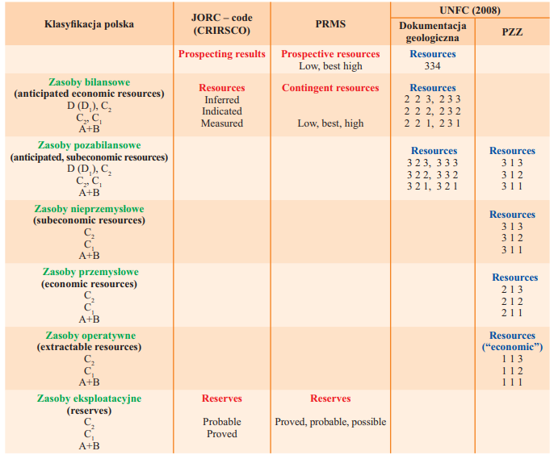
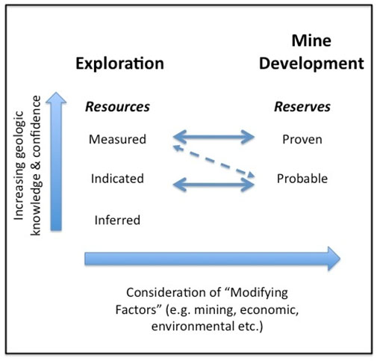
Classification of resources and reserves
Comparison of Polish and international classifcations of resources and reserves
Resources and Reserves: The relationships between the five groups of mineral asset reporting
After Vukas and Dajovic, 2017
After Nieć, 2010
Notes:
There are several classification systems for the economic evaluation of mineral deposits worldwide. The most commonly used schemes base on the International Reporting Template, developed by the CRIRSCO - Committee for Mineral Reserves International Reporting Standards, like the Australian Joint Ore Reserves Committee - JORC Code 2012. It is mainly based on economics, which means that for certain fossil fuels/ deposits its use will preclude exploitation.

Slide 16
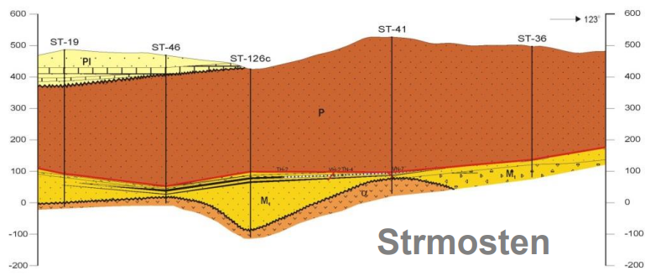
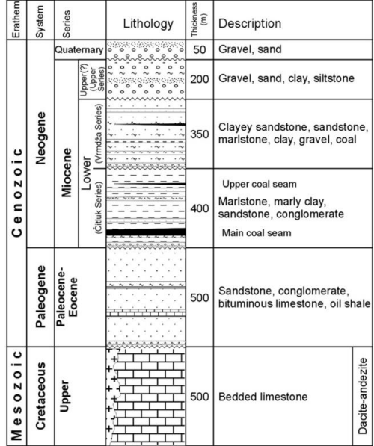
General analysis of the local geological and mining conditions in Serbia
Mine | RMU "Bogovina" (Bogovina-Istok) | RA "Vrška Čuka" | RKU "Ibarski rudnici" |  | RMU "Jasenovac" | RMU "Rembas" |  |  | RMU "Soko" | RL "Lubnica" | RMU "Štavalj"
 |  |  | Jarando | Tadenje |  | Strmosten | Jelovac | Senjski rudnik
Coal seams | Two coal seams | Main seam and interlayers | Two coal seams | Five coal seams | One coal seam | One coal seam | One coal seam | One coal seam | One coal seam | Two coal seams | One coal seam
Coal seam thickness, m | 1-7.2 m and 1-4.5 m | 0.3-3.0 with thickenings up to 6.0 m | 1.5-12 m and 1-2.5 m | 4.4 m, 2.2 m, 1.95 m, 1.9 m and 2.4 m | 5-29 m | 7.7 m | 4.5 m | 7 m | 25-40 m | 5-9 m and 2-5 m | 10.0-14.0 m
Coal seam slope, ° | 12-14° | 0-35° | 10-40° | 5-25° | 20-33° | 10-20° | 5-10° | 10-25° | 35-45° | 20-33° | 5-20°
Hanging wall rocks (roof rocks) | Marls | Clayey sandstones | Marls | Marls, clays | Clays, sandstones | Marls and red sandstones | Red sandstones | Marls | Marls | Marls, clays | Marls
Foot wall rocks (floor rocks) | Clays | Clayey sandstones | Sandstones | Marls | Sandy clays | Green sandstones | Green sandstones | Clayey marls | Coal clays | Sandstones and clays | Marls
Tectonics | Expressed | Very expressed | Expressed | Expressed | Expressed | Expressed | Expressed | Expressed | Expressed | Expressed | Expressed
Ivkovic et al., 2012
RMU "Soko"

Slide 17
What can be done to improve underground coal mining in Serbia?
It is necessary to:
introduce new modern equipment for the construction of pit rooms, excavation and transport and raise the level of production (especially in RMU "Soko„, RMU "Štavalj„, RMU "Rembas„ (Strmosten), and RL "Lubnica„),
conduct technical and organizational changes (change of structure, and reduce the number of employed non-production workers in the company to the optimal number),
begin work on the construction of a new mine,
and start a program of planned closure of mines whose coal reserves are about to be exhausted.
Notes:
The main causes of the negative operation of underground coal mines are contained mainly in the low price of coal, price disparities of energy and raw materials, low degree of mechanization and lack of investments in the last 20 years or so.
The average price of coal from our mines was 30 EU/t in 2016, which was the lowest price in the region and probably in Europe.
With such low coal prices for a long period of time, neither ongoing business nor investments in regular maintenance of existing and acquisition of new equipment can be ensured, and the devastation of mines is now practically a continuous process.

Slide 18
Identification of the problems related to mine closure
Closure procedures will commence following decision of proper authorities (Company Management and Ministry of Mining and Energy). Issues related to closure of the mines are as follows:
Legal and financial issues;
Physical closure issues;
Environmental issues and
Social mitigation issues.
Physical closure of the mine starts with development of technical documentation regarding:
Disassembly and recovery of underground equipment, including steel support;
Isolation of all mine accesses – backfilling of shafts and construction of concrete slabs on shafts entries and construction of isolation dams on drifts entries;
Demolition of surface facilities;
Rehabilitation and reclamation of mine industrial estate.

Slide 19
Identification of the problems related to mine closure NATURAL HAZARDS IN ACTIVE MINES IN SERBIA
Water hazard
Mine | RMU "Bogovina" (Bogovina-Istok) | RA "Vrška Čuka" | RKU "Ibarski rudnici" |  | RMU "Jasenovac" | RMU "Rembas" |  |  | RMU "Soko" | RL "Lubnica" | RMU "Štavalj"
 |  |  | Jarando | Tadenje |  | Strmosten | Jelovac | Senjski rudnik
Water inflow, m³/min | 0,04 | 1,5 l/s | 1 | 0,5 | 3 | 2,5 | 0,6-1,0 | 3 | 3,67 | 0,5 | 6,0-8,0
Gas hazard
Ivkovic et al., 2012
Mine | RMU "Bogovina" (Bogovina-Istok) | RA "Vrška Čuka" | RKU "Ibarski rudnici" |  | RMU "Jasenovac" | RMU "Rembas" |  |  | RMU "Soko" | RL "Lubnica" | RMU "Štavalj"
 |  |  | Jarando | Tadenje |  | Strmosten | Jelovac | Senjski rudnik
Relative methane-bearing capacity, m³ CH₄/t | registered appearance | 8,93) | 0,025-0,245 | non-methane | non-methane | registered appearance | registered appearance | registered appearance | 11,74 | registered appearance/non-methane | non-methane
Absolute methane-bearing capacity, m³ CH₄/min | registered appearance | 0,147 | 0,008-0,079 | non-methane | non-methane | registered appearance | registered appearance | registered appearance | 2,71 | registered appearance/non-methane | non-methane
Dust hazard
Mine | RMU "Bogovina" (Bogovina-Istok) | RA "Vrška Čuka" | RKU "Ibarski rudnici" |  | RMU "Jasenovac" | RMU "Rembas" |  |  | RMU "Soko" | RL "Lubnica" | RMU "Štavalj"
 |  |  | Jarando | Tadenje |  | Strmosten | Jelovac | Senjski rudnik
Dust explosives (g/m³) | 225 | non-explosive | 70-100 | 270 | 225 | 180 | 230 | 200 | 230 | 110 | -
Dust self-ignition (°C) | 250 | not self-ignition | 630-700 | no data | 260 | 280-290 | 300 | 260-290 | 250-350 | 215-235 | 220-280
Fire hazard
Mine | RMU "Bogovina" (Bogovina-Istok) | RA "Vrška Čuka" | RKU "Ibarski rudnici" |  | RMU "Jasenovac" | RMU "Rembas" |  |  | RMU "Soko" | RL "Lubnica" | RMU "Štavalj"
 |  |  | Jarando | Tadenje |  | Strmosten | Jelovac | Senjski rudnik
Coal self-ignition, °C/min | 80-120 | not self-ignition | 69-98 | no tendency | 80-100 | 110-120 | 70-110 | 118-140 | 115-188 | 80 | 103-111
Ivkovic et al. 2012; Savic, 2015; Todorovic et al., 2020

Slide 20
Identification of the problems related to mine closure Redundant Surface facilities and environmental reclamation
Mine | Objects for demolition during closure of mine |  | Objects for potential for social mitigation |  | Other objects (objects dislocated from industrial estate of the mine and in use for non-mining purpose) |  | Total
 | Number | Area, m² | Number | Area, m² | Number | Area, m² | Number | Area, m²
RMU "Bogovina" | 23 | 3,999 | 15 | 3,331 | 9 | 1,224 | 47 | 8,554
RA "Vrška Čuka" | 12 | 2,595 | 4 | 1,48 | 0 | 0 | 16 | 4,075
RKU "Ibarski rudnici" | 21 | 4,861 | 9 | 2,039 | 4 | 4,074 | 34 | 10,974
RMU "Jasenovac" | 9 | 1,478 | 7 | 1,552 | 1 | 0,620 | 17 | 3,650
RMU "Rembas" | 11 | 8,243 | 14 | 10,93 | 11 | 4,567 | 36 | 23,740
RMU "Soko" | 10 | 1,596 | 10 | 8,804 | 0 | 0 | 20 | 10,400
RL "Lubnica" | 6 | 2,555 | 5 | 2,946 | 3 | 1,499 | 14 | 7,000
RMU "Štavalj" | 15 | 0,826 | 7 | 4,393 | 0 | 0 | 22 | 5,219
Total | 107 | 26,153 | 71 | 35,475 | 28 | 11,984 | 206 | 73,612
Mine | Area for reclamation (industrial estate) |  | Waste heaps | Total area for reclamation
 | Area, m² |  | Area, m2 | Area, m²
RMU "Bogovina" | Bogovina-Zapad, 52,500 | Bogovina-Istok, 2500 | Several loactions: 153,800 | 208,800
RA "Vrška Čuka" | 23,000 |  | Four locations: 100,700 | 123,700
RKU "Ibarski rudnici" | 89,900 |  | 80,000 | 160,900
RMU "Jasenovac" | 35,500 |  | 2,000 | 37,500
RMU "Rembas" | 79,000 |  | Five locations: 377,700 | 456,700
RMU "Soko" | 130,000 |  | 43,100 | 173,100
RL "Lubnica" | 85,000 |  | 104,300 | 189,300
RMU "Štavalj" | 87,000 |  | 73,300 | 160,300
Total | 584,400 |  | 934,900 | 1,510,300

Slide 21
How can the infrastructure/resources of the active mines in Serbia and the closed mines in Albania be better utilised?
Synergistic POTENTIALS of end-of-life coal mines and coal-fired power plants, along with closely related neighbouring industries: update and re-adoption of territorial just transition plans.
EU Research Fund for Coal and Steel (RFCS)
Grant Agreement No 101034042
www.potentialsproject.eu
Leveraging the competitive advantages of end-of-life underground coal mines to maximise the creation of green and quality jobs.
EU Research Fund for Coal and Steel (RFCS) Grant Agreement No 101057789
www.greenjobsproject.eu
Notes:
There are two projects funded by the Research Fund for Coal and Steel (RFCS) linked to the objectives of the European Green Deal, aiming to achieve in the EU no net emissions of greenhouse gases in 2050 and with economic growth decoupled from resource use.
First, the POTENTIALS project focuses on the repurposing of end-of-life underground coal mines and coal-fired power plants, identifying and assessing the development of new business models relying on renewable energy and contributing to the circular economy.
Second, the GreenJOBS project develops some of these business models by leveraging five competitive advantages of end-of-life underground coal mines.

Slide 22
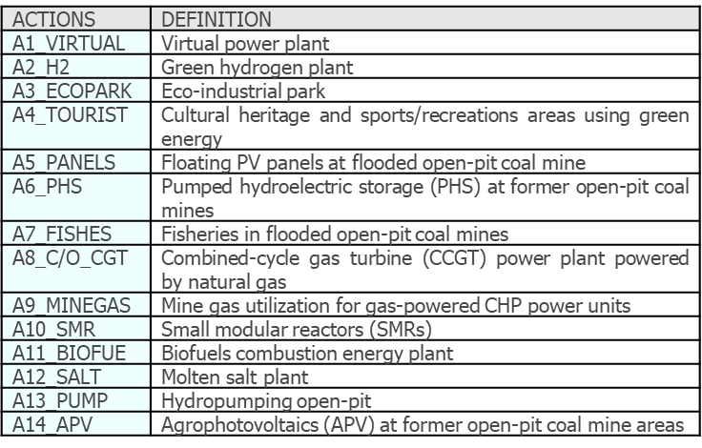
POTENTIALS Project
It focuses on taking advantage of the joint potential of end-of-life coal mines and coal-fired power plants to stimulate new economic activities and develop jobs in Coal Regions in Transition.
It identifies and assess opportunities by means of a prospective analysis, enabling to develop business models that rely on renewable energy, on the circular economy or scale energy storage, guaranteeing a sustainable and combined use of assets and resources.
Notes:
ACTIONS selected business models that rely on renewable energy, circular economy or scale energy storage.
CRITERIA refers to evaluation criteria emanating from the goal and objectives of the study.
POLICIES directly related to one of the Commission priorities for 2019-2024: the European Green Deal.

Slide 23
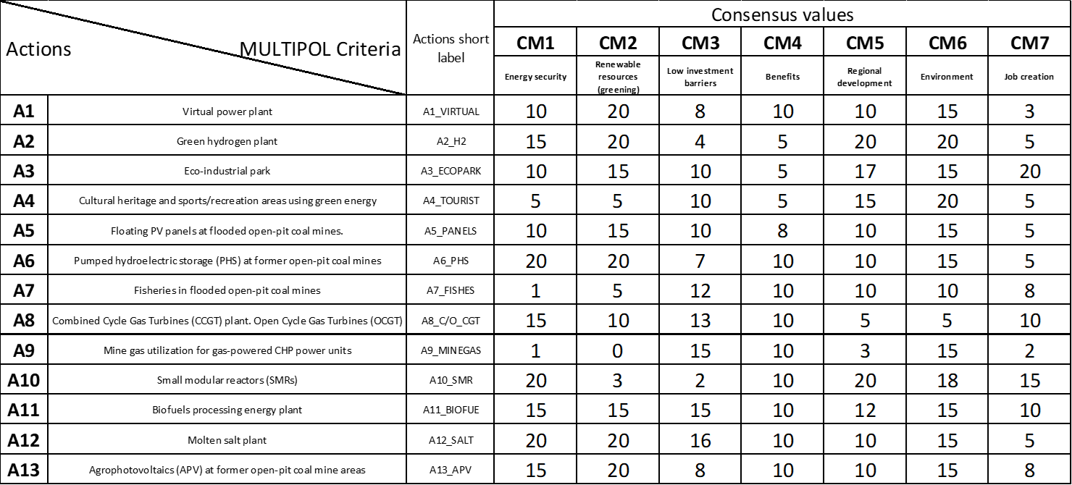
POTENTIALS Project
Using MULTIPOL program (Multicriteria and policy), first, the scoring of actions with respect to criteria from 0 to 20 is made.
Notes:
MULTIPOL (acronym for MULTI-criteria and POLicy) is one of the simplest existing multi-criteria applications but by no means the least useful. It is based on the evaluation of actions through means of weighted average, similar to the evaluation of students in a class calculated according to coefficients per subject.
The matrix ‘evaluation of actions related to criteria’ defines the set of criterion weights, for every action with respect to every defined criterion.

Slide 24
POTENTIALS Project
Second, matrix values corresponding to policy evaluation with respect to the criteria are assigned. As this concerns the set of criteria weights, the row sum must always equal 100.
Notes:
The matrix ‘evaluation of policies related to criteria’ defines the scores for every policy with respect to every defined criterion.
The row sum in this matrix must equal 100.
The different values given to the criteria following the policies will be used as weights for the evaluation of actions.

Slide 25
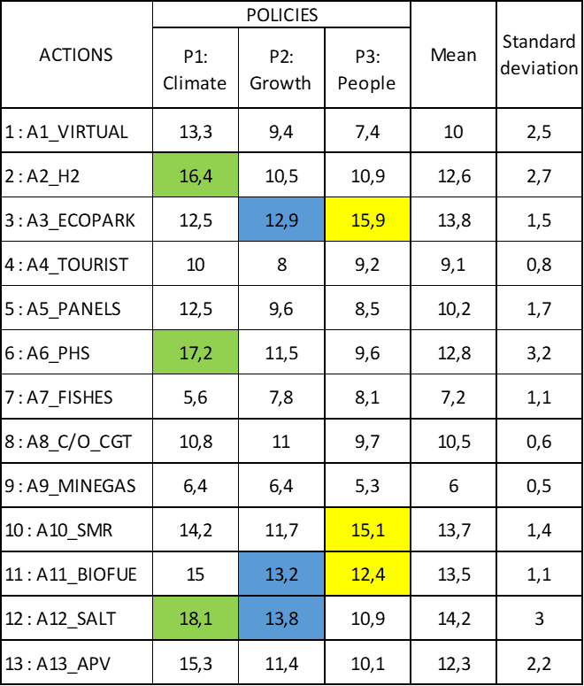
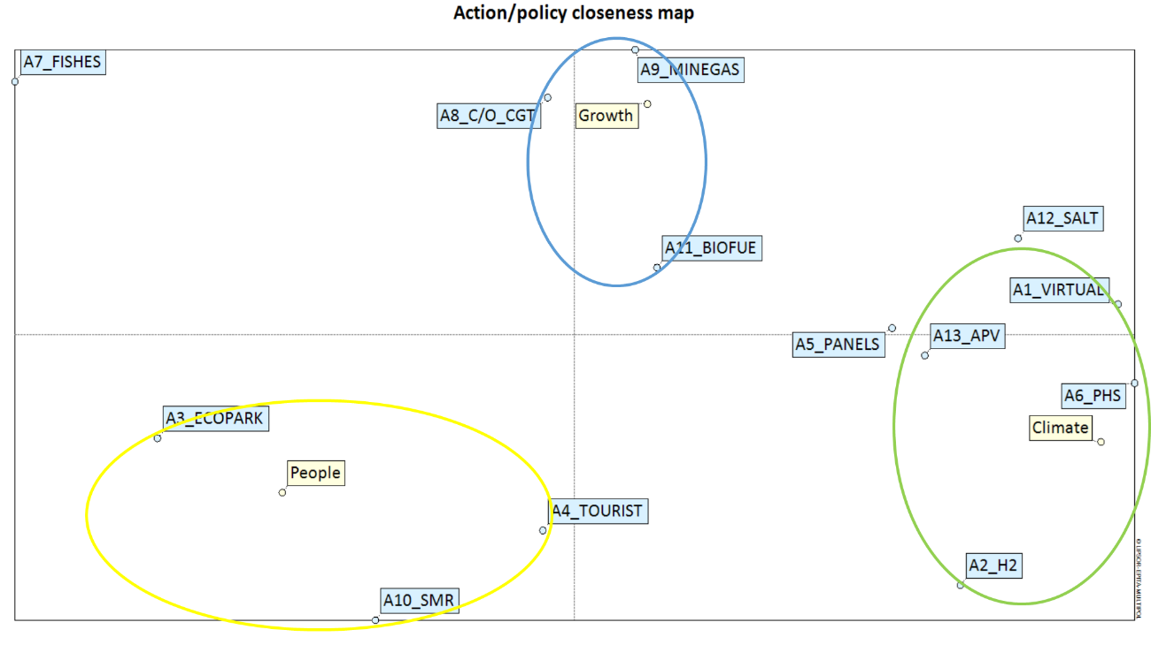
POTENTIALS Project
Evaluation of actions related to policies and cctions/policies closeness map.
Notes:
Table shows the scores of actions related to policies. In other words these are calculated by applying the set of weights of the ‘matrix evaluation of actions related to criteria’ to the ‘matrix of policies related to criteria’. Other information such as the mean, standard deviations and the rank of actions by policy can also be found in this matrix.
This map is used to determine which actions are to be chosen whilst taking into consideration policies as well as convergences between policies and given actions.
This is achieved via Correspondence Analysis (CA) and is computed using the matrix of evaluation of actions related to policies.

Slide 26
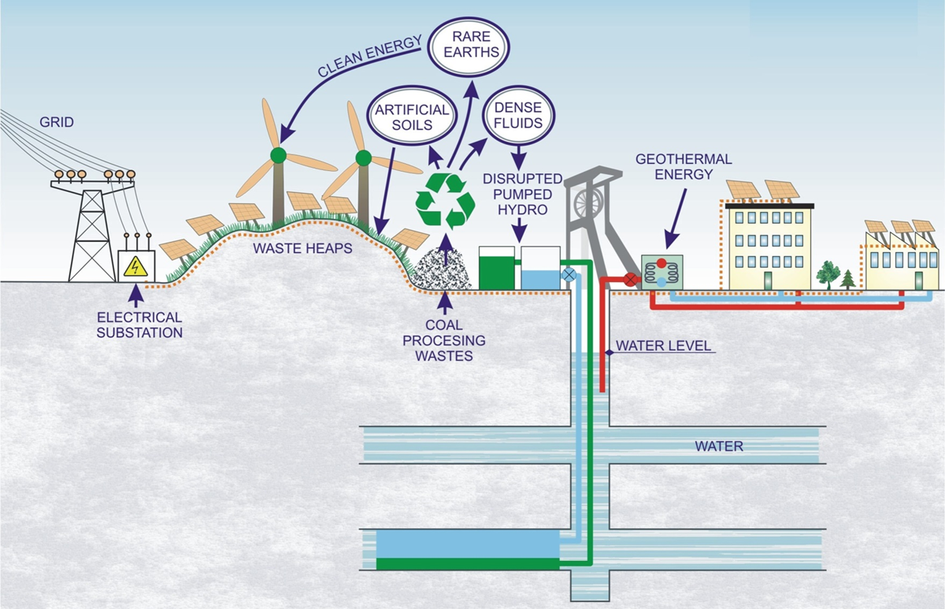
GreenJOBS Project
Business model 1: Virtual Power Plant where energy is sold to the grid.

Slide 27
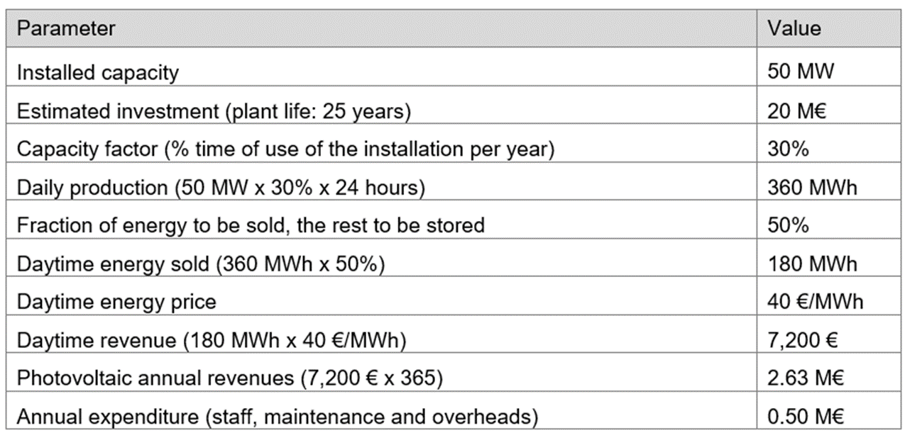
Photovoltaic deployment parameters
Photovoltaic parameters for a 50 ha waste heap area with an installed capacity of 1 MW/ha, a capacity factor of 30% and 50% of energy to be stored.

Slide 28
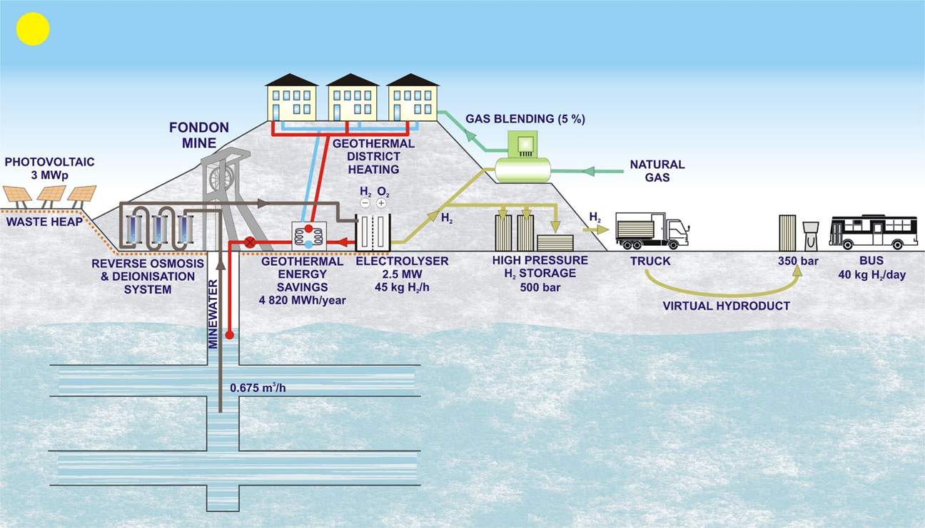
GreenJOBS Project
Business model 2: Green hydrogen plant.

Slide 29
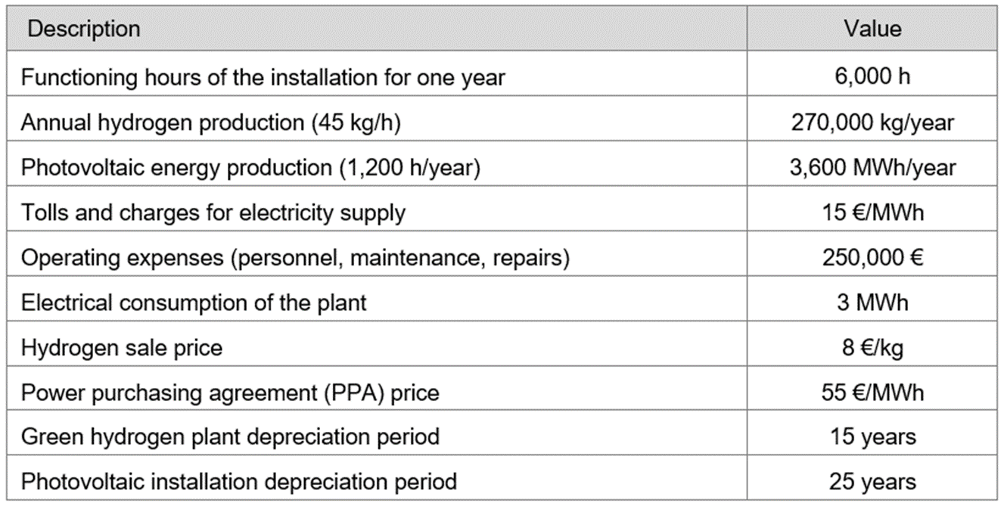
Technical and economic parameters
Parameters for a 69% of green hydrogen plant functioning and a 14% of photovoltaic plant functioning.

Slide 30
THANK YOU FOR ATTENTION
Aleksander Wrana
Department of Extraction Technologies, Rockburst and Risk Assessment
Plac Gwarków 1 40-166 Katowice Poland phone: +48 32 259 2307 awrana@gig.eu
Aleksander Frejowski
Department of Extraction Technologies, Rockburst and Risk Assessment
Plac Gwarków 1 40-166 Katowice Poland phone: +48 32 259 2848 afrejowski@gig.eu

