Slide 1
Task Force on Safe Operations and
Closure of Coal Mines
Alicja Krzemień
18th session of the Group of Experts on Coal Mine Methane and Just Transition
Geneva, Switzerland, 21-22 March 2023

Slide 2

Alicja KRZEMIEń
Who am I? Where do I work?
Professor, Central Mining Institute (GIG), Katowice, Poland
Department of Extraction Technologies, Rockburst and Risk Assessment at GIG
A specialist in risk assessment and Occupational Health and Safety in mines. The EURACOAL’s Technical Research Committee Chair and a member of the European Commission’s advisory group for coal (CAG). A lecturer in Risk Management at the University of Oviedo (Spain).
What do I do?
European R&D projects related to:
leveraging the competitive advantages of end-of-life underground coal mines;
management of environmental risks during and after mine closure;
recovery of degraded and transformed ecosystems in coal mining-affected areas.
Notes:
There are two projects funded by the Research Fund for Coal and Steel (RFCS) linked to the objectives of the European Green Deal, aiming to achieve in the EU no net emissions of greenhouse gases in 2050 and with economic growth decoupled from resource use.
First, the POTENTIALS project focuses on the repurposing of end-of-life underground coal mines and coal-fired power plants, identifying and assessing the development of new business models relying on renewable energy and contributing to the circular economy.
Second, the GreenJOBS project develops some of these business models by leveraging five competitive advantages of end-of-life underground coal mines.

Slide 3


TWO ideas on potential scope and activities of THE Safe Operations and Closure of Coal Mines Taskforce
Synergistic POTENTIALS of end-of-life coal mines and coal-fired power plants, along with closely related neighbouring industries: update and re-adoption of territorial just transition plans.
EU Research Fund for Coal and Steel (RFCS) Grant Agreement No 101034042
www.potentialsproject.eu
Leveraging the competitive advantages of end-of-life underground coal mines to maximise the creation of green and quality jobs.
EU Research Fund for Coal and Steel (RFCS) Grant Agreement No 101057789
www.greenjobsproject.eu
Notes:
There are two projects funded by the Research Fund for Coal and Steel (RFCS) linked to the objectives of the European Green Deal, aiming to achieve in the EU no net emissions of greenhouse gases in 2050 and with economic growth decoupled from resource use.
First, the POTENTIALS project focuses on the repurposing of end-of-life underground coal mines and coal-fired power plants, identifying and assessing the development of new business models relying on renewable energy and contributing to the circular economy.
Second, the GreenJOBS project develops some of these business models by leveraging five competitive advantages of end-of-life underground coal mines.

Slide 4

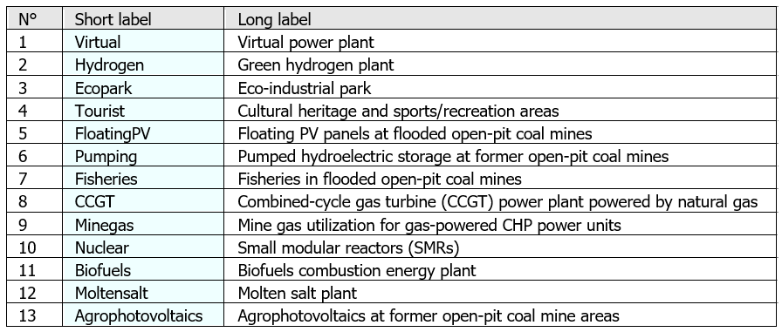
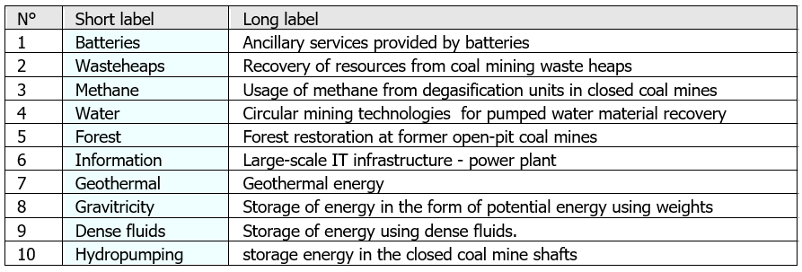
POTENTIALS Project
It focuses on taking advantage of the joint potential of end-of-life coal mines and coal-fired power plants to stimulate new economic activities and develop jobs in Coal Regions in Transition.
It identifies and assess opportunities by means of a prospective analysis, enabling to develop business models that rely on renewable energy, on the circular economy or scale energy storage, guaranteeing a sustainable and combined use of assets and resources.
ACTIONS
MICRO-ACTIONS
Notes:
ACTIONS selected business models that rely on renewable energy, circular economy or scale energy storage.
CRITERIA refers to evaluation criteria emanating from the goal and objectives of the study.
POLICIES directly related to one of the Commission priorities for 2019-2024: the European Green Deal.

Slide 5
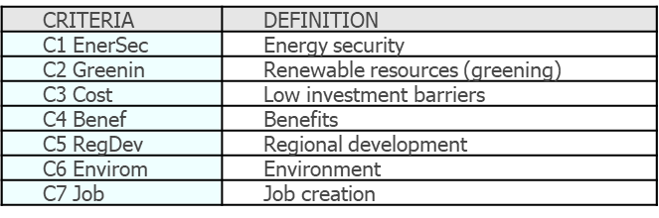
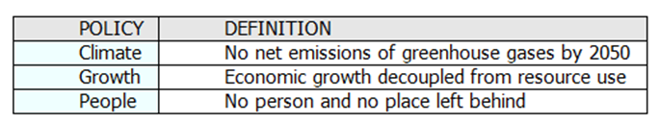
POTENTIALS Project
CRITERIA
EUROPEAN GREEN DEAL POLICIES
Notes:
ACTIONS selected business models that rely on renewable energy, circular economy or scale energy storage.
CRITERIA refers to evaluation criteria emanating from the goal and objectives of the study.
POLICIES directly related to one of the Commission priorities for 2019-2024: the European Green Deal.

Slide 6

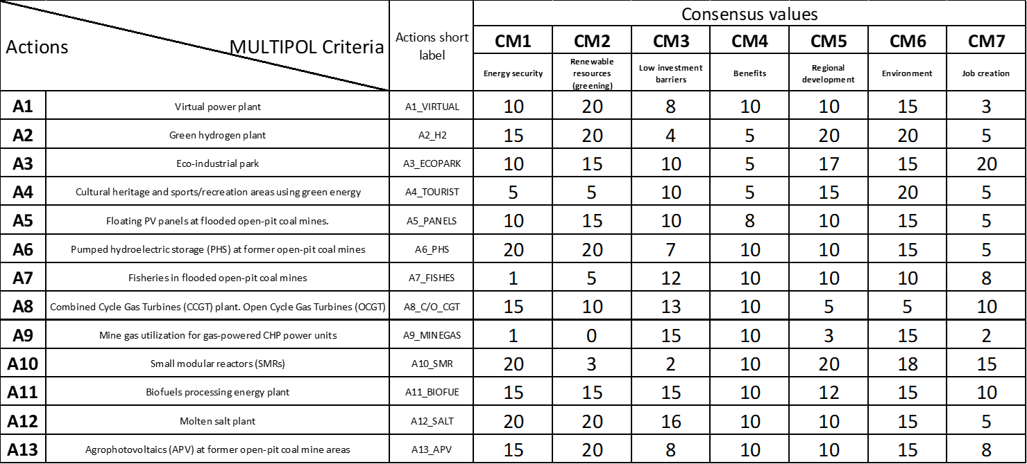
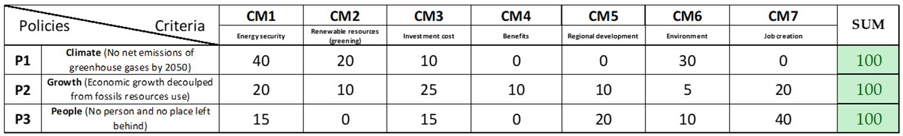
POTENTIALS Project - ACTIONS
First, using MULTIPOL program (Multicriteria and policy), the scoring of actions with respect to criteria from 0 to 20 is made.
Second, matrix values corresponding to policy evaluation with respect to the criteria are assigned. As this concerns the set of criteria weights, the row sum must always equal 100.
Notes:
MULTIPOL (acronym for MULTI-criteria and POLicy) is one of the simplest existing multi-criteria applications but by no means the least useful. It is based on the evaluation of actions through means of weighted average, similar to the evaluation of students in a class calculated according to coefficients per subject.
The matrix ‘evaluation of actions related to criteria’ defines the set of criterion weights, for every action with respect to every defined criterion.
The matrix ‘evaluation of policies related to criteria’ defines the scores for every policy with respect to every defined criterion.
The row sum in this matrix must equal 100.
The different values given to the criteria following the policies will be used as weights for the evaluation of actions.

Slide 7
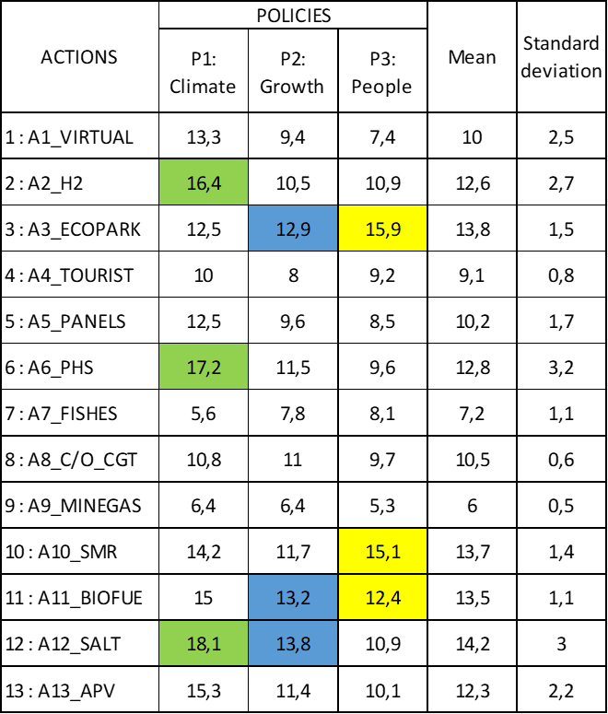
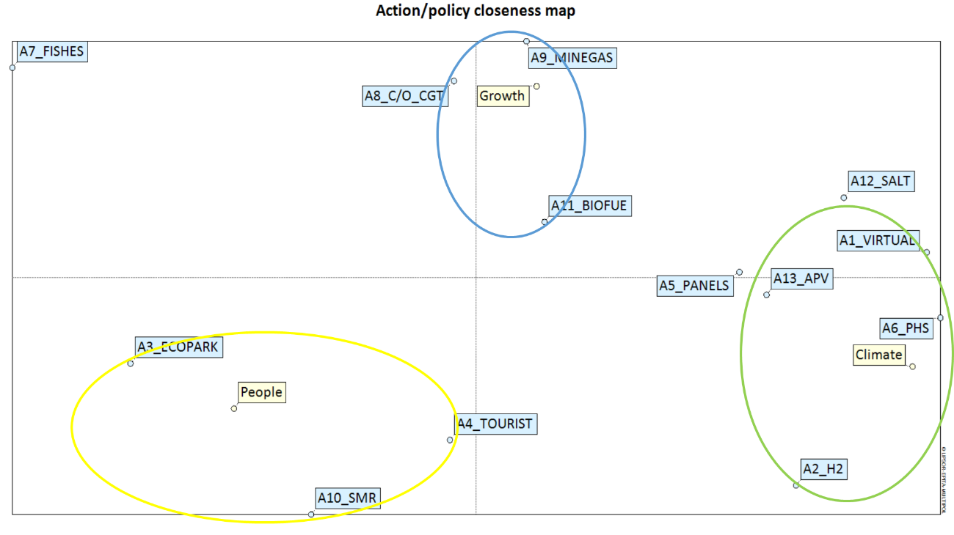
POTENTIALS Project - ACTIONS
Evaluation of actions related to policies and actions/policies closeness map.
Notes:
Table shows the scores of actions related to policies. In other words these are calculated by applying the set of weights of the ‘matrix evaluation of actions related to criteria’ to the ‘matrix of policies related to criteria’. Other information such as the mean, standard deviations and the rank of actions by policy can also be found in this matrix.
This map is used to determine which actions are to be chosen whilst taking into consideration policies as well as convergences between policies and given actions.
This is achieved via Correspondence Analysis (CA) and is computed using the matrix of evaluation of actions related to policies.

Slide 8
POTENTIALS Project – micro-ACTIONS
First, using MULTIPOL program (Multicriteria and policy), the scoring of micro-actions with respect to criteria from 0 to 20 is made.
Second, matrix values corresponding to policy evaluation with respect to the criteria are assigned. As this concerns the set of criteria weights, the row sum must always equal 100.
Notes:
MULTIPOL (acronym for MULTI-criteria and POLicy) is one of the simplest existing multi-criteria applications but by no means the least useful. It is based on the evaluation of actions through means of weighted average, similar to the evaluation of students in a class calculated according to coefficients per subject.
The matrix ‘evaluation of actions related to criteria’ defines the set of criterion weights, for every action with respect to every defined criterion.
The matrix ‘evaluation of policies related to criteria’ defines the scores for every policy with respect to every defined criterion.
The row sum in this matrix must equal 100.
The different values given to the criteria following the policies will be used as weights for the evaluation of actions.

Slide 9
POTENTIALS Project – micro-ACTIONS
Evaluation of actions related to policies and micro-actions/policies closeness map.
Notes:
Table shows the scores of actions related to policies. In other words these are calculated by applying the set of weights of the ‘matrix evaluation of actions related to criteria’ to the ‘matrix of policies related to criteria’. Other information such as the mean, standard deviations and the rank of actions by policy can also be found in this matrix.
This map is used to determine which actions are to be chosen whilst taking into consideration policies as well as convergences between policies and given actions.
This is achieved via Correspondence Analysis (CA) and is computed using the matrix of evaluation of actions related to policies.

Slide 10
POTENTIALS Project
Evaluation of actions and micro-actions related to policies.

Slide 11
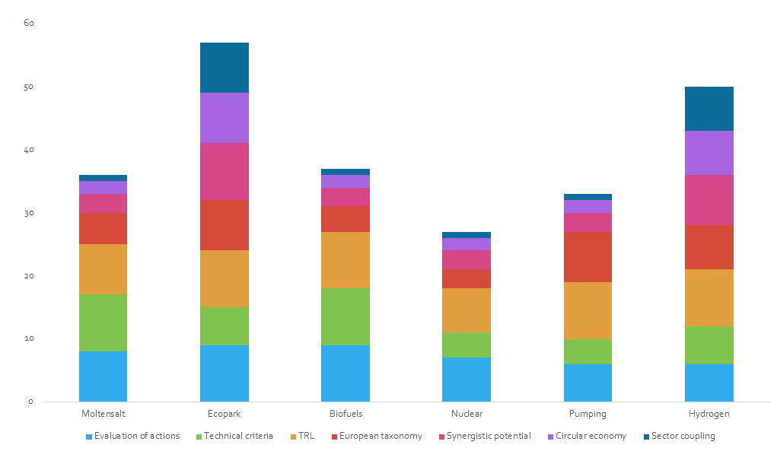
POTENTIALS Project - business model choice (actions)
Evaluation of actions
Technical criteria
TRL
European taxonomy
Synergistic potential
Circular economy
Sector coupling
ECO-INDUSTRIAL PARK
HYDROGEN

Slide 12
POTENTIALS Project
ECO-INDUSTRIAL PARK SCENARIO
Eco-industrial parks (with virtual power plant) as an integrated alternative to be developed within coupled end-of-life coal mine sites and coal-fired power plants along with surrounding residential/industrial areas for sustainable renewable energy generation (geothermal and photovoltaic/wind), storage technologies, circular economy contributions and synergies for reducing waste and pollution by promoting short distance transport and optimising the park’s material, resource, and energy flows, producing the goods needed for the industrial transition in Europe and cooperating to its achievement.
Eco-industrial parks should be based on district networks that allow multiple energy sources to be connected to various energy consumption points, helping to increase photovoltaic deployment by transforming heat and power energy customers into prosumers or customers with excess electricity from solar panels on their roofs. Eco-industrial parks should be supported by pursuing financial privileges and other benefits to boost and diversify the area’s economy, attracting external investment: tax exemptions for industries, access to preferential credits from National authorities, European Investment Bank, and others.

Slide 13
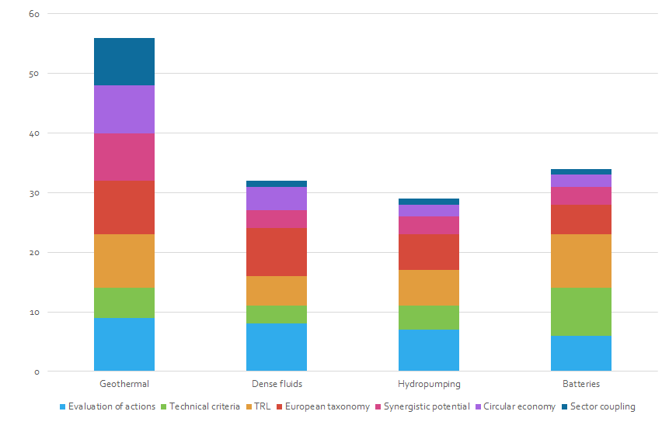
POTENTIALS Project - business model choice (micro-actions)
Evaluation of actions
Technical criteria
TRL
European taxonomy
Synergistic potential
Circular economy
Sector coupling
GEOTHERMAL
BATTERIES

Slide 14
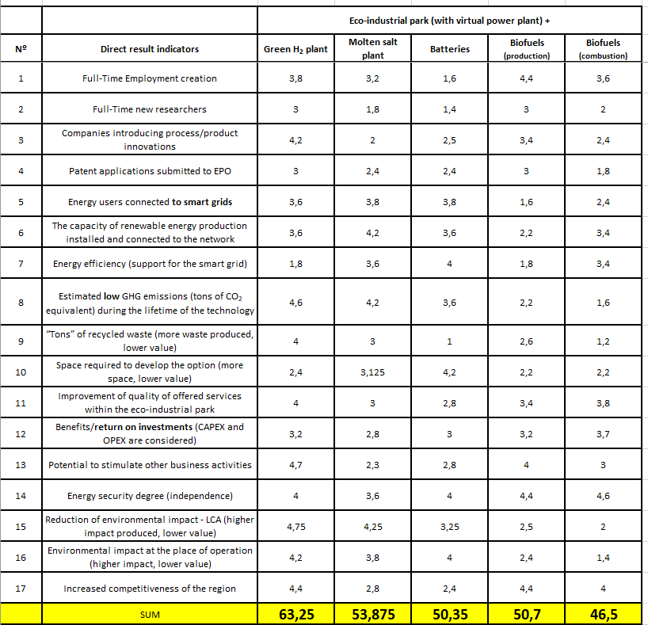
POTENTIALS Project
SCENARIO (MULTI-ACTION)
Eco-industrial park (with virtual power plant)
+
Green H₂ plant
Molten salt plant
Batteries
Biofuels production
Biofuels combustion

Slide 15

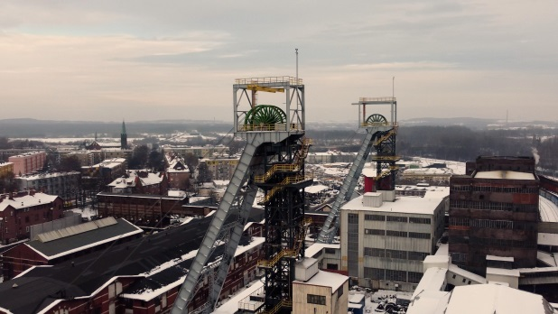
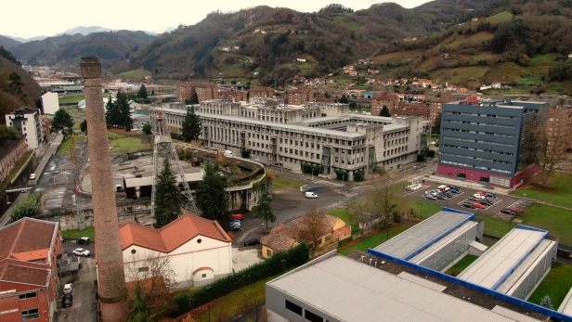
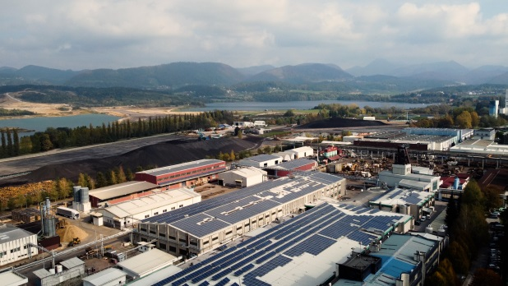
Bobrek-Piekary Coal Mine, POLAND
GreenJOBS Project
Aller-Barredo-Figaredo, SPAIN
Premogovnik Velenje, SLOVENIA

Slide 16

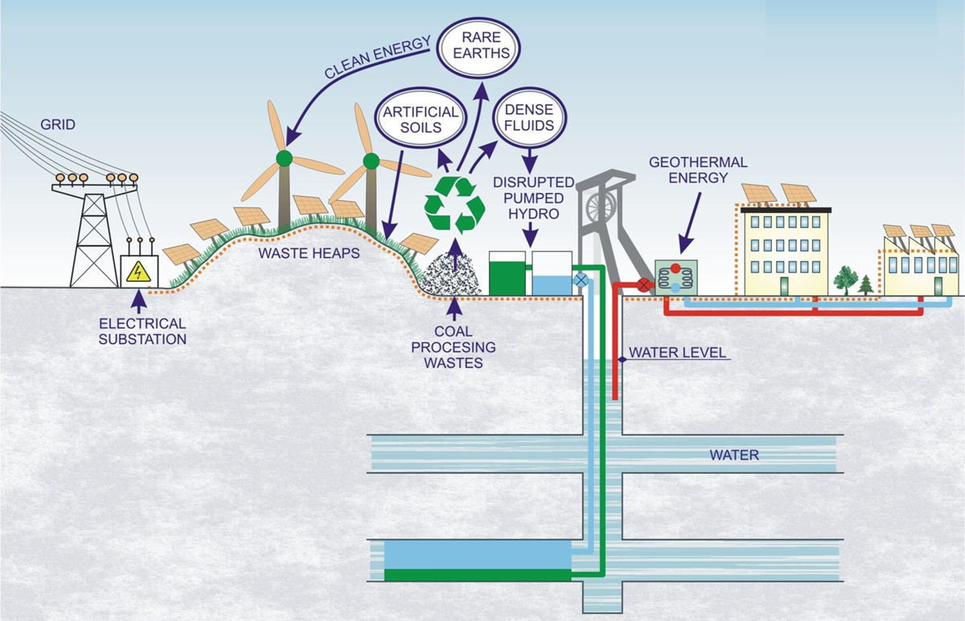
GreenJOBS Project
Business model 1: Virtual Power Plant where energy is sold to the grid.

Slide 17
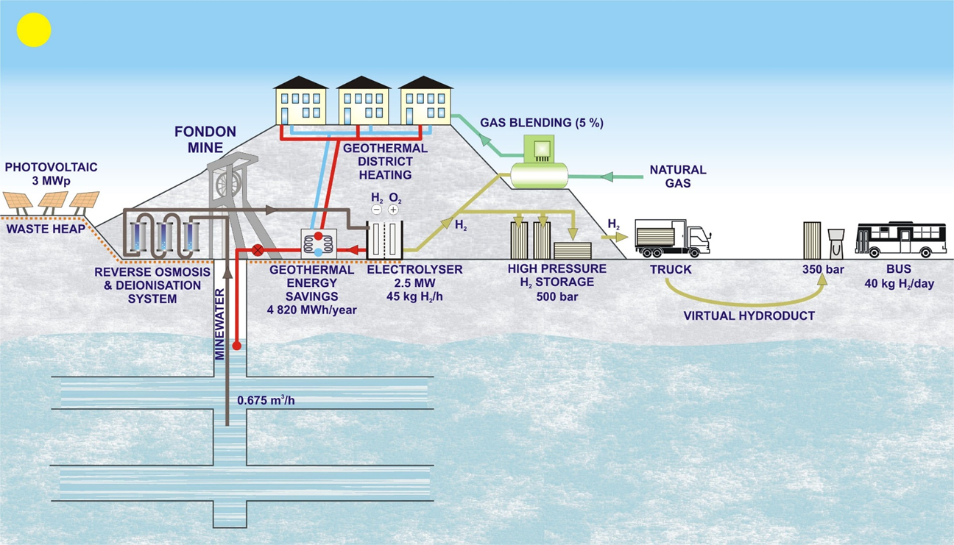
GreenJOBS Project
Business model 2: Green hydrogen plant.

Slide 18
POTENTIAL SCOPE and activities of Task Force on Safe Operations and Closure of Coal Mines
How could the results change when applying specific criteria and policies corresponding to different non-European countries?
How to adapt the business models based on renewable energy to different non-European countries?
Are there any alternative opportunities to develop business models that rely on renewable energy, on the circular economy or scale energy storage?
Which direct result indicators might be representative in other non-European countries?

Slide 19
THANK YOU FOR ATTENTION
Alicja Krzemień
Head of Laboratory of Risk Assessment and Industrial Safety
Department of Extraction Technologies, Rockburst and Risk Assessment
Plac Gwarków 1
40-166 Katowice
Poland
phone: +48 32 259 2556
akrzemien@gig.eu

