Slide 1


School of Mining, Energy and Materials Engineering of Oviedo
University of Oviedo
Synergies between different EU-funded projects
Prezentacja synergii między projektami finansowanymi z funduszy europejskich
Dr Mariusz Kruczek, GIG
Prof. Pedro Riesgo Fernandez, UNIOVI
Libiąż, 2.06.2023

Slide 2



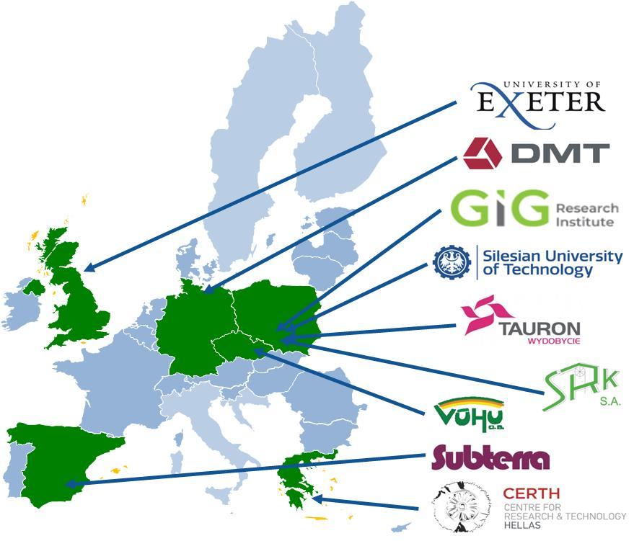

The impact of extreme weather events on mining operations
Call: RFCS-2018
Instrument: RPJ
Start date: 01/06/2019
End date: 31/10/2022

Slide 3
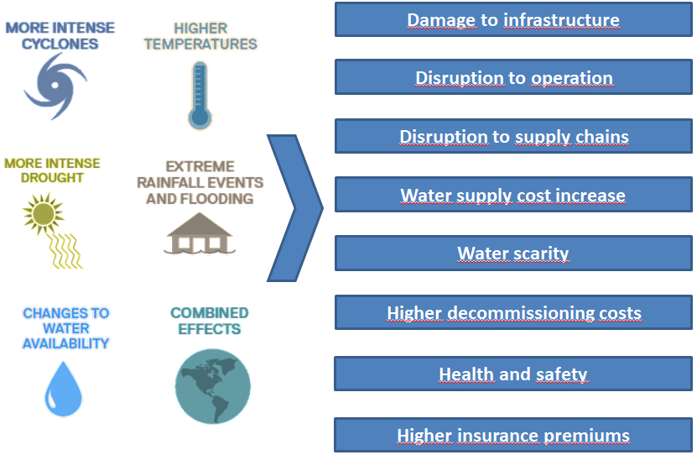
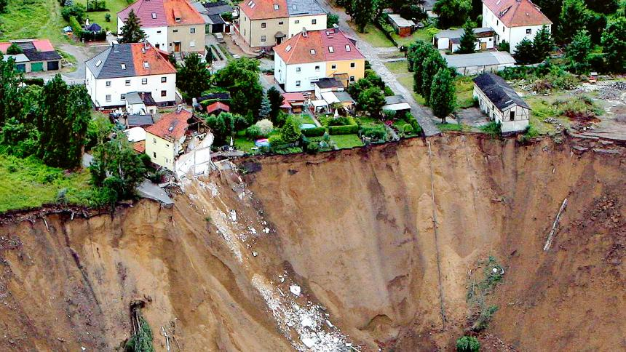
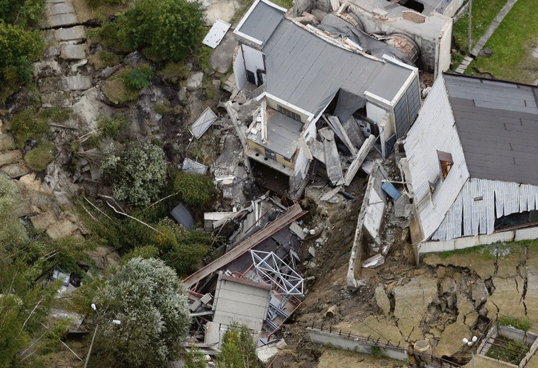
Problem tackled by TEXMIN project
What: climate change & extreme weather events impacts on mining operations ?
Who: mining companies, mining municipalities and entire regions ?
Main objective
Provision of guidance to stakeholders on gradual and sudden impacts on operating, closed and abandoned coal mines in European regions, by:
Integrated management tool,
Adaptation strategies and measures

Slide 4
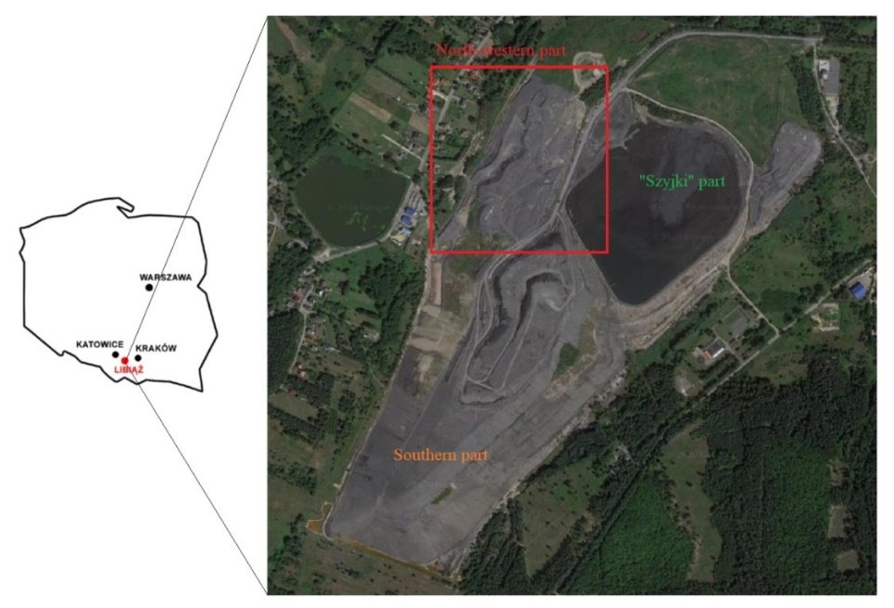
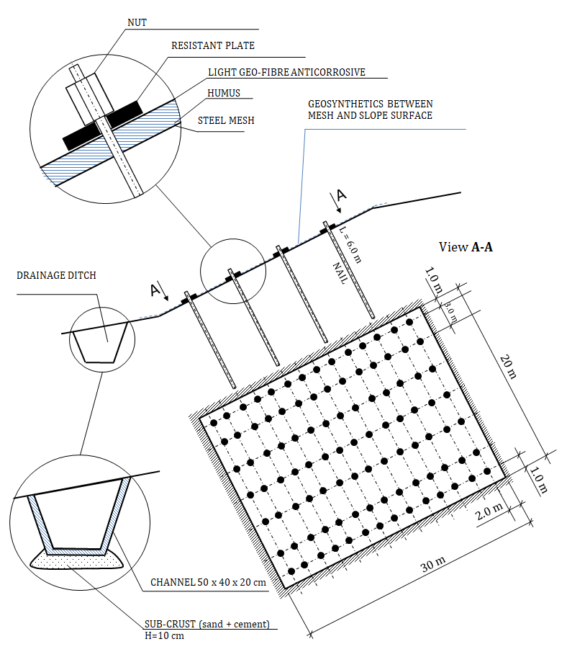
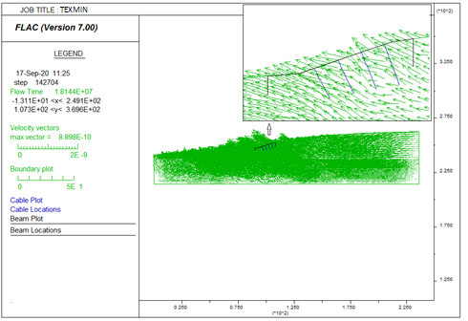
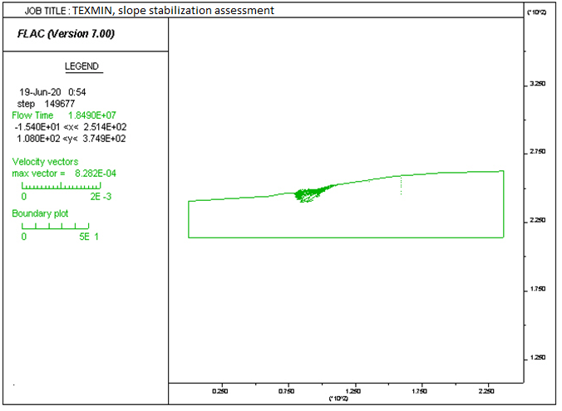
SYNERGIES BEETWEEN Projects
Pilot installation:
the remedial measures for stabilization of mine spoil dump in situation of extreme weather events occurrence: installation for slope protection, located at the mine waste dumps of the Janina mine site (in Libiąż, PL)
Scheme of slope preservation of the mine waste dumps
A numerical model

Slide 5
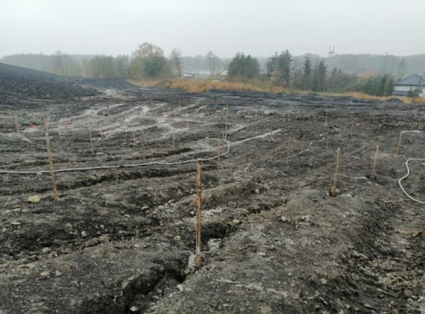
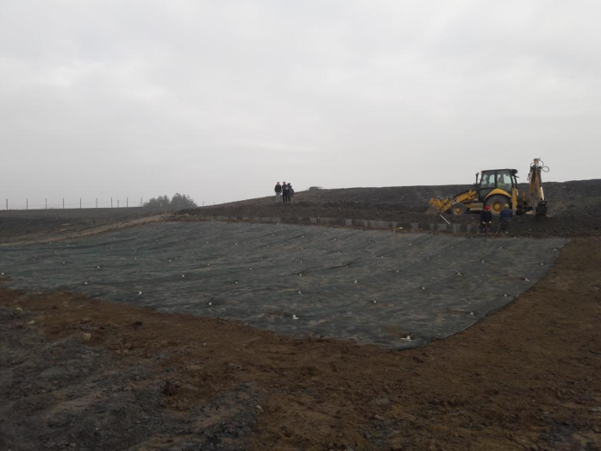
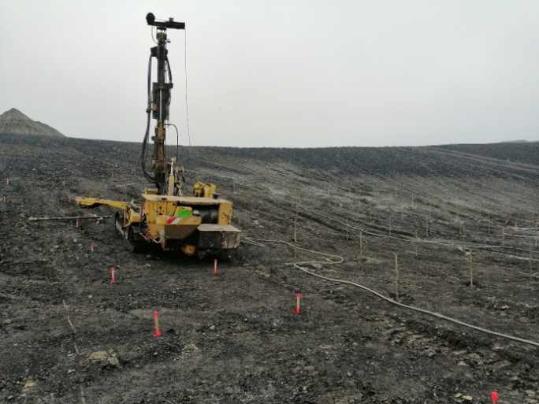
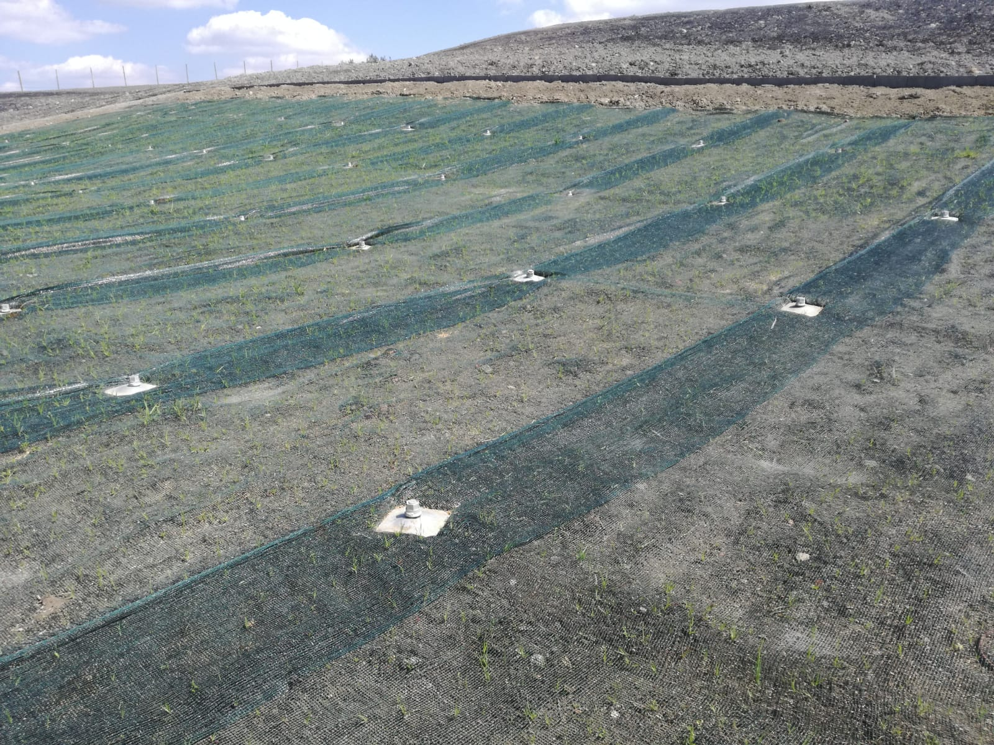
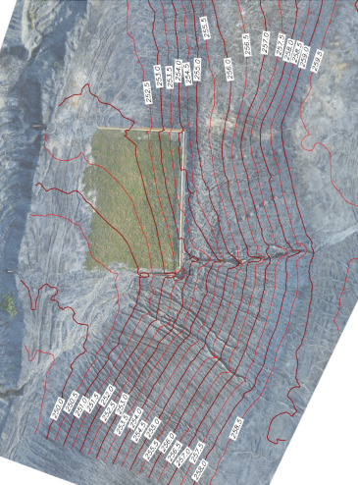

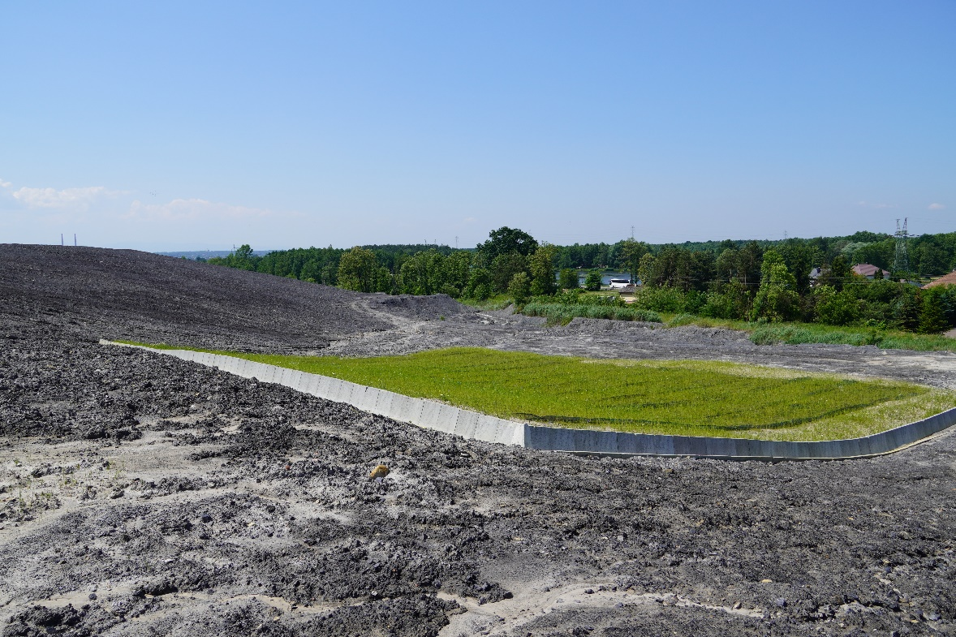
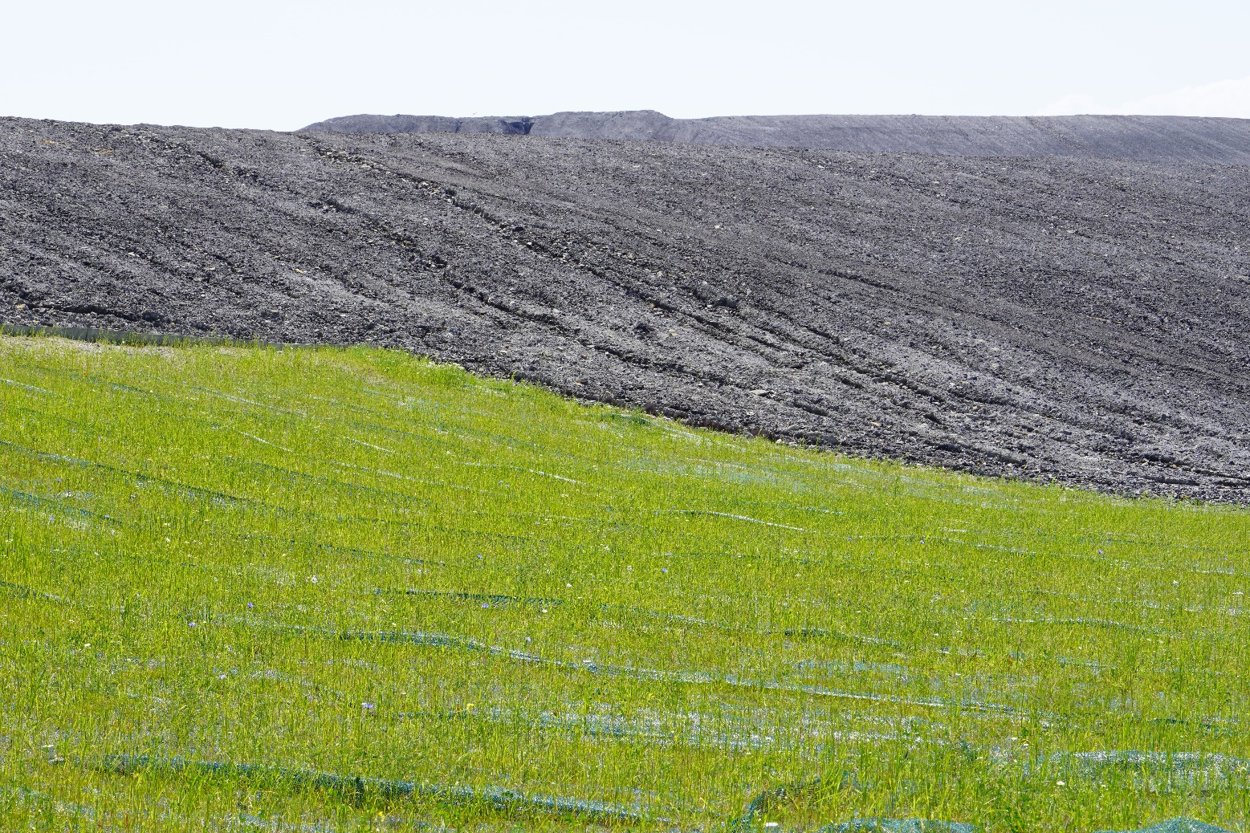
SYNERGIES BEETWEEN Projects
2nd step
Conducted facing consisting of anti-erosion protection and steel mesh
1st step
Nailing
4th step
Monitoring
3rd step
Strengthening the surface

Slide 6
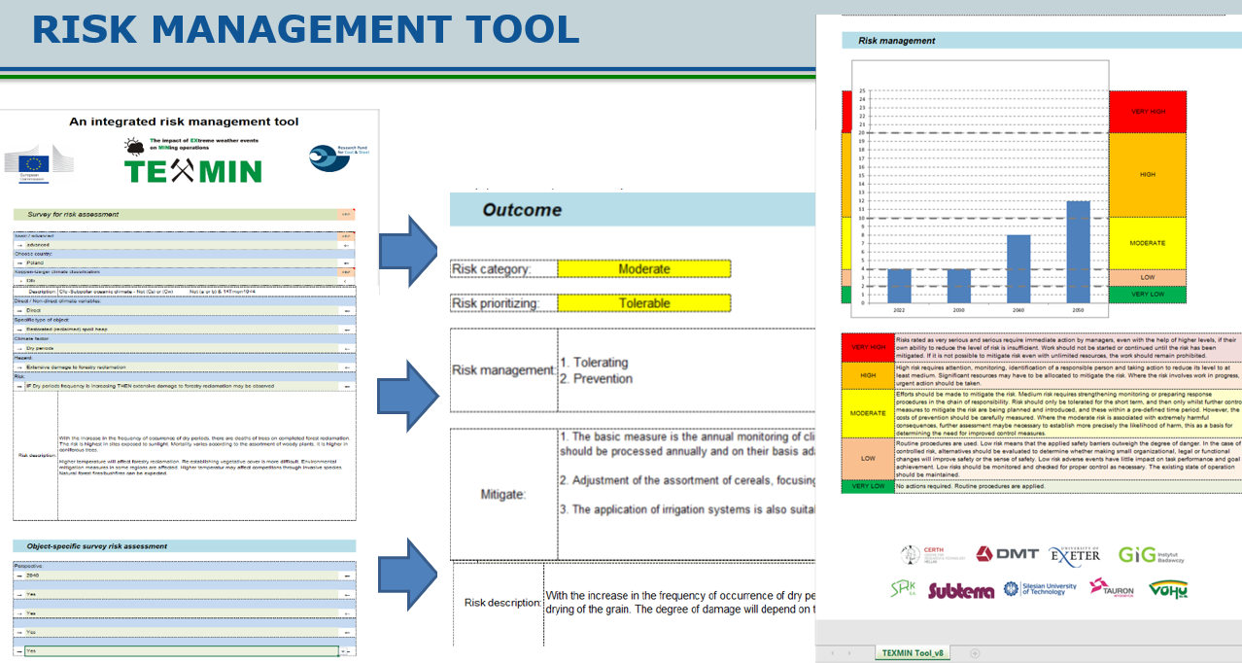
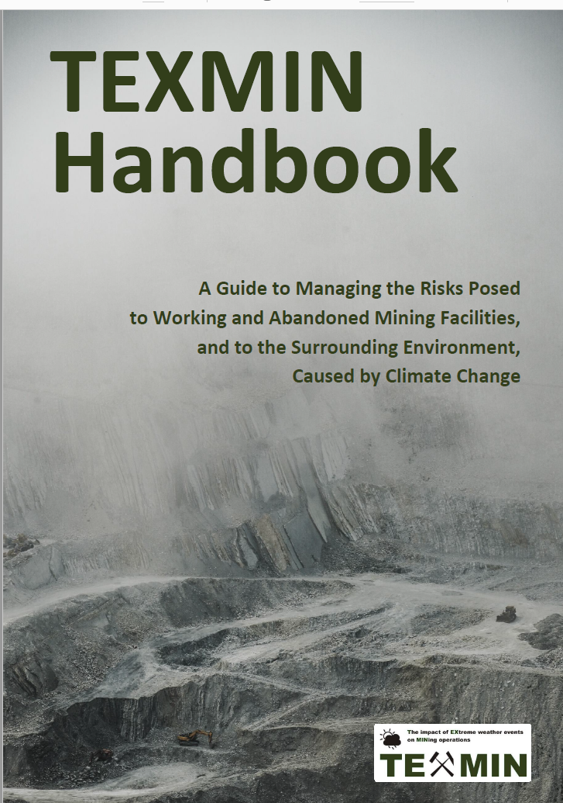

RESULTS

Slide 7

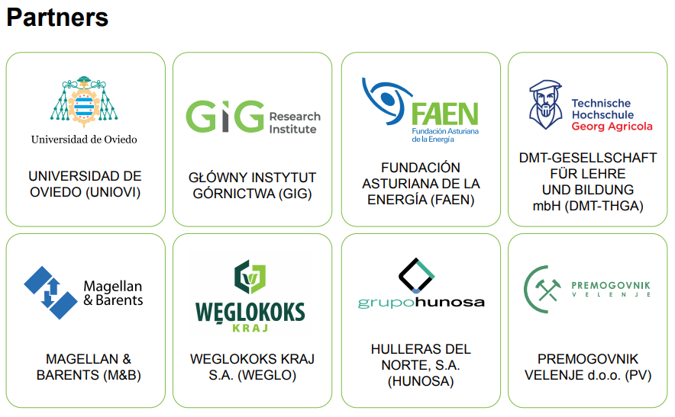

Leveraging the competitive advantages of
end-of-life underground coal mines to maximise the creation of green and quality jobs
Call: RFCS-2021
Instrument: RPJ
Start date: 01/07/2022
End date: 31/12/2025
Budget: 2,202,647 €

Slide 8
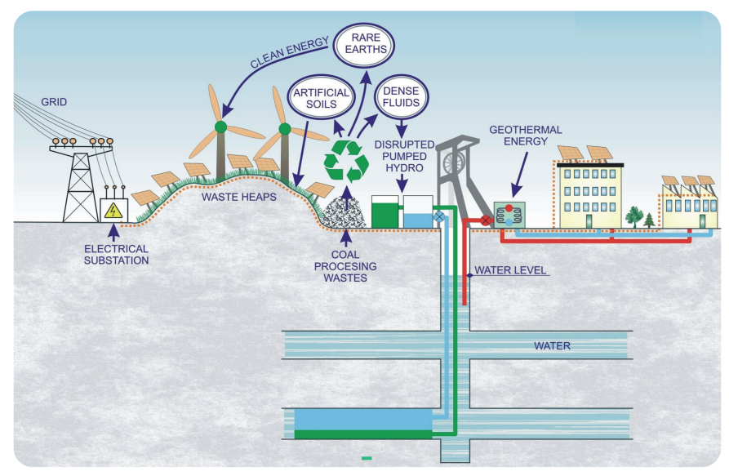
PROJECT AIM
To provide mining companies with innovative business plans for developing new activities taking advantage of the former mining infrastructures

Slide 9
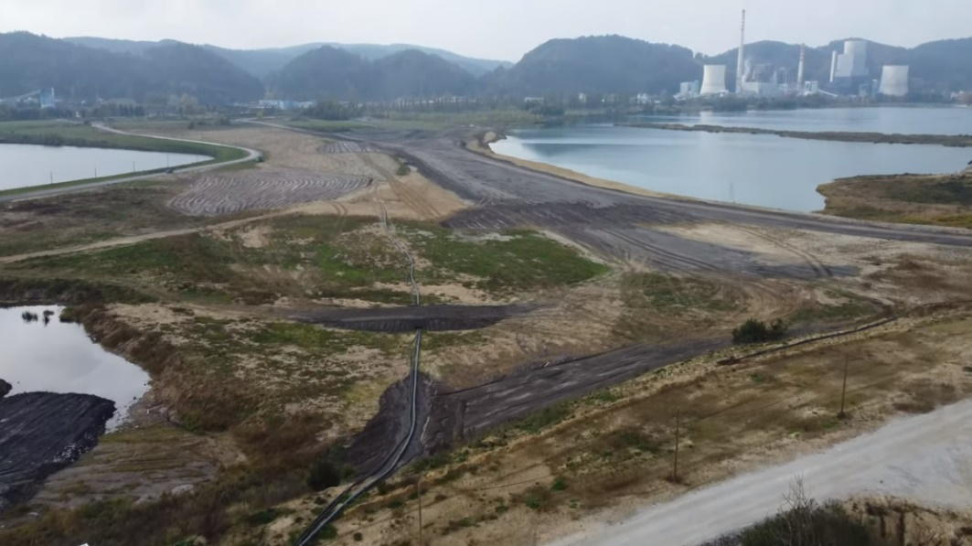
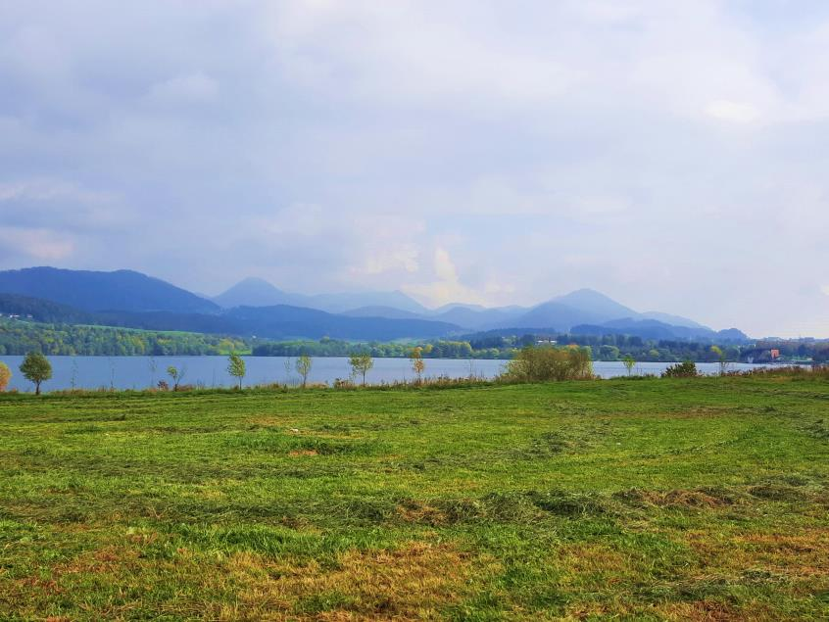
SYNERGIES BEETWEEN Projects
One of the aims of the GreenJOBS project is to develop artificial soils based on industrial and organic local wastes.
The soil substitutes are intended to support the transformation of
difficult terrains in coal mining areas in Slovenia into green ecosystems

Slide 10
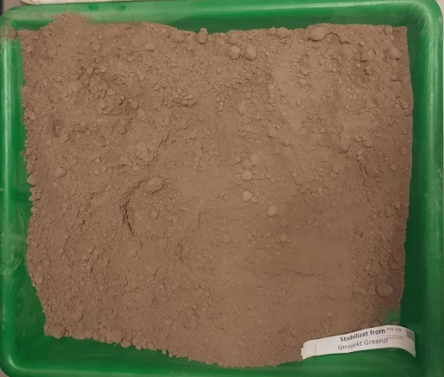
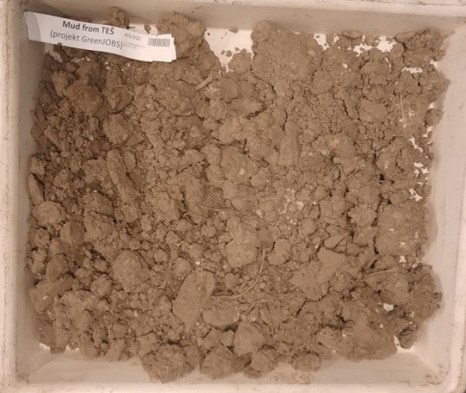
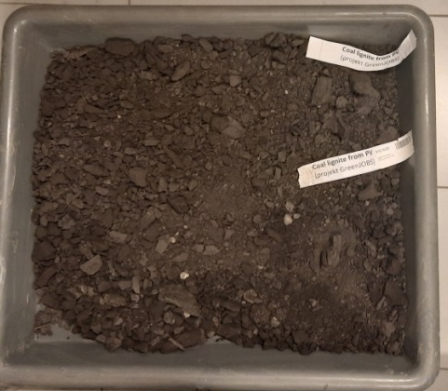
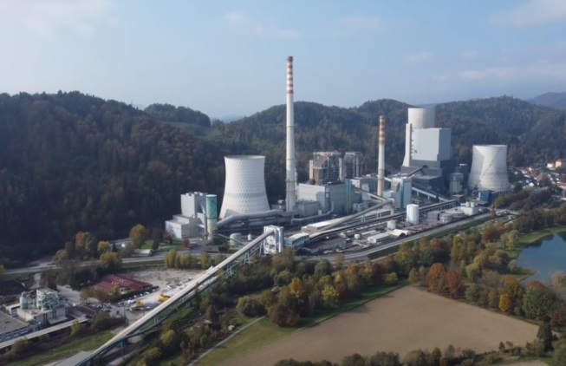
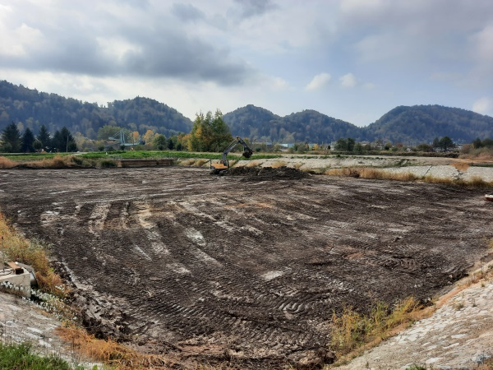
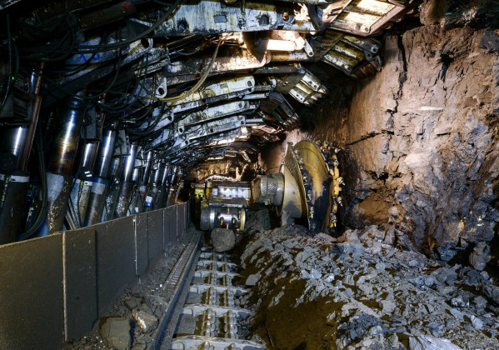
MAIN WASTE COMPONENTS FOR PREPARING SOIL SUBSTITUTES FOR LAND REHABILITATION OF COAL-MINE AFFECTED AREA
Mix of: fly ash+gypsum+slag
Desulfurization and combustion process
Combustion process
Coal lignite extraction
Termoelektrarna Šoštanj
Termoelektrarna Šoštanj
Premogovnik Velenje Mine
Stabiliser
Water pool mud
Coal lignite

Slide 11
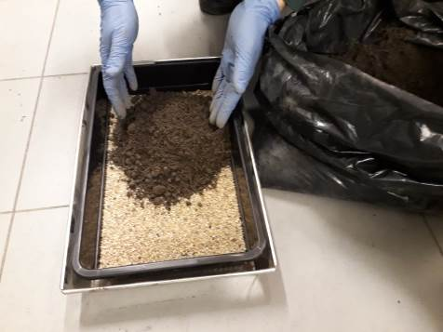
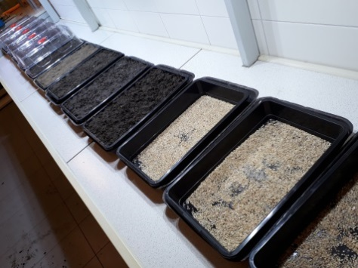

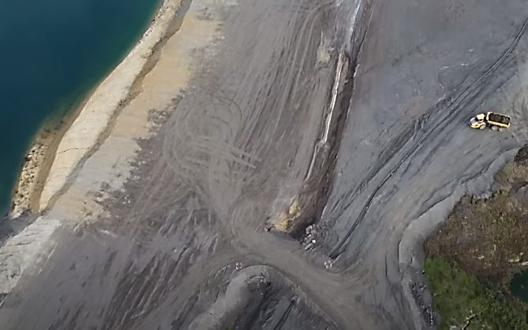
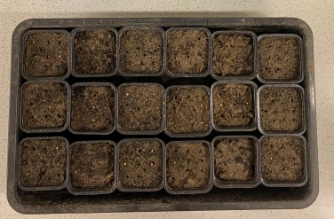
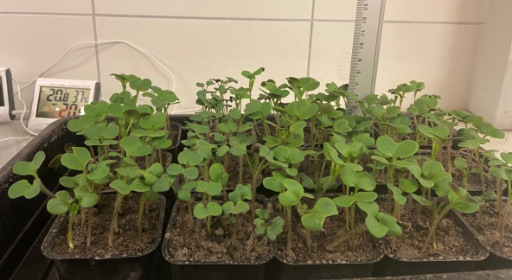

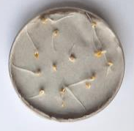
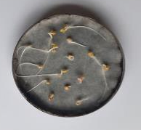
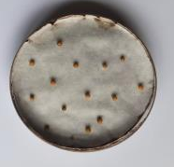
TESTING of soil substitutes: in progress
Different shares of waste components will allow the preparation of artificial soils for
land rehabilitation of coal-mine affected area in Velenje (Slovenia)
The physicochemical analysis and phytotoxicity tests, in GIG laboratories, determine which of the developed soil substrates have the best plant growth-stimulating properties.

Slide 12
Thank you for your attention!
www.texmin.gig.eu
www.greenjobsproject.eu

