Slide 1

Task Force on Safe Operations and Closure of Coal Mines
Group of Experts on Coal Mine Methane and Just Transition
Report on activities by the Task Force
Alicja Krzemień
Central Mining Institute – National Research Institute Katowice, Poland
19.03.2024

Slide 2
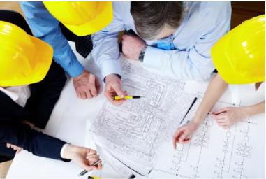
Task Force on Safe Operations and Closure of Coal Mines
Areas of Focus
Degasification
Risk assessment
Ventilation
Methane capture
Methane content and flow assessment
Staff training
Mine closure
Land reclamation
Mine repurposing
etc.
WEB PAGE: https://unece.org/task-force-safe-operations-and-closure-coal-mines

Slide 3
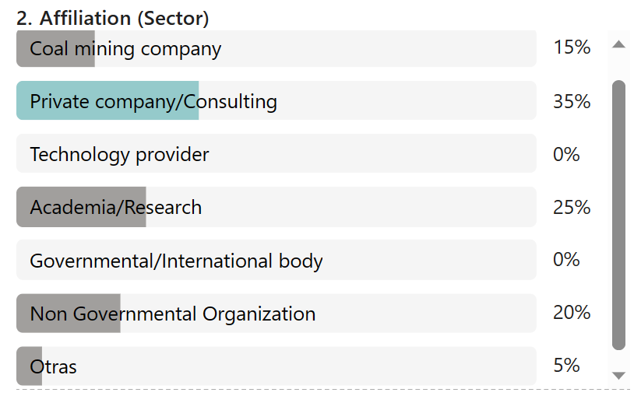
Affiliation

Slide 4
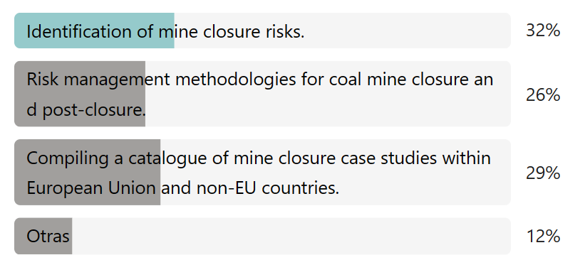
Activities decided to be developed in the near time
Activity 1: Compiling a catalogue of mine closure case studies within European Union and non-EU countries focusing on Identification of mine closure risks, and Risk management methodologies.

Slide 5
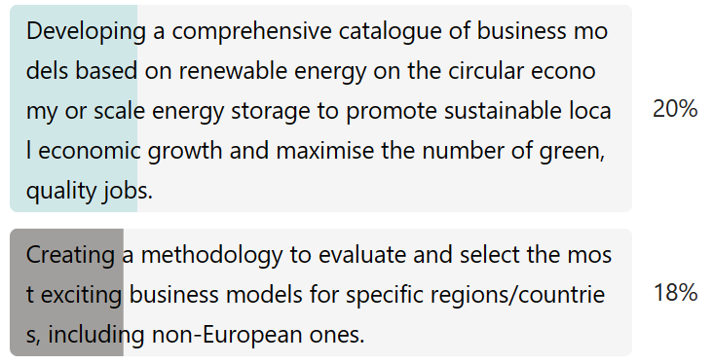
Activities decided to be developed in the near time
Activity 2: Developing a comprehensive catalogue of business models based on renewable energy on the circular economy or scale energy storage to promote sustainable local economic growth and maximise the number of green, quality jobs.

Slide 6
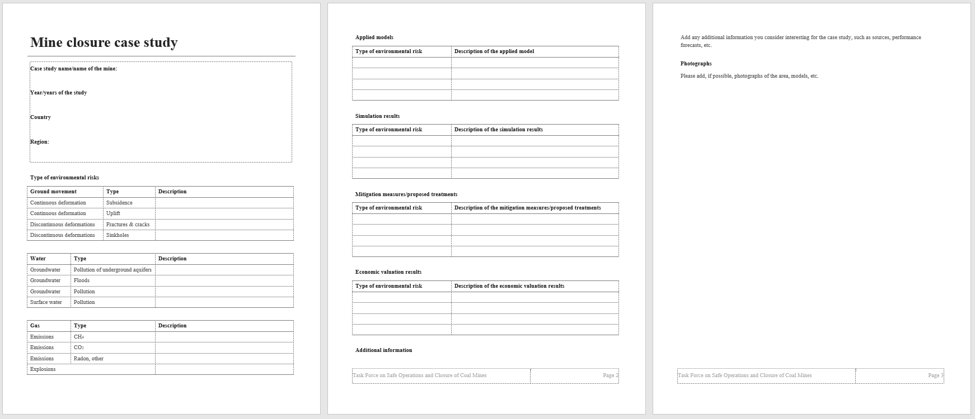
Template for Mine closures case studies

Slide 7
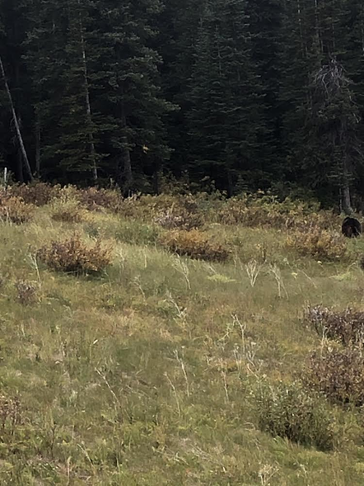
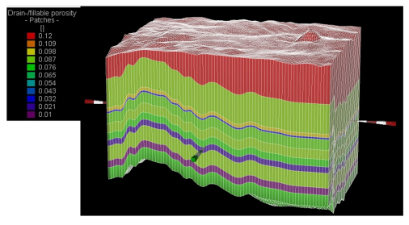
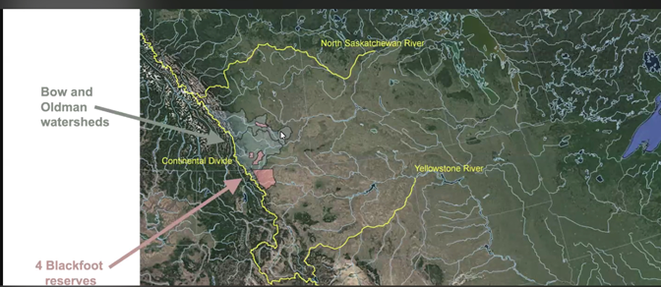
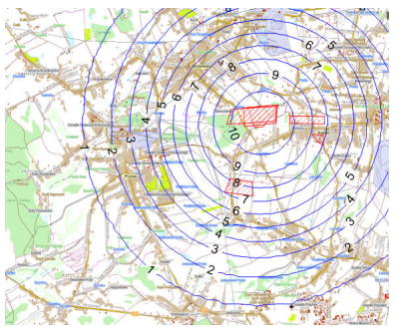
Presented Mine closure case studies
Rydułtowy ‐ Anna Mining Complex
Poland
Cardinal Teck
Western Canada

Slide 8
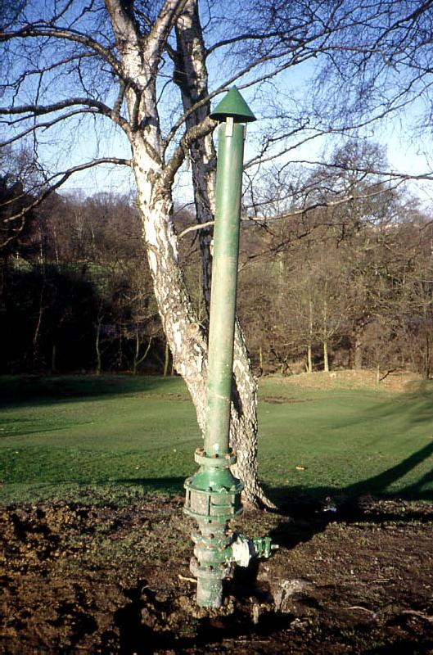
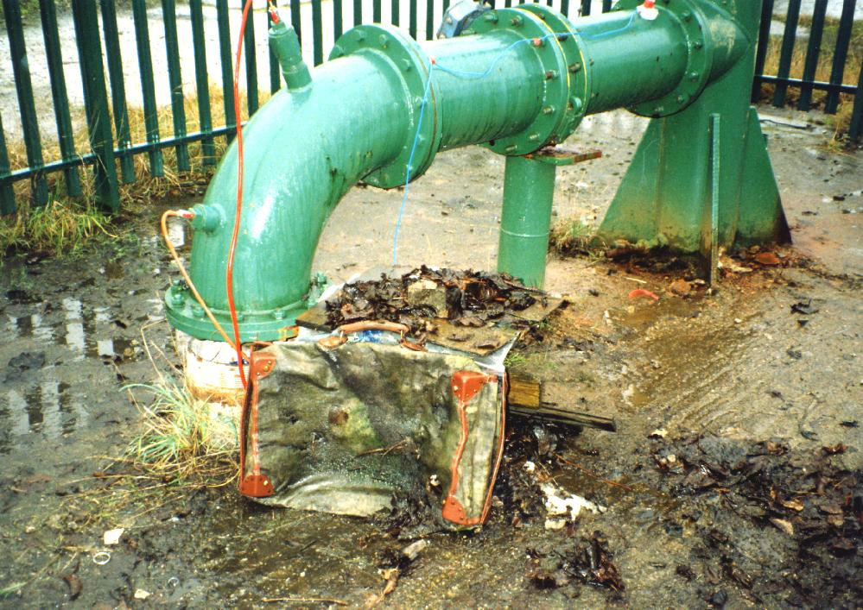
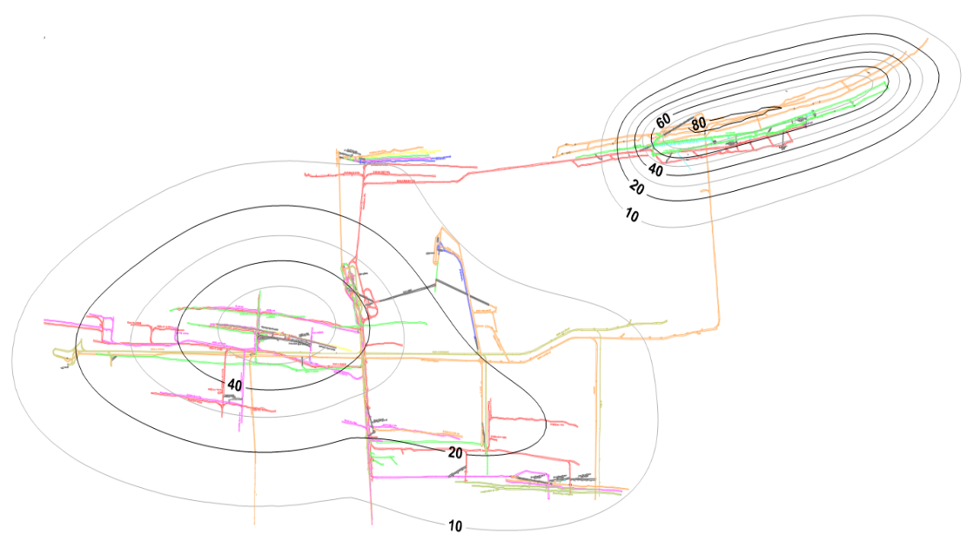
Presented Mine closure case studies
Mosquitera and Pumarabule mines
Spain
North Derbyshire coalfield
United Kingdom

Slide 9
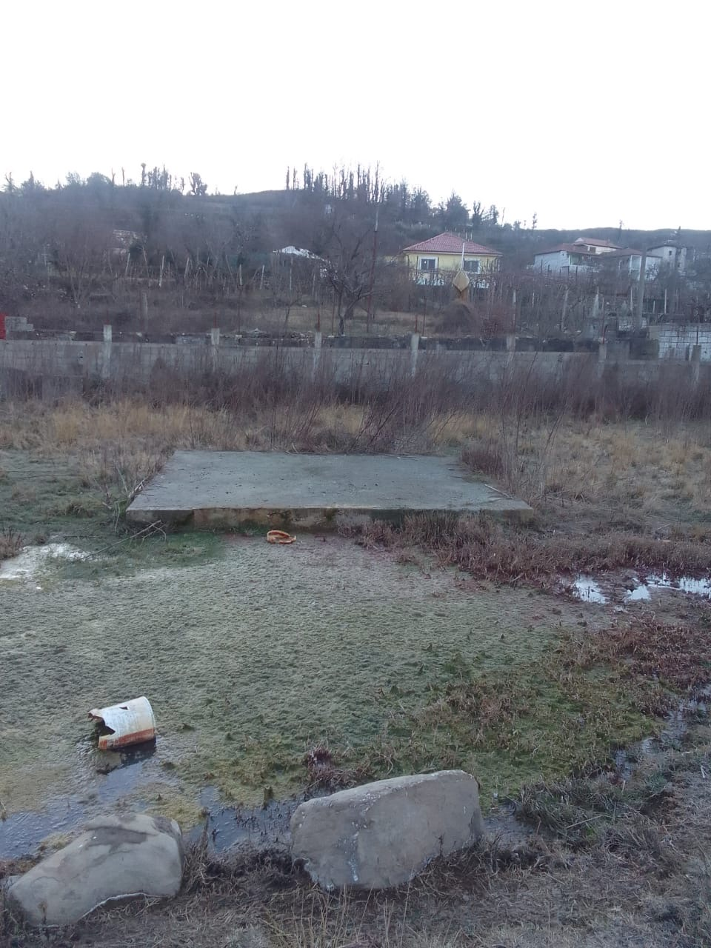
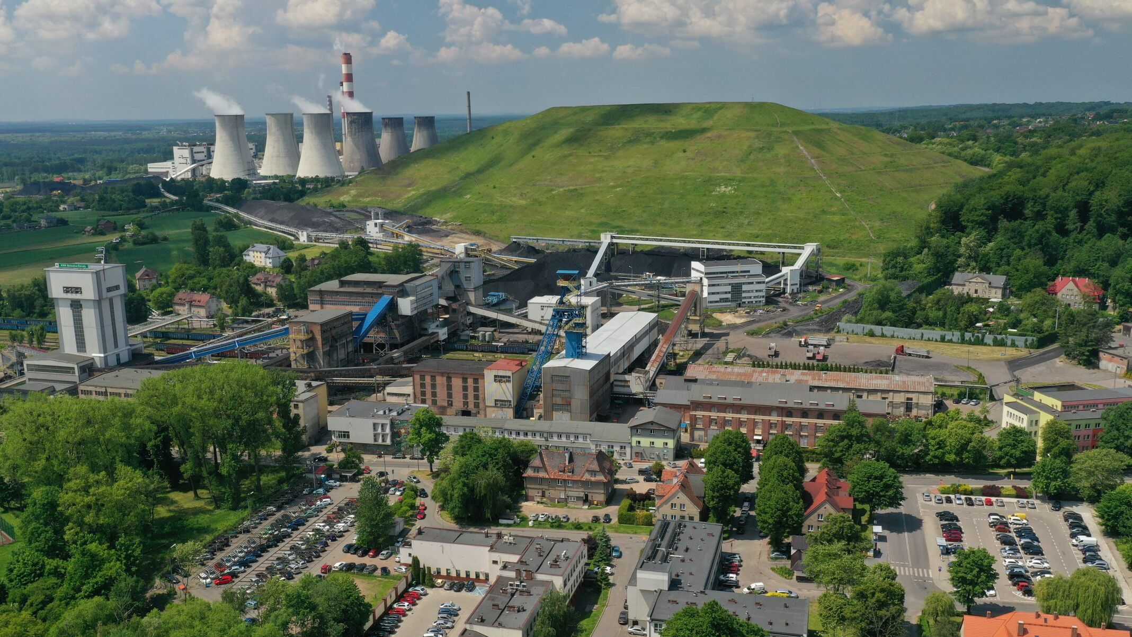
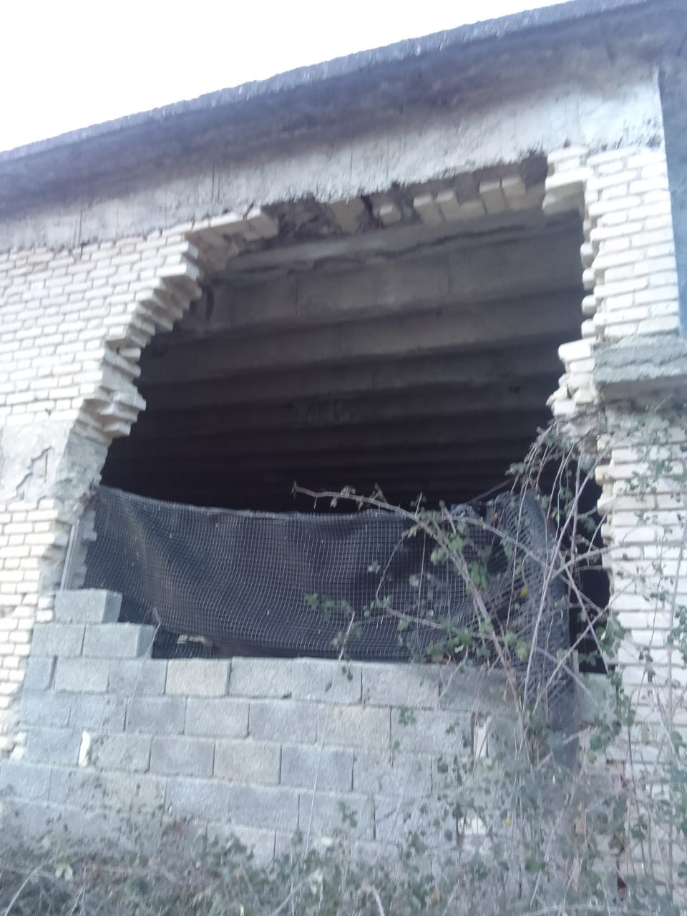
Presented Mine closure case studies
Mushqeta & Krraba Coal Mine
Albania
Bolesław Śmiały Coal Mine
Poland

Slide 10
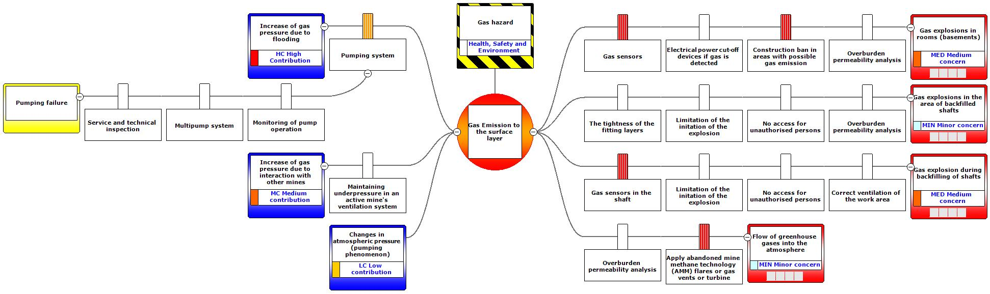
An example on methane emissions analysis in “Anna” mine (Poland)
Gas hazard Bowtie diagram

Slide 11
An example on methane emissions analysis in “Anna” mine (Poland)
Factors influencing risk associated with the emission of gases to the surface
Numerical model of the
Ventilation network

Slide 12
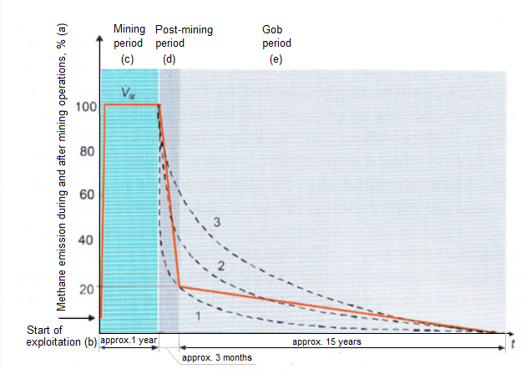
An example on methane emissions analysis in “Anna” mine (Poland)
Forecasted methane emission into goafs in seams of Anna coal mine, 2017-2031
Model of methane emission from longwall goafs after concluding mining operations

Slide 13
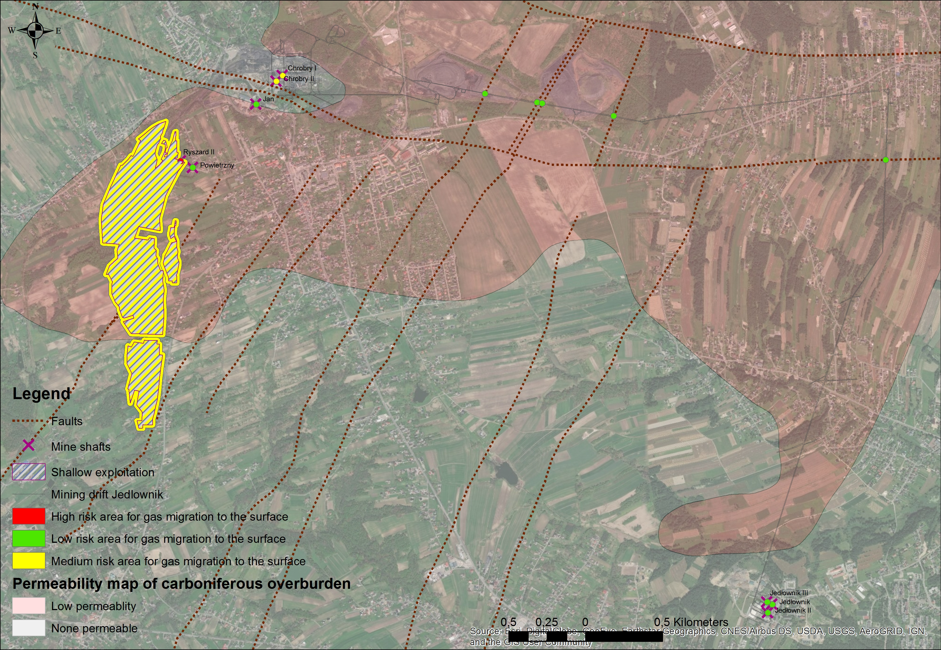
An example on methane emissions analysis in “Anna” mine (Poland)
Risk matrix for emission of gases to the surface
Map of gas risk areas

Slide 14
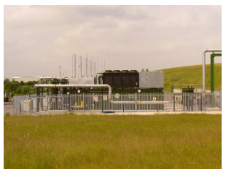
An example on methane emissions analysis in “Anna” mine (Poland)
Proposed treatment:
Destruction or energy
production depending on
the methane amount and
concentration

Slide 15
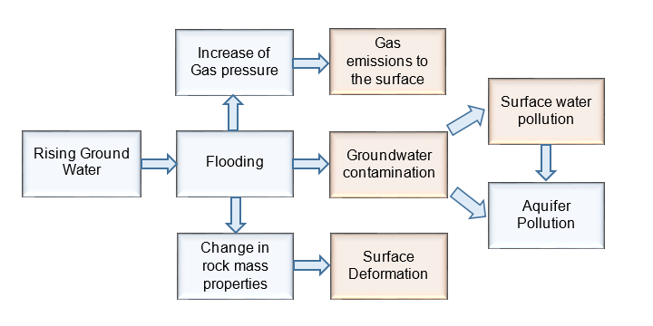
An example on methane emissions analysis in “Anna” mine (Poland)
Interrelationship of the Risk Components

Slide 16
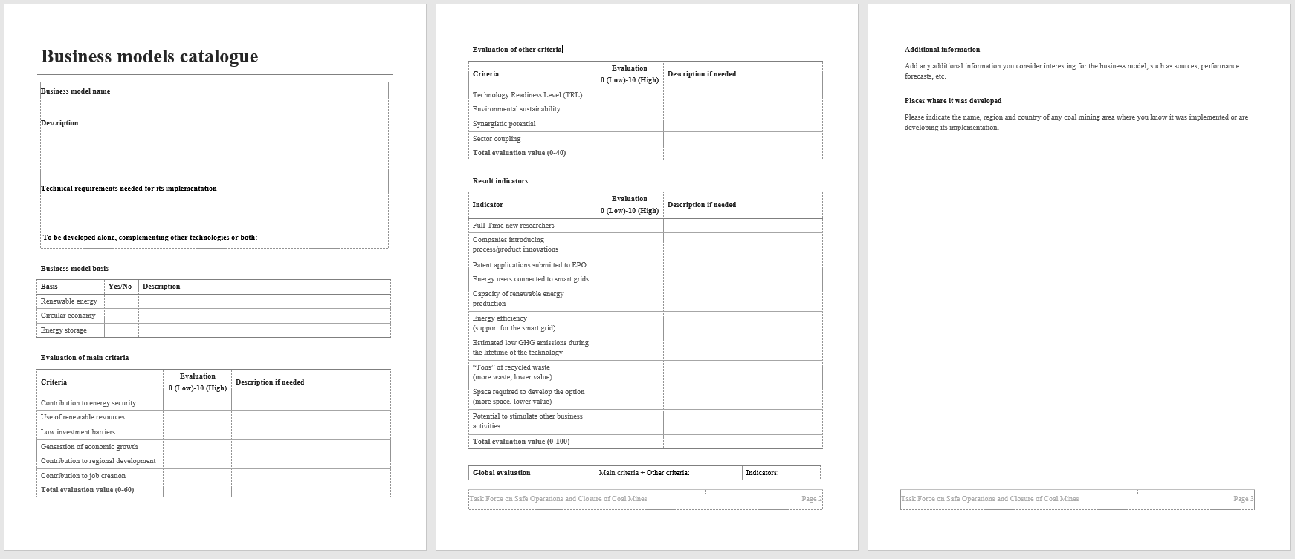
Template for Business models catalogue

Slide 17

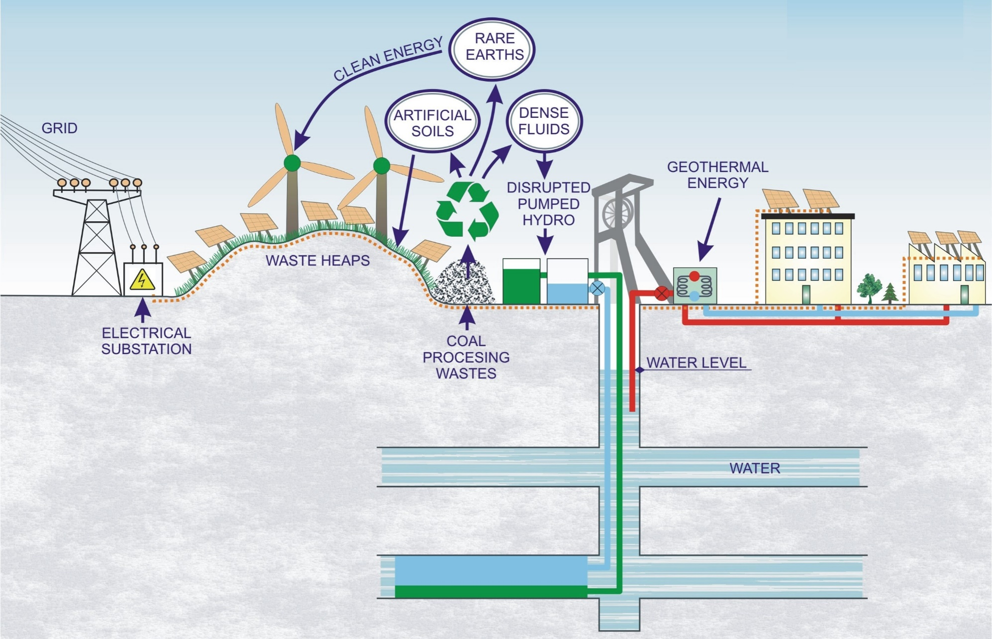


Business models within the GreenJOBS project
Virtual Power
Plant

Slide 18
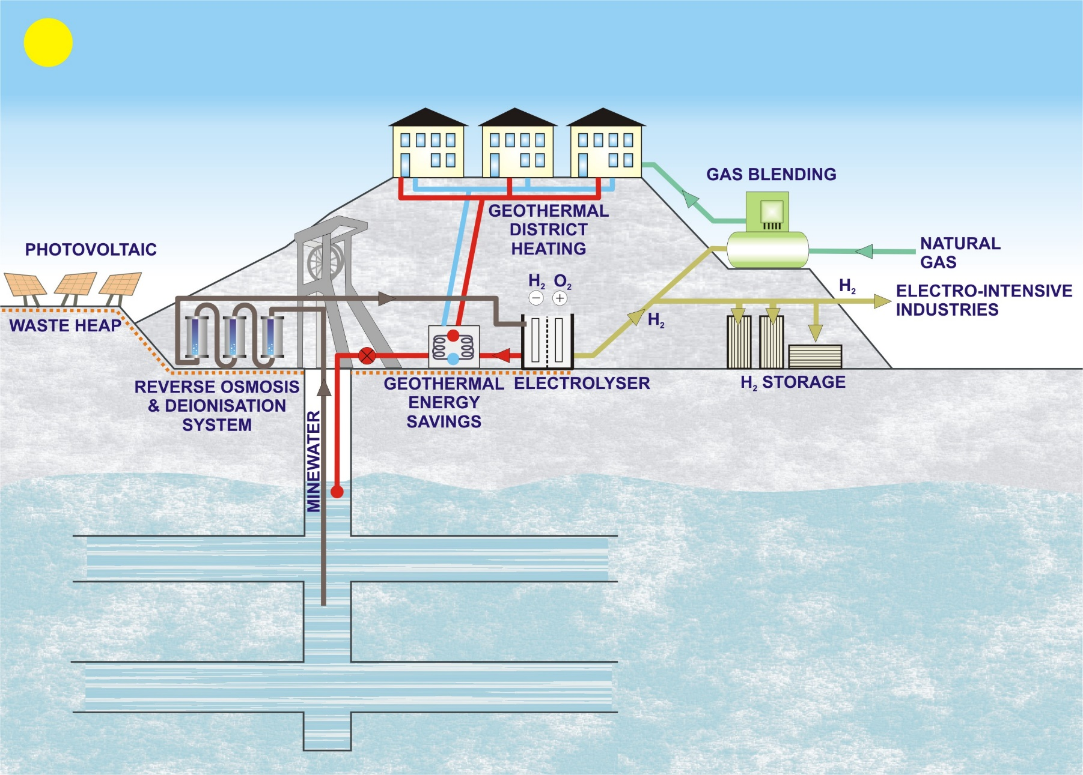
Business models within the GreenJOBS project
Green H₂
Plant

Slide 19
THANK YOU FOR ATTENTION
Prof. Alicja Krzemień
Head of Laboratory of Risk Assessment and Industrial Safety
Department of Extraction Technologies, Rockburst and Risk Assessment
Central Mining Institute – National Research Institute
Plac Gwarków 1
40-166 Katowice
Poland
phone: +48 32 259 2556
akrzemien@gig.eu

