Slide 2
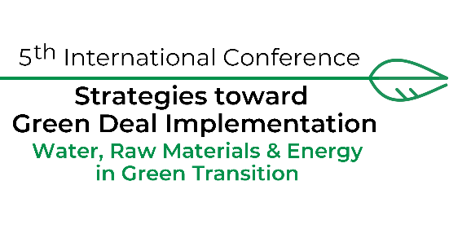
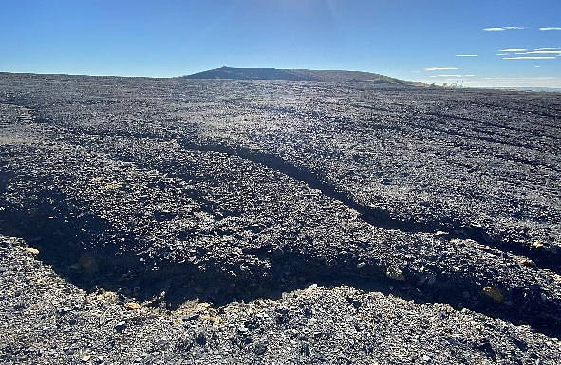
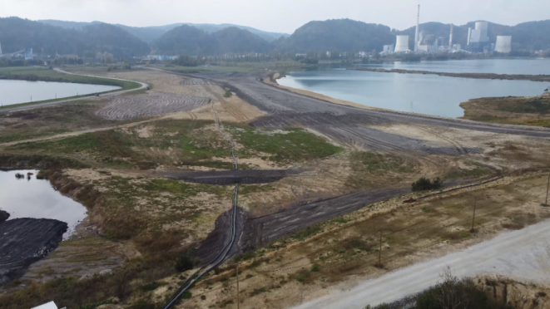
Reclamation of post-mining lands by conversion of industrial waste and combustion by-products into soil covers: A study in Poland and Slovenia
Angelika Więckol-Ryk and Alicja Krzemień, GIG-National Research Institute, Katowice, Poland
AIM OF THE RESEARCH: The primary goal of the research was the safe use of CCPs, mining waste, and organic materials as components for creating artificial soils aimed at reclaiming post-mining areas.
MATERIALS AND METHODS:
Components of soil substitutes created at the GIG-NRI Laboratory:
Mineral:
CCPs (fly ashes and slags)
Sludges
Agregates
Decarbonization lime
Organic:
Mushroom compost
Green compost
Lignite coal
STUDY AREA:
In addition, lignite mine water from the PVM in Slovenia was tested for its use in irrigating the soil substitutes.
Physicochemical analysis of the components and soil substitutes included measurements of nutrients and trace elements content, pH, and salinity.
Fig. 1 Subsidence mining site in Slovenia (Premogovnik Velenje Mine, Velenje)
Fig. 2 Highly acidic and eroded slopes of the waste heap in Poland (ZG Janina Mine, Libiąż)
Phytotoxicity tests with test plants:
Sprouting efficiency,
Root and stalk growth,
Increase of biomass

Slide 3
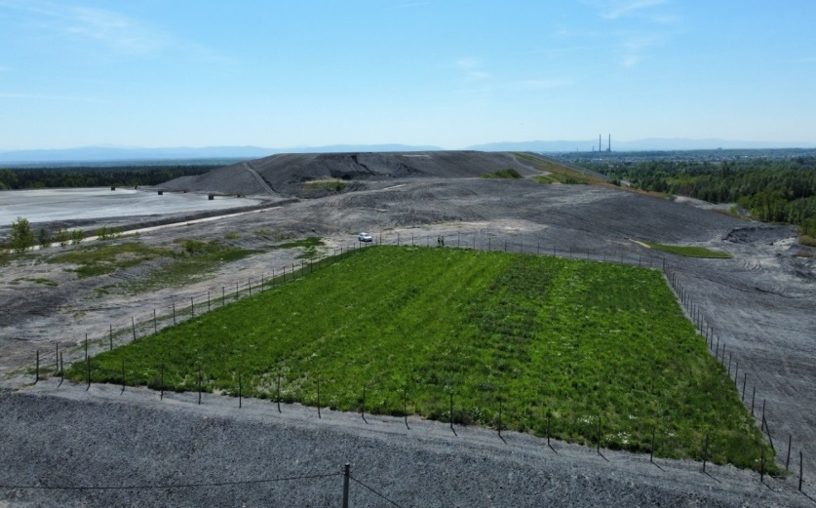
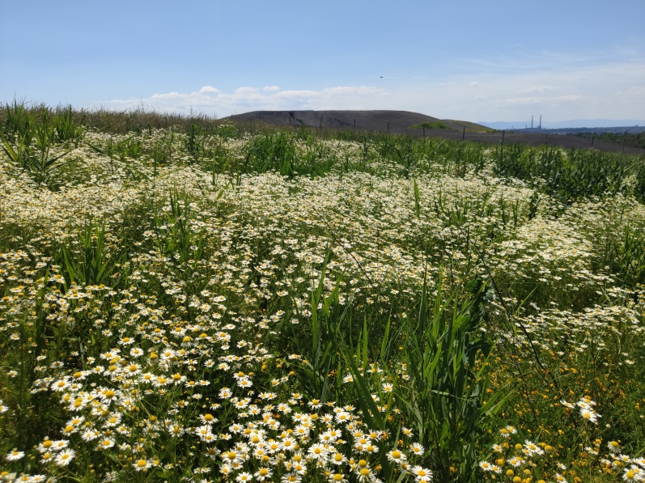
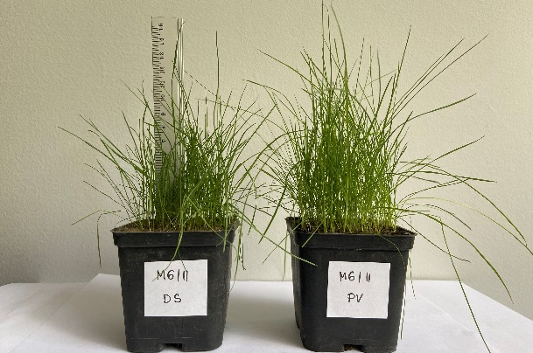
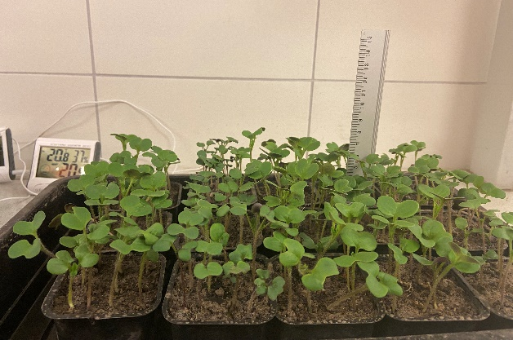
RESULTS AND CONCLUSIONS:
The amounts of organic matter and essential nutrients (N, P, K, Ca, Mg) in the soil substitutes were sufficient to support plant growth and hold significant potential for the reclamation of post-mining areas in Poland and Slovenia.
The analysis of mine water showed a low concentration of heavy metals and parameters (pH, EC, Na, B) indicated a low risk of soil salinity after irrigation.
Phytotoxicity tests using Sinapis alba and a mixture of grass showed good germination results (>80%) and a high biomass growth.
The most promising soil substitutes contained from 20 to 30 % by weight of lignite.
www.greenjobsproject.eu
www.recoveryproject.eu
Fig. 3 Part of the reclaimed Janina waste heap in Poland (4 ha) two years after using soil substitutes
The concentrations of toxic elements (As, Cd, Cu, Cr, Ni, Pb, and Zn) did not exceed the permissible thresholds and soil substitutes may be applied in green sites, including wooded or shrubby areas.
Fig. 4 Results of phytotoxicity tests conducted on artificial soils after irrigation with mine water from PVM

