Slide 1

From “RECOVERY of degraded and transformed ecosystems in coal mining-affected areas” to “Leveraging the competitive advantages of end-of-life underground coal mines to maximise the creation of green and quality jobs”
Pedro Riesgo Fernández, Universidad de Oviedo, Spain

Slide 2








RECOVERY
Recovery of degraded and transformed ecosystems in coal mining-affected areas
Coordinator: GIG-PIB
Call:​ RFCS-2018
Start date:​ 01/07/2019
End date:​ 30/06/2023
Total costs: 1,980,327 €

Slide 3
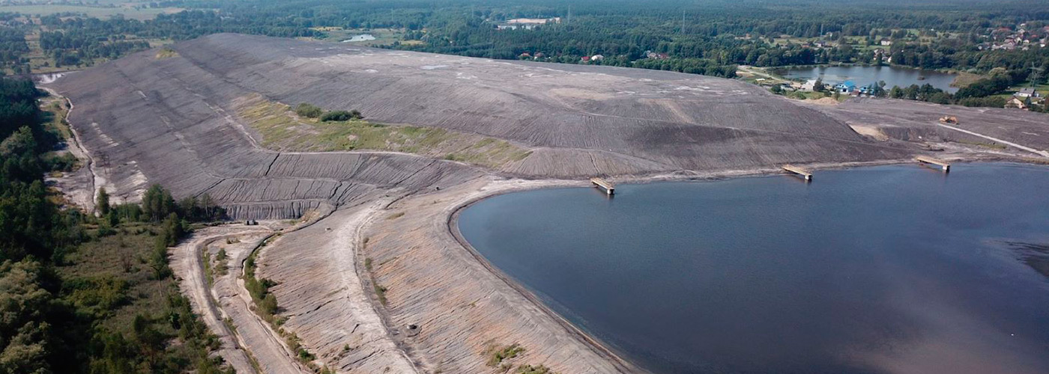

Problem tackled by RECOVERY
Almost no information is available on the environmental and social cost-effectiveness of land rehabilitation and ecological restoration.
There is no framework for land rehabilitation and ecological restoration of coal mining-affected areas.
There are limited examples of artificial soil production applying a circular economy approach in the coal mining industry.
Notes:
To ensure the accessibility of this presentation to blind users who use a screen reader,
if you translate this presentation or include parts not in English, make sure the proofing language is set to the right one (Review > Language > Set proofing Language). This will make sure the screen reader uses the right pronunciation.

Slide 4
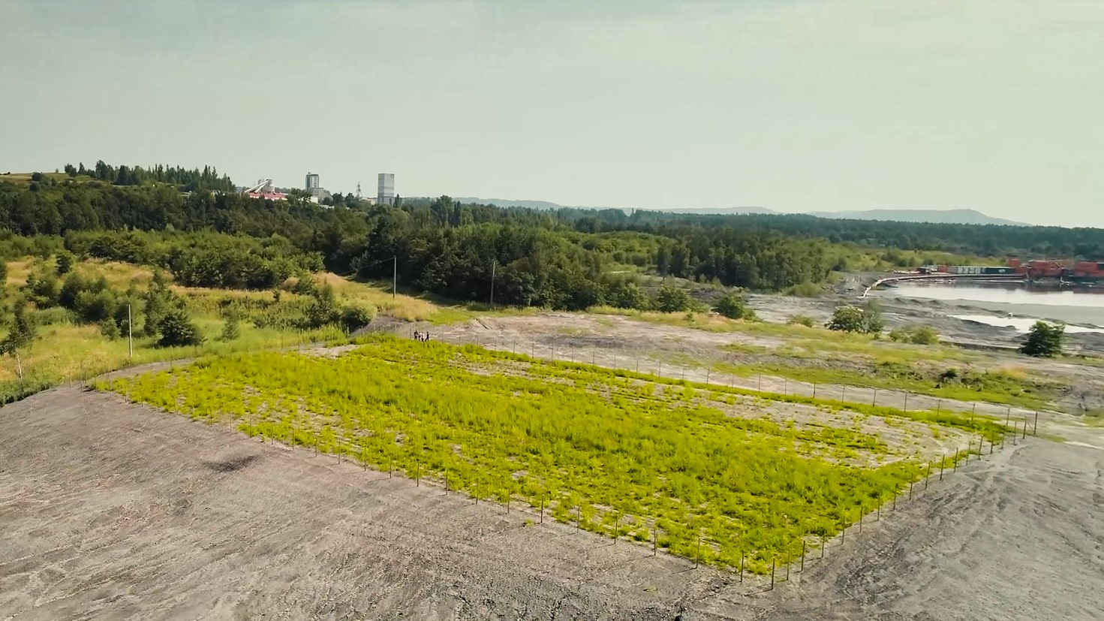
Main objectives
To determine the optimal ecological restoration by developing a valuation of the ecosystem services.
To propose suitable land rehabilitation techniques for coal mining waste heaps.
To provide an innovative framework, in the form of best practice guidelines, for land rehabilitation and ecological restoration of coal mining-affected areas.
Notes:
To ensure the accessibility of this presentation to blind users who use a screen reader,
if you translate this presentation or include parts not in English, make sure the proofing language is set to the right one (Review > Language > Set proofing Language). This will make sure the screen reader uses the right pronunciation.

Slide 5

Main results
An application of cost-effect relationships for developing suitable indicators of ecosystem services.
A new valuation methodology for ecosystem services based on the EU Emissions Trading System.
Artificial soil substitutes for the sustainable reclamation of “difficult terrains” in coal mining waste heaps.
Notes:
To ensure the accessibility of this presentation to blind users who use a screen reader,
if you translate this presentation or include parts not in English, make sure the proofing language is set to the right one (Review > Language > Set proofing Language). This will make sure the screen reader uses the right pronunciation.

Slide 6
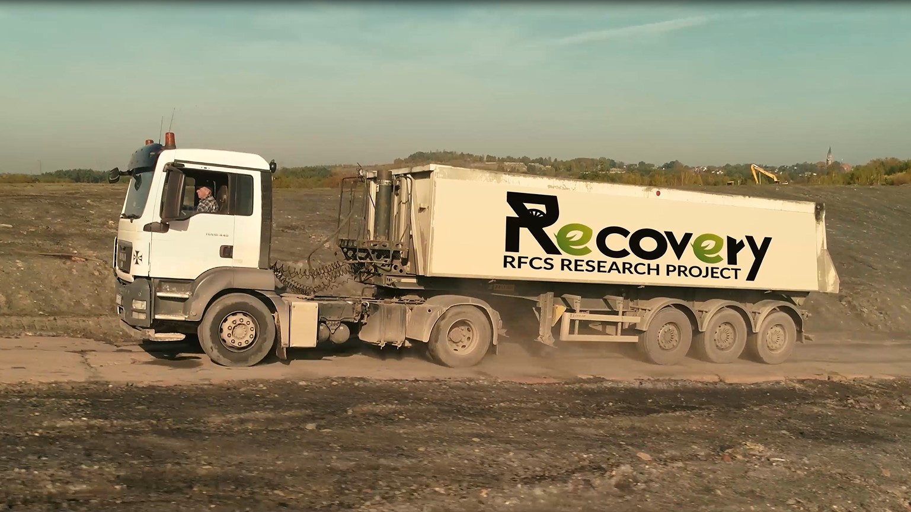
Notes:
Ladies & Gentlemen. I came here today to take you on a travel. So please fasten your seat belts and come on board the RECOVERY Project.

Slide 7
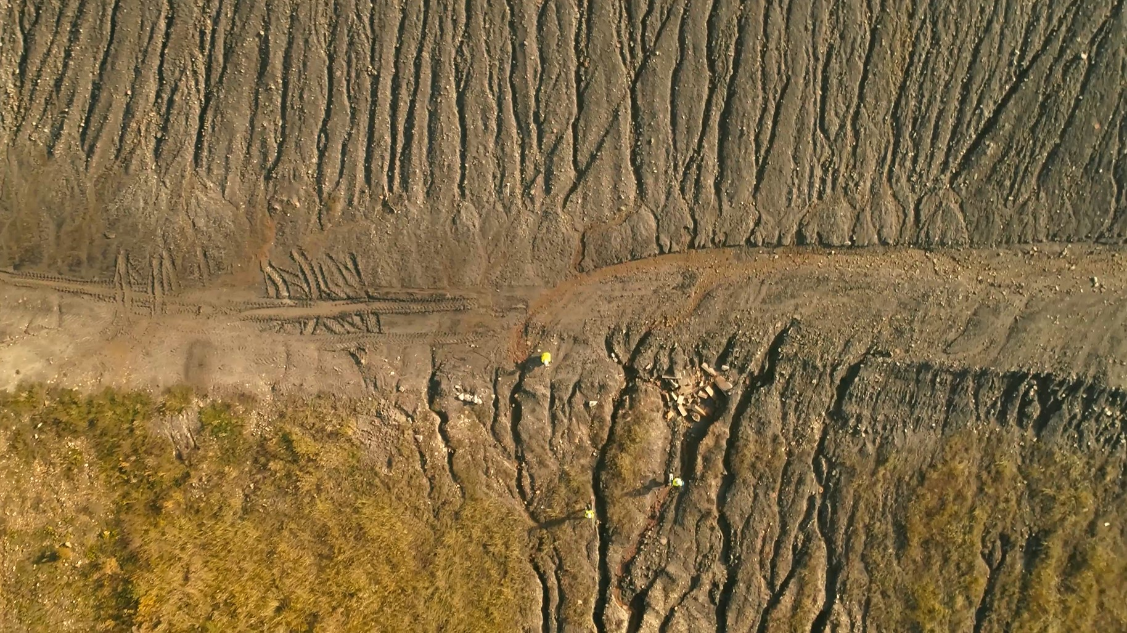
Notes:
The travel is not to Mars. Let us take a closer look of these image that looks like coming from NASA.

Slide 8
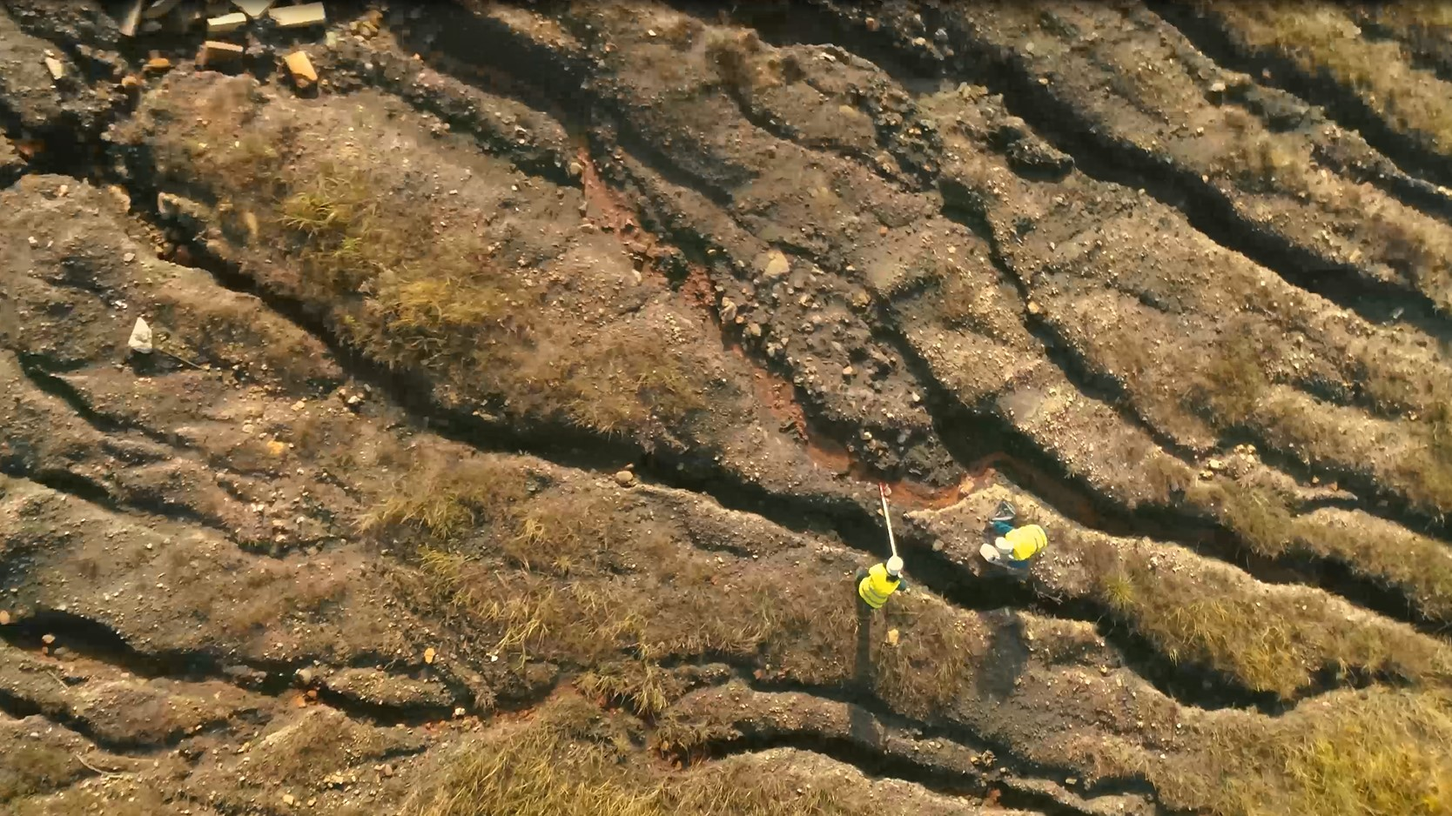
Notes:
Certainly, these yellow figures are not astronauts. Let us get a closer look.

Slide 9
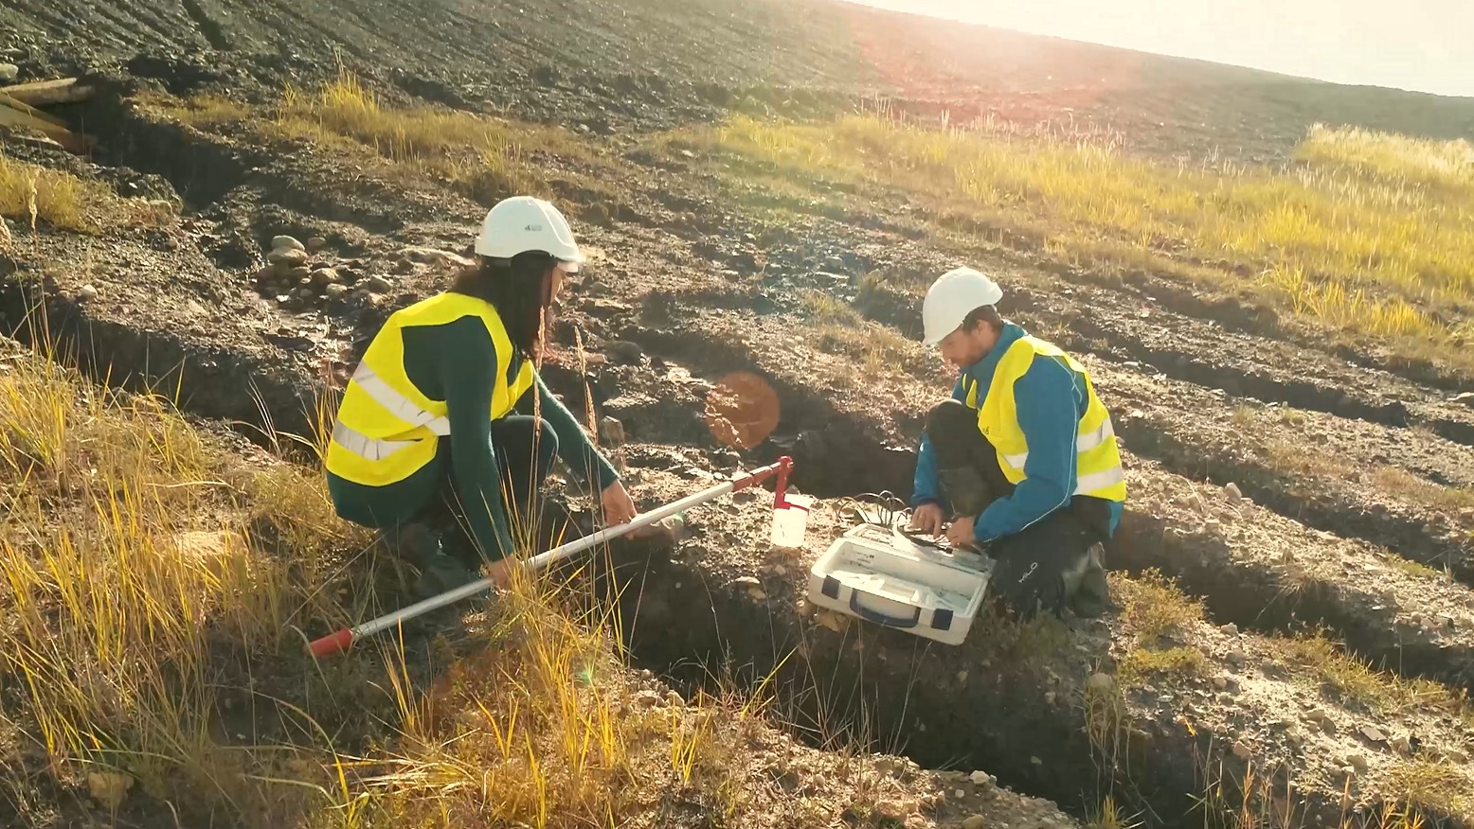
Notes:
Technical staff from Central Mining Institute gathering simples.
Eroded slopes and high acidic character of the terrain is very challenging.
Soil composition and runoff water characteristics were analysed.
So the question you may pose now is what kind of place is this?

Slide 10
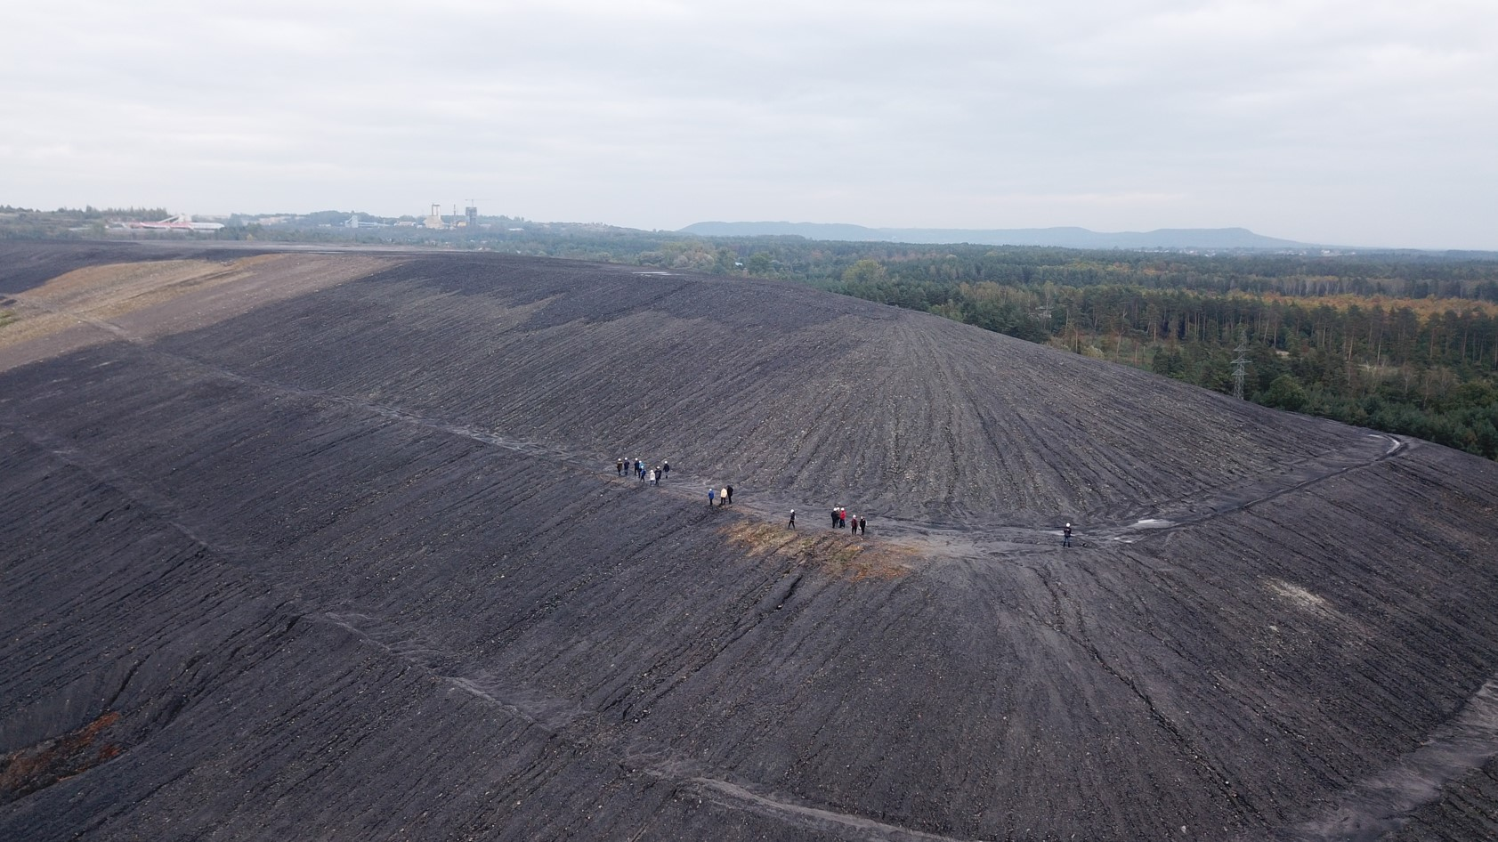
Notes:
It is the Janina waste heap in Libiąż, covering an area of 80 hectares and reaching 35 m of height. It is one of the biggest objects of this kind in the eastern part of the Silesian Coal Basin in Poland.
It is a very good “field laboratory” for assessing land rehabilitation techniques, as it has extremely difficult conditions for reclamation.

Slide 11
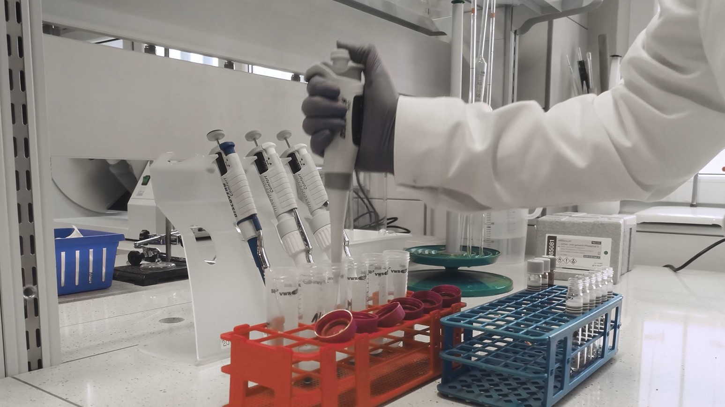
Notes:
RECOVERY project tested different techniques to enhance land rehabilitation of mining-affected areas in the case of ‘difficult terrains’.
It attempts to develop artificial soils mixes suitable to several types of plant communities that deliver a wide range of ecosystem services.
These mixes have been developed in the research laboratory of the Central Mining Institute.

Slide 12
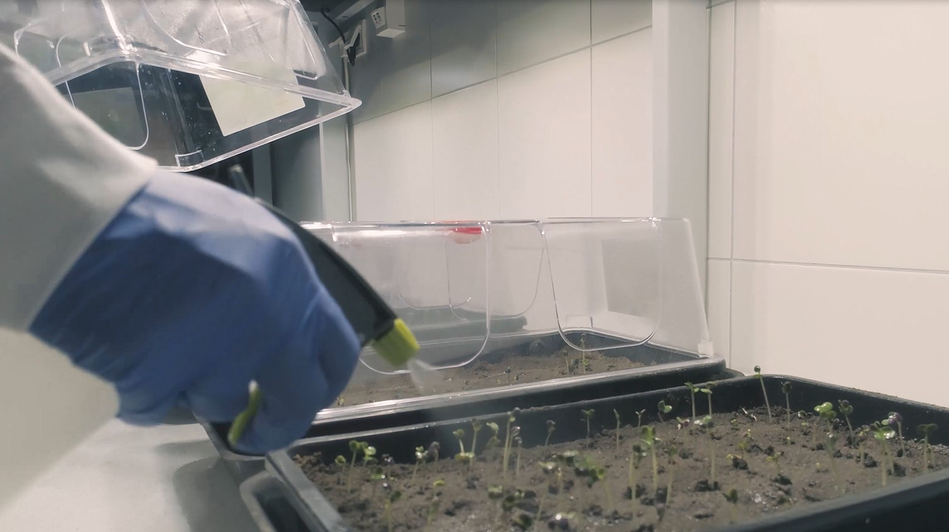
Notes:
The innovative approach of the RECOVERY project is to use waste from the mining and energy industries. Several blends were tested as substrate.

Slide 13
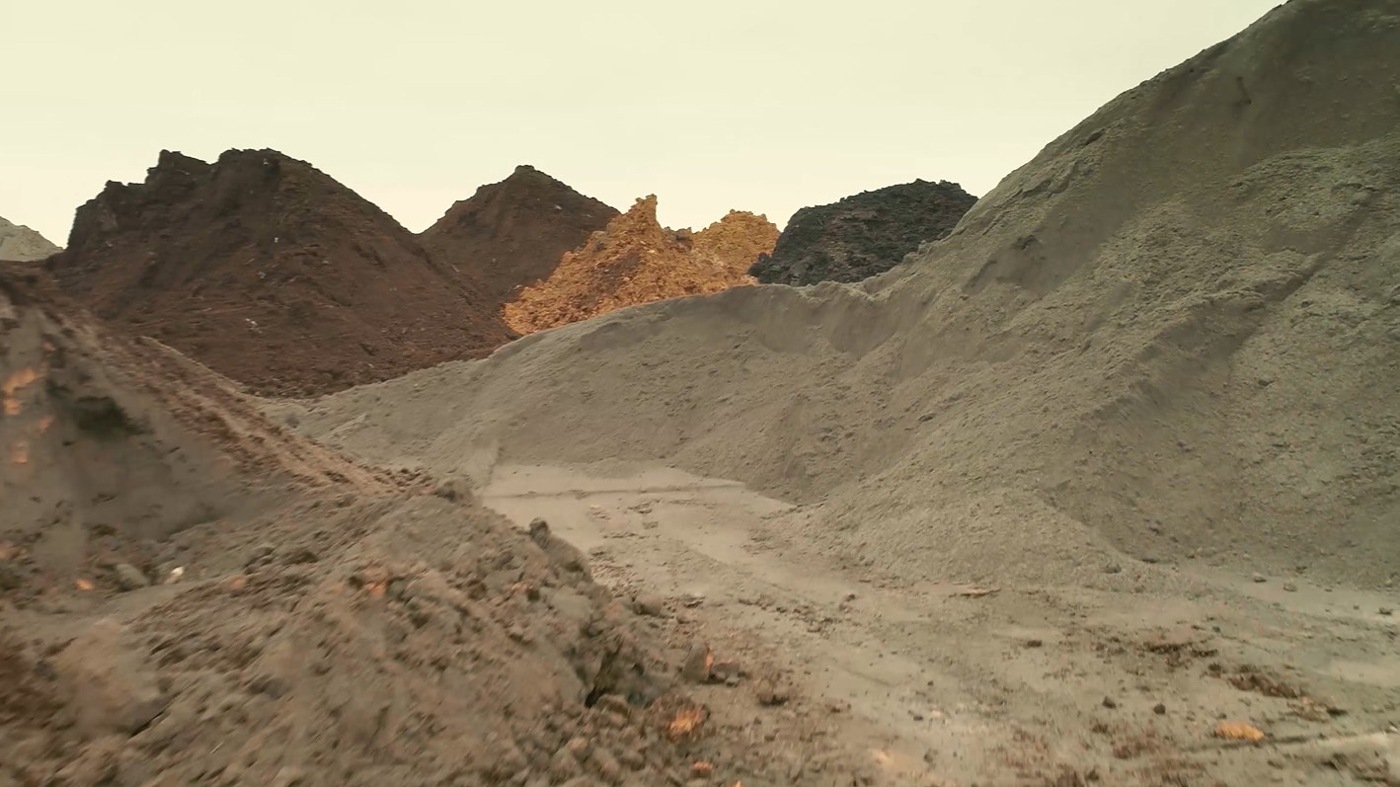
Notes:
Seven wastes from industrial plants were used in these investigation: fly ashes from coal and biomass combustion, by-products from energetic and coal mine processing, and two organic waste materials such as sewage sludge and spent mushroom compost.

Slide 14
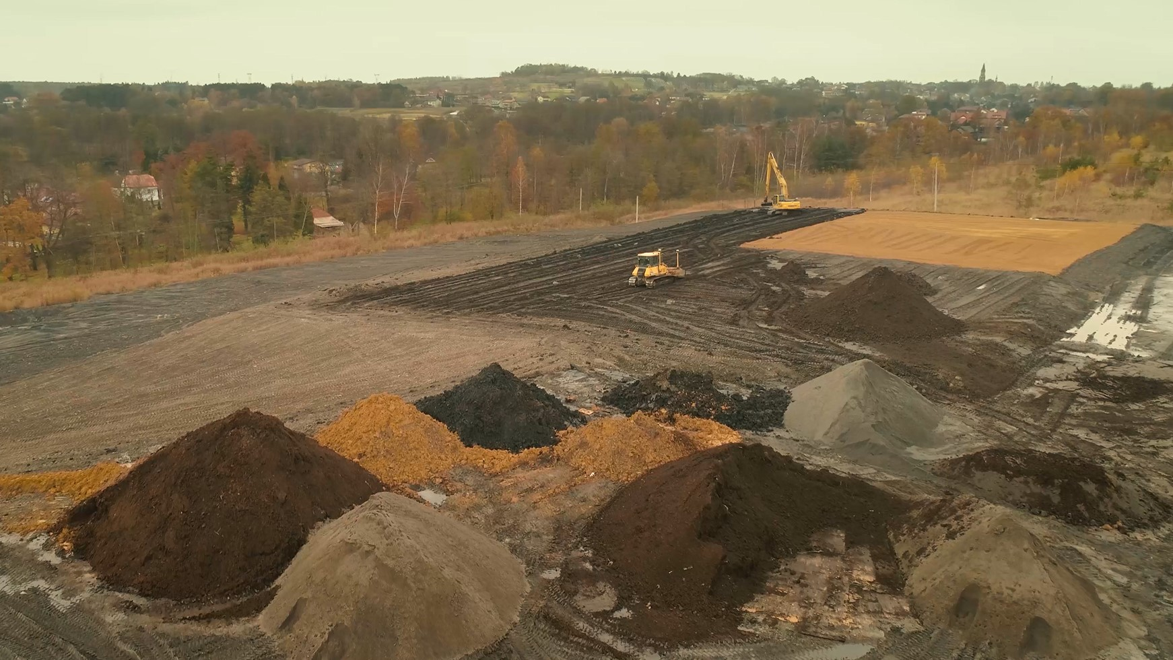
Notes:
With these materials a test polygon was constructed.

Slide 15
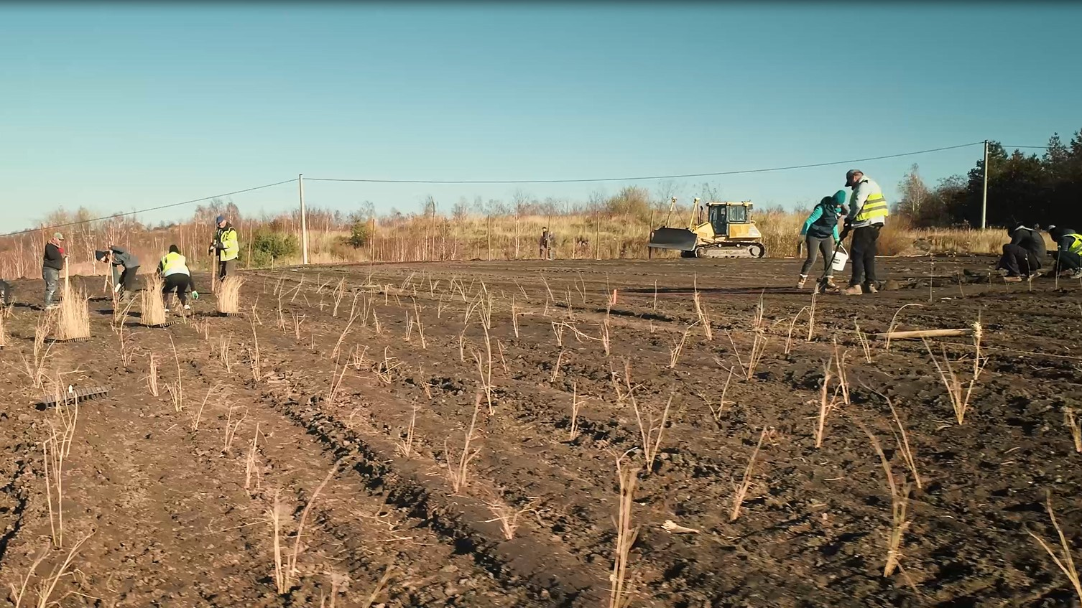
Notes:
In autumn 2020, seeds were sowed and vegetation was planted on the artificial soil.

Slide 16

Notes:
After seven months it was possible to see the first effects of the work. We studied the behaviour of meadow vegetation, shrubs, and wetland habitat plants.
We already know that some plant species tolerate artificial soil conditions very well, whereas others, have shown much lower resistance to the artificial conditions that we have created.

Slide 17
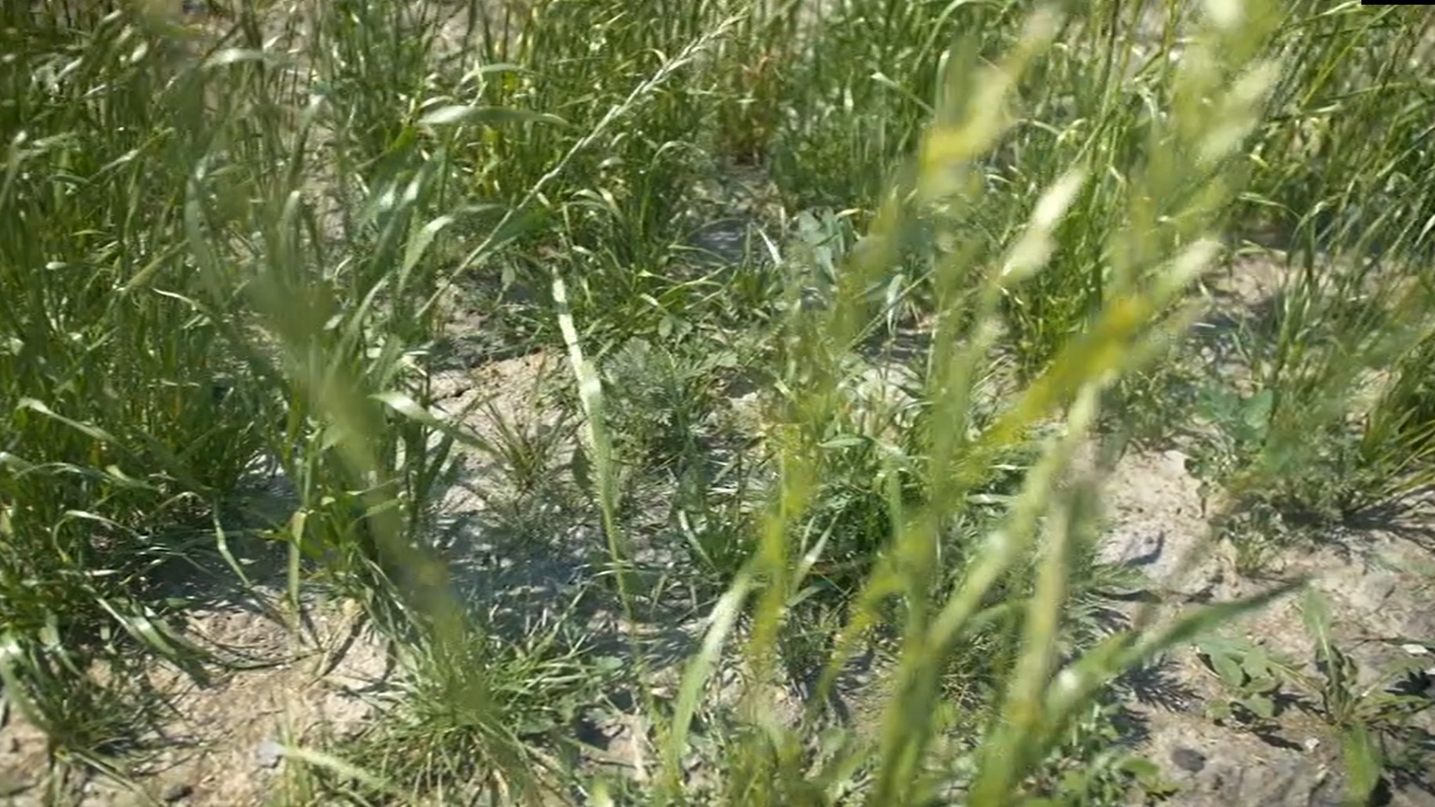
Notes:
Currently, we are in the process of studying the phenomenon of falling out of some of the species we have planted.

Slide 18
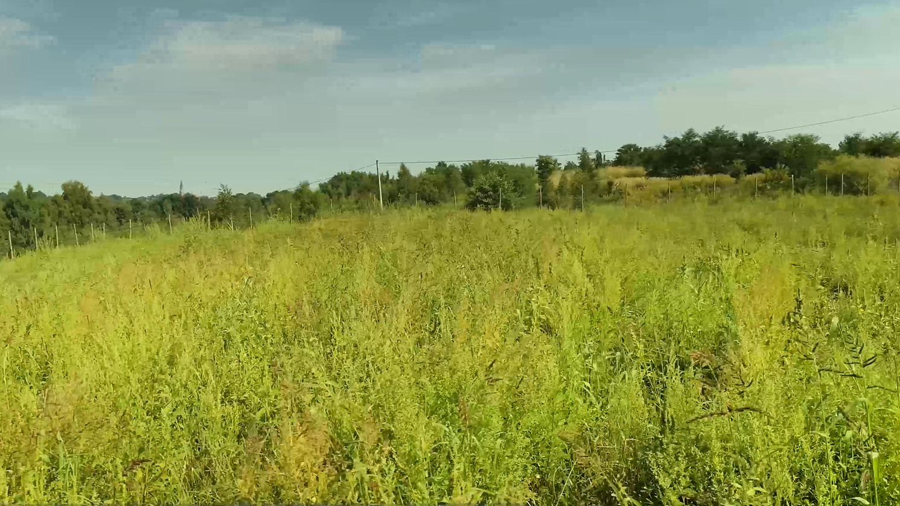
Notes:
Of the dozen or so meadow plant species we have observed rise for eight species.

Slide 19
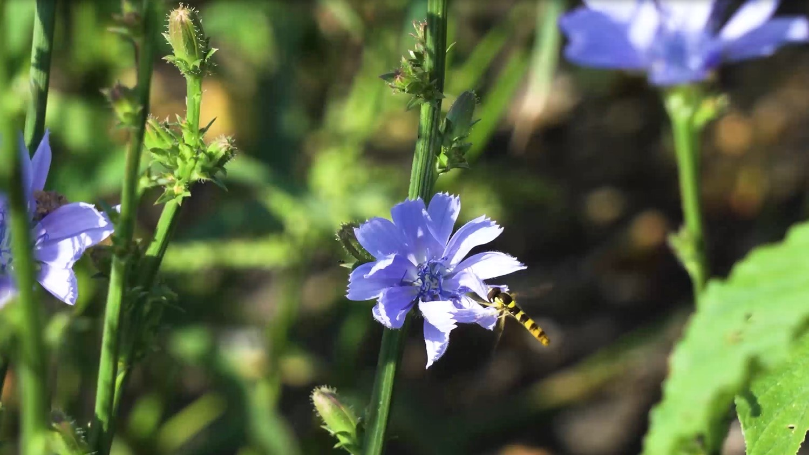
Notes:
And those are the first results of our research… You are all invited to come to Poland and see the polygon by yourselves. You will not be alone there.

Slide 20
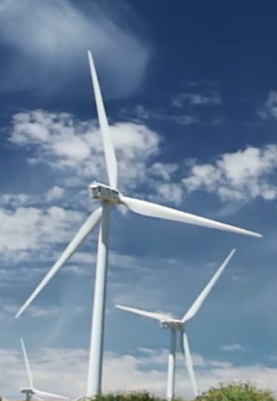


From RECOVERY to GreenJOBS
www.greenjobsproject.eu
www.recoveryproject.eu
Notes:
To ensure the accessibility of this presentation to blind users who use a screen reader,
if you translate this presentation or include parts not in English, make sure the proofing language is set to the right one (Review > Language > Set proofing Language). This will make sure the screen reader uses the right pronunciation.

Slide 21






GreenJOBS
Leveraging the competitive advantages of end-of-life underground coal mines to maximise the creation of green and quality jobs for the cooperation of international
Coordinator: UNIOVI
Call:​ RFCS-2021
Start date:​ 01/07/2022
End date:​ 31/12/2025
Total costs: 2,202,647 €

Slide 22
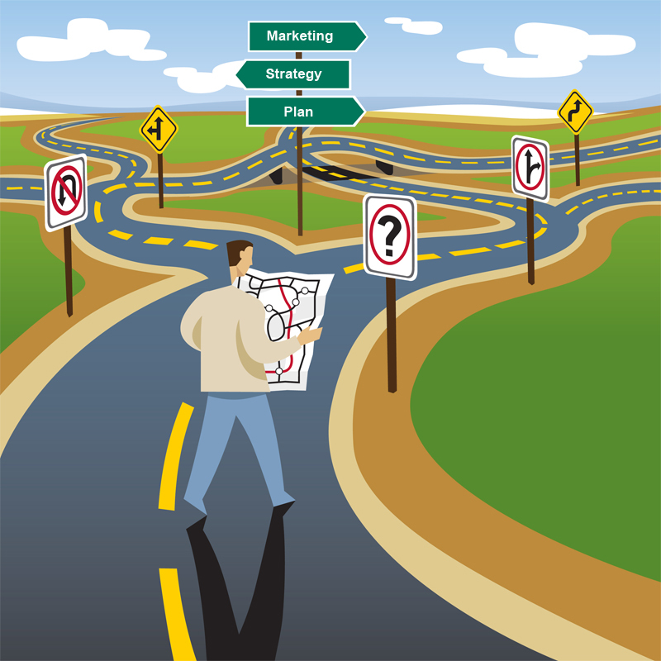
Problem tackled by GreenJOBS
Before GreenJOBS, there was no guidance focused on operating underground coal mining companies to understand, evaluate, design, and implement alternative economic activities within their future closing period, i.e., to have a holistic and long-term approach:
  Leaving behind short-term patchwork.
  Promoting sustainable local economic growth.
  Maximising the number of green and quality jobs.
Notes:
To ensure the accessibility of this presentation to blind users who use a screen reader,
if you translate this presentation or include parts not in English, make sure the proofing language is set to the right one (Review > Language > Set proofing Language). This will make sure the screen reader uses the right pronunciation.

Slide 23
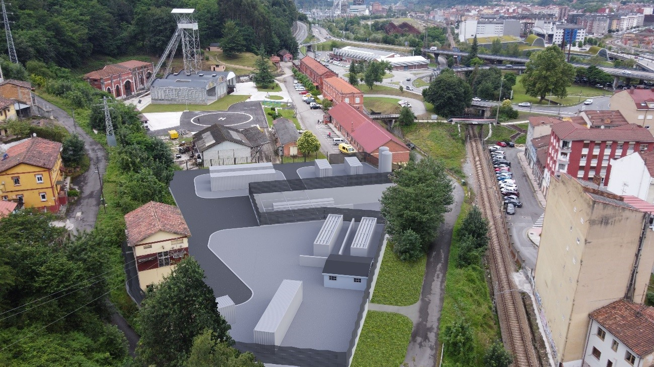
Problem tackled by GreenJOBS
There were no studies on repurposing end-of-life underground coal mines, leveraging their competitive advantages:
  Mine water.
  Connections to the grid.
  Large waste heap areas.
  Very deep shafts and galleries.
  Fine coal waste.
Notes:
To ensure the accessibility of this presentation to blind users who use a screen reader,
if you translate this presentation or include parts not in English, make sure the proofing language is set to the right one (Review > Language > Set proofing Language). This will make sure the screen reader uses the right pronunciation.

Slide 24
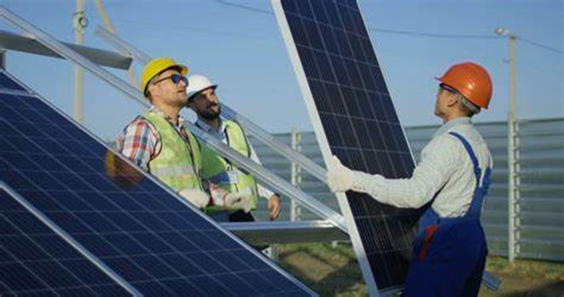
Main objectives
To develop innovative business plans for coal mining companies to deploy emerging renewable energy and circular economy technologies.
To plan and disseminate training and re-skilling programmes addressing former coal mining among mining companies and regional authorities in the coal regions in transition.
.
Notes:
To ensure the accessibility of this presentation to blind users who use a screen reader,
if you translate this presentation or include parts not in English, make sure the proofing language is set to the right one (Review > Language > Set proofing Language). This will make sure the screen reader uses the right pronunciation.

Slide 25
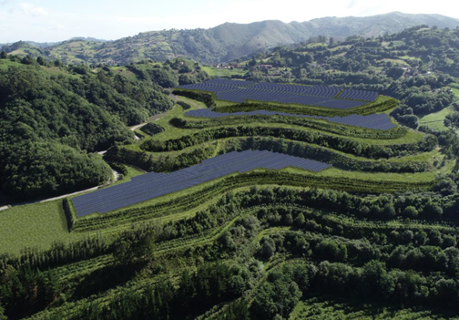
Main results
A Virtual Power Plant business plan where the energy locally produced will be sold to the grid or used to power electro-intensive industries or companies with constant energy consumption close to mines, such as aluminium factories or green data centres.
A business plan for a Green Hydrogen Plant, where renewable hydrogen will be produced by electrolysis of mine water and green electricity.
Notes:
To ensure the accessibility of this presentation to blind users who use a screen reader,
if you translate this presentation or include parts not in English, make sure the proofing language is set to the right one (Review > Language > Set proofing Language). This will make sure the screen reader uses the right pronunciation.

Slide 26
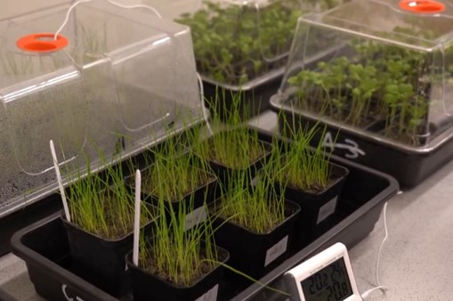
Main results
Three circular economy technologies:
  The development of soil substitutes to restore waste heaps before installing photovoltaic/wind.
  The development of dense fluids for unconventional pumped hydro energy storage.
  The recovery of rare earths, critical raw materials for the EU.
Notes:
To ensure the accessibility of this presentation to blind users who use a screen reader,
if you translate this presentation or include parts not in English, make sure the proofing language is set to the right one (Review > Language > Set proofing Language). This will make sure the screen reader uses the right pronunciation.

Slide 27
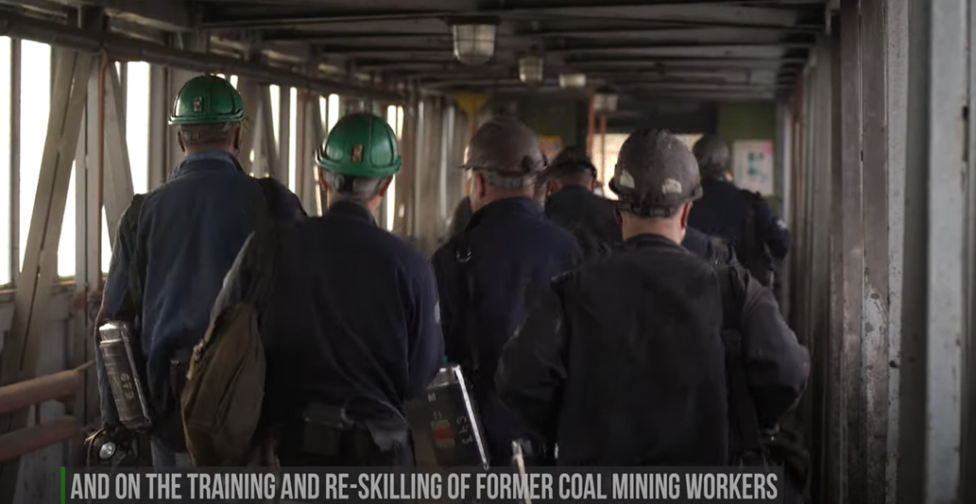
Main results
Training and re-skilling programmes in each of the stages of the value chains and according to the skill levels required, addressing the skill gaps of former coal mining workers to facilitate the development of the business alternatives.
Notes:
To ensure the accessibility of this presentation to blind users who use a screen reader,
if you translate this presentation or include parts not in English, make sure the proofing language is set to the right one (Review > Language > Set proofing Language). This will make sure the screen reader uses the right pronunciation.

Slide 28
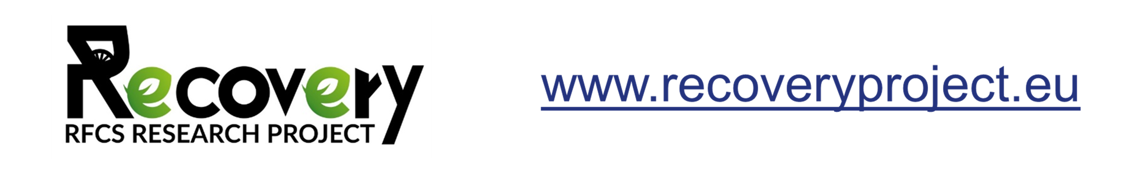
Thank you very much for your attention
www.greenjobsproject.eu
Notes:
To ensure the accessibility of this presentation to blind users who use a screen reader,
if you translate this presentation or include parts not in English, make sure the proofing language is set to the right one (Review > Language > Set proofing Language). This will make sure the screen reader uses the right pronunciation.

