Slide 1











GreenJOBS
Leveraging the competitive advantages of end-of-life underground coal mines to maximise the creation of green and quality jobs ……………………………………….. ​
Coordinator: UNIVERSITY OF OVIEDO
Call:​ RFCS-2021
Start date:​ 01/07/2022
End date: 31/12/2025​
Total budget: 2,202,647 €

Slide 2
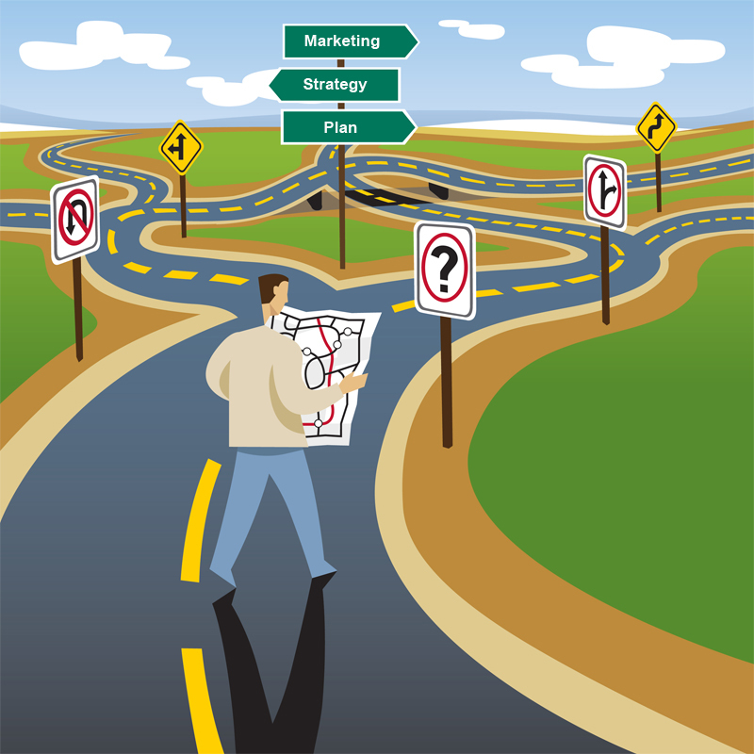
Problem identification
Before GreenJOBS, there was no guidance focused on operating underground coal mining companies to understand, evaluate, design, and implement alternative economic activities within their future closing period, i.e., to have a holistic and long-term approach:
  Leaving behind short-term patchwork.
  Promoting sustainable local economic growth.
  Maximising the number of green and quality jobs.
Notes:
To ensure the accessibility of this presentation to blind users who use a screen reader,
if you translate this presentation or include parts not in English, make sure the proofing language is set to the right one (Review > Language > Set proofing Language). This will make sure the screen reader uses the right pronunciation.

Slide 3
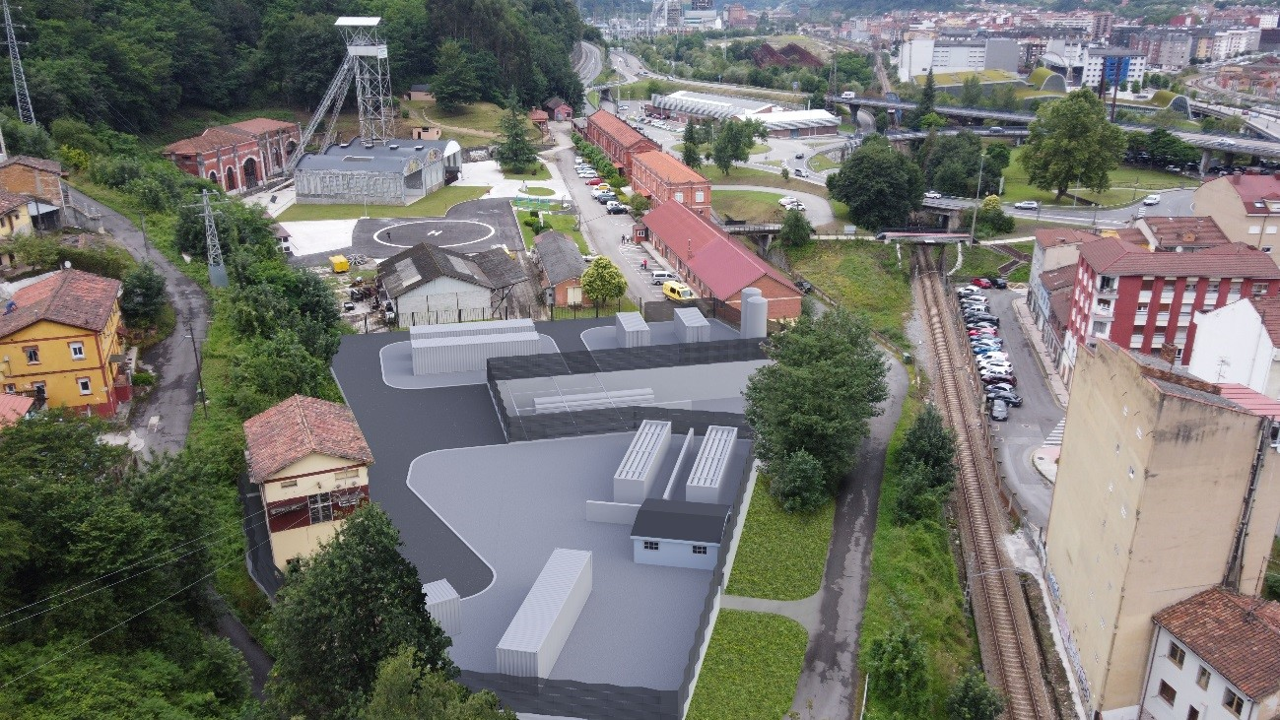
Problem identification
There were no studies on repurposing end-of-life underground coal mines, leveraging their competitive advantages:
  Mine water.
  Connections to the grid.
  Large waste heap areas.
  Very deep shafts and galleries.
  Fine coal waste.
Notes:
To ensure the accessibility of this presentation to blind users who use a screen reader,
if you translate this presentation or include parts not in English, make sure the proofing language is set to the right one (Review > Language > Set proofing Language). This will make sure the screen reader uses the right pronunciation.

Slide 4
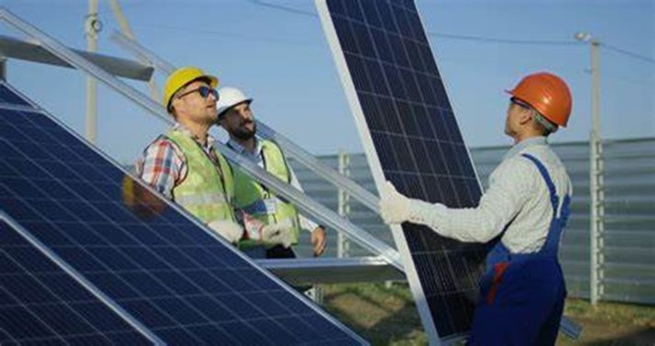
Main objectives
To develop innovative business plans for coal mining companies to deploy emerging renewable energy and circular economy technologies.
To plan and disseminate training and re-skilling programmes addressing former coal mining among mining companies and regional authorities in the coal regions in transition.
Notes:
To ensure the accessibility of this presentation to blind users who use a screen reader,
if you translate this presentation or include parts not in English, make sure the proofing language is set to the right one (Review > Language > Set proofing Language). This will make sure the screen reader uses the right pronunciation.

Slide 5
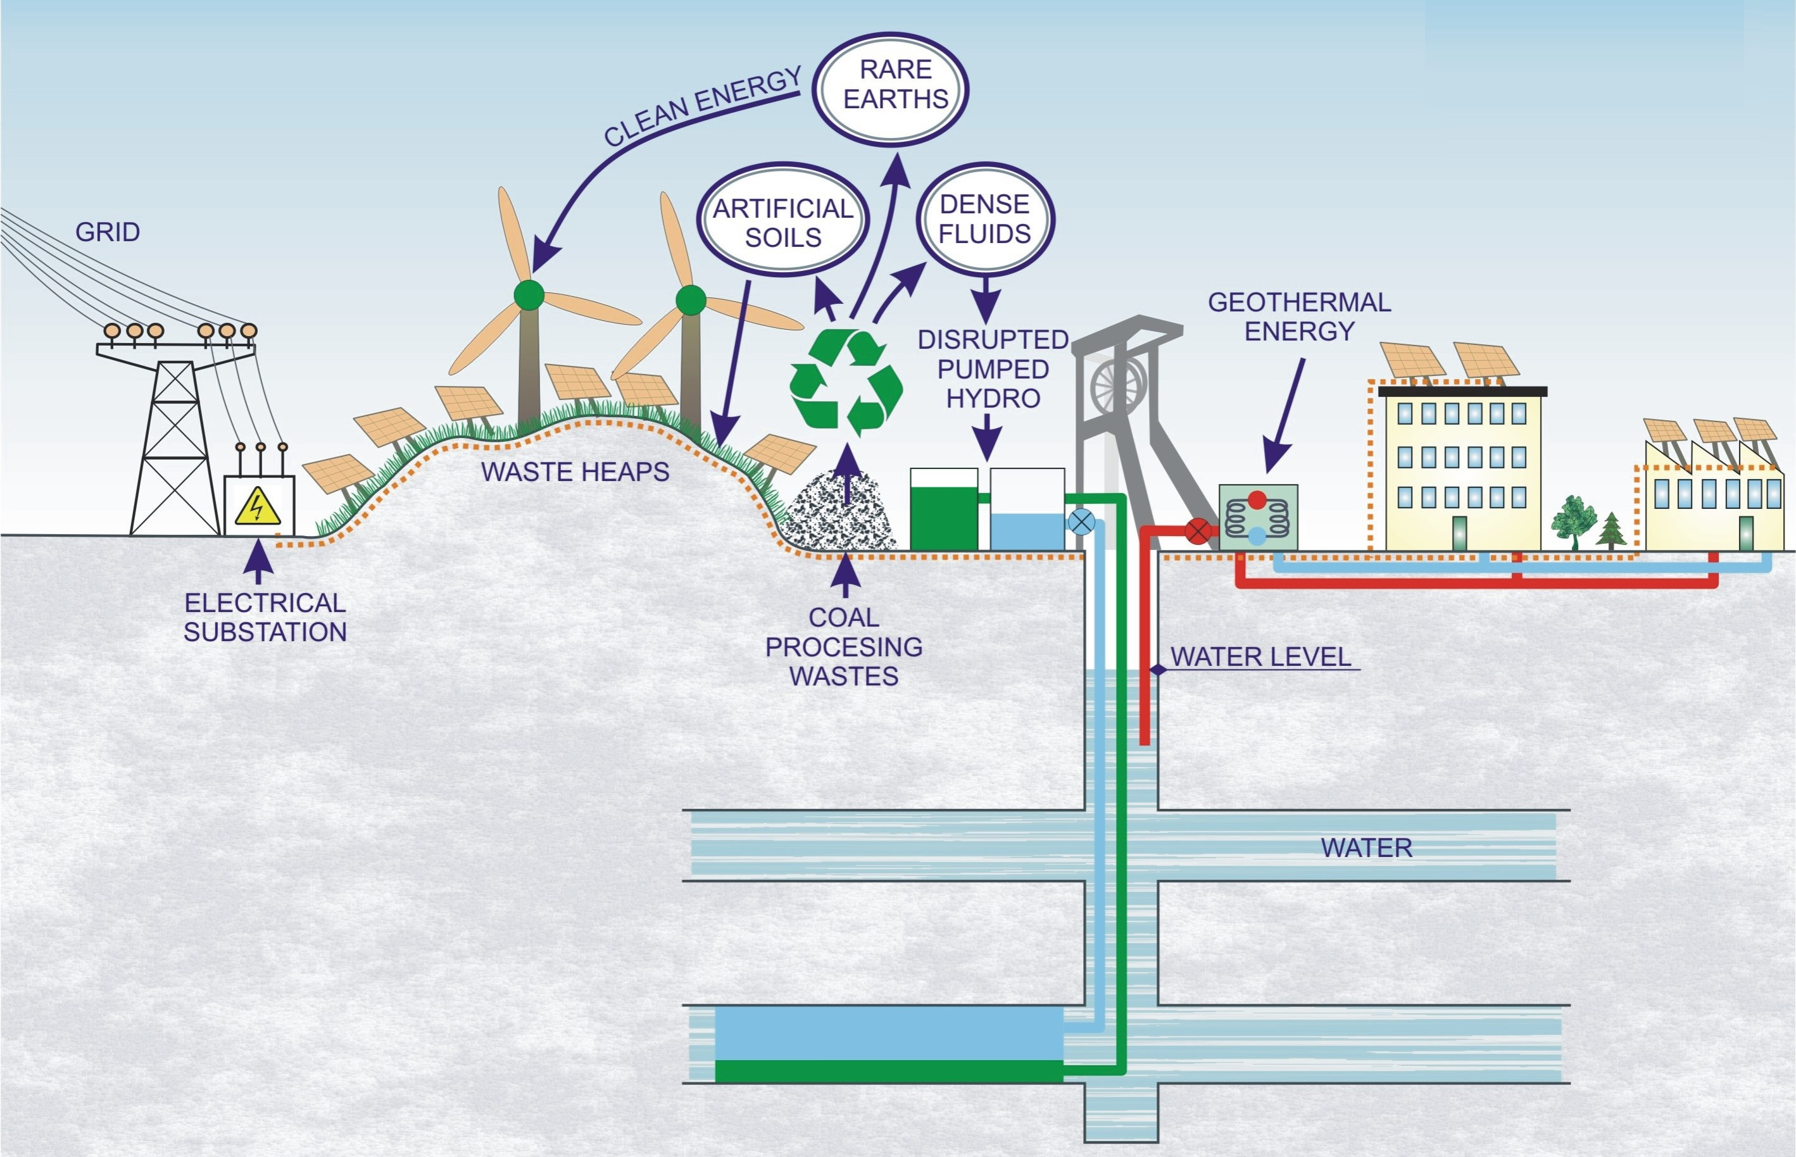
Main innovative results
A Virtual Power Plant business plan where the energy locally produced will be sold to the grid.
A business plan for a Green Hydrogen Plant, where renewable hydrogen will be produced by electrolysis of mine water and green electricity.
Notes:
To ensure the accessibility of this presentation to blind users who use a screen reader,
if you translate this presentation or include parts not in English, make sure the proofing language is set to the right one (Review > Language > Set proofing Language). This will make sure the screen reader uses the right pronunciation.

Slide 6
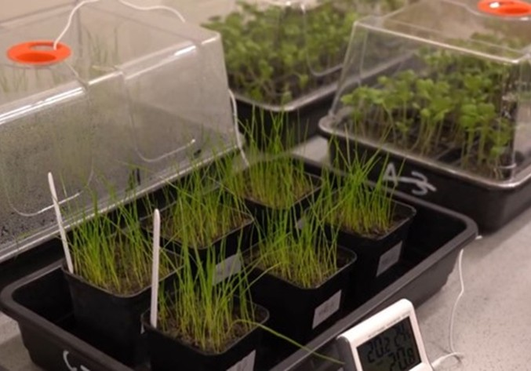
Main innovative results
Three circular economy technologies:
  The development of soil substitutes to restore waste heaps before installing photovoltaic/wind.
  The development of dense fluids for unconventional pumped hydro energy storage.
  The recovery of rare earths, critical raw materials for the EU.
Notes:
To ensure the accessibility of this presentation to blind users who use a screen reader,
if you translate this presentation or include parts not in English, make sure the proofing language is set to the right one (Review > Language > Set proofing Language). This will make sure the screen reader uses the right pronunciation.

Slide 7
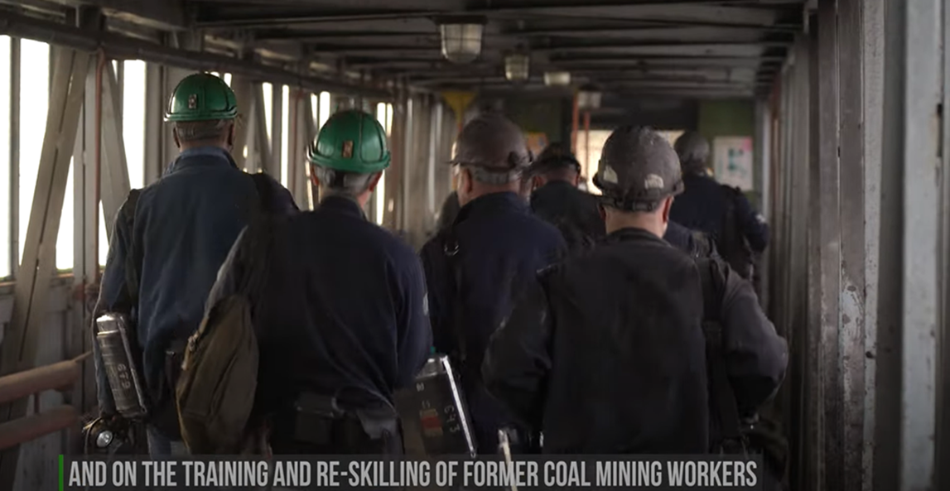
Main innovative results
Training and re-skilling programmes in each of the stages of the value chains and according to the skill levels required, addressing the skill gaps of former coal mining workers to facilitate the development of the business alternatives.
Notes:
To ensure the accessibility of this presentation to blind users who use a screen reader,
if you translate this presentation or include parts not in English, make sure the proofing language is set to the right one (Review > Language > Set proofing Language). This will make sure the screen reader uses the right pronunciation.

Slide 8
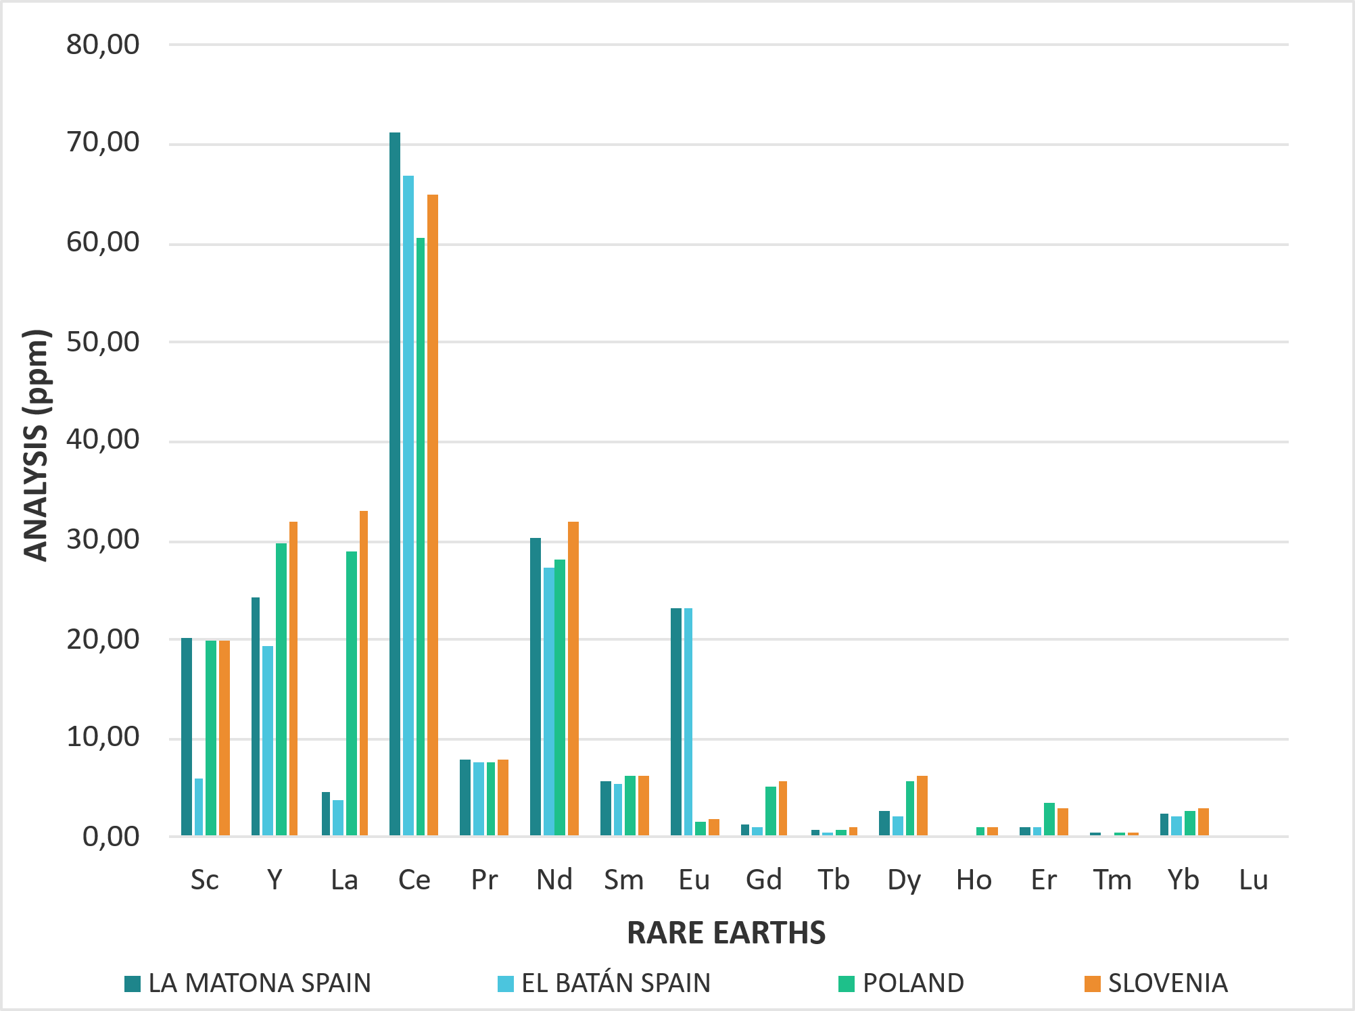
Lessons learnt
Rare earth concentrations from coal wastes range from 150-310 ppm (0.015-0.031%). For a mine to be mineable, concentrations between 1 and 2% are required. This suggests that the amount of rare earths present in the waste heaps in the three studied countries (ES, PL, SI) is too low to be economically viable.
Notes:
To ensure the accessibility of this presentation to blind users who use a screen reader,
if you translate this presentation or include parts not in English, make sure the proofing language is set to the right one (Review > Language > Set proofing Language). This will make sure the screen reader uses the right pronunciation.

Slide 9
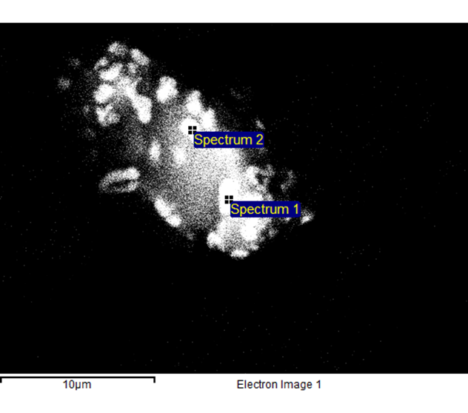
Lessons learnt
Mechanical separation methods, such as granulometric concentration, gravimetric, magnetic, and electric separators, and froth flotation, were used.
Scanning Electron Microscopy (SEM) image of a particle size of 20 microns. REE targets are 0.5-1 microns.
We are currently testing hydrometallurgical concentration; however, the results are not yet available.
Notes:
To ensure the accessibility of this presentation to blind users who use a screen reader,
if you translate this presentation or include parts not in English, make sure the proofing language is set to the right one (Review > Language > Set proofing Language). This will make sure the screen reader uses the right pronunciation.

Slide 10
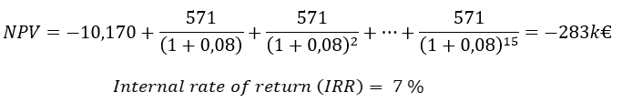
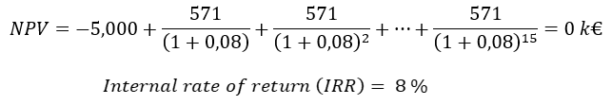
Lessons learnt
The economic assessment of hydrogen production via electrolysis showed that the investment is not feasible unless a specific subvention of at least 50% is obtained for developing the Green Hydrogen Plant.
Notes:
To ensure the accessibility of this presentation to blind users who use a screen reader,
if you translate this presentation or include parts not in English, make sure the proofing language is set to the right one (Review > Language > Set proofing Language). This will make sure the screen reader uses the right pronunciation.

Slide 11
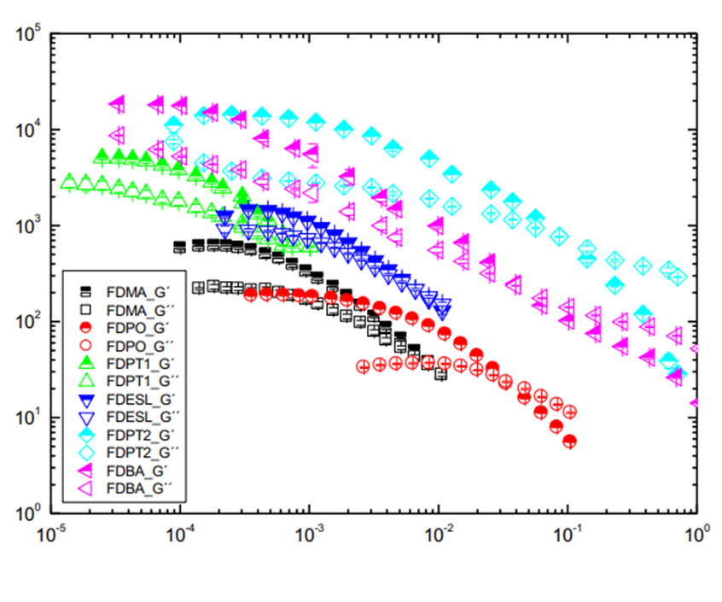
Lessons learnt
Experimental tests consisting of fluid-dynamic and rheology analysis showed that developing dense fluids with coal waste from the Spanish and Slovenian mines is feasible. At the same time, it was not feasible to use the Polish mine coal waste.
Notes:
To ensure the accessibility of this presentation to blind users who use a screen reader,
if you translate this presentation or include parts not in English, make sure the proofing language is set to the right one (Review > Language > Set proofing Language). This will make sure the screen reader uses the right pronunciation.

Slide 12
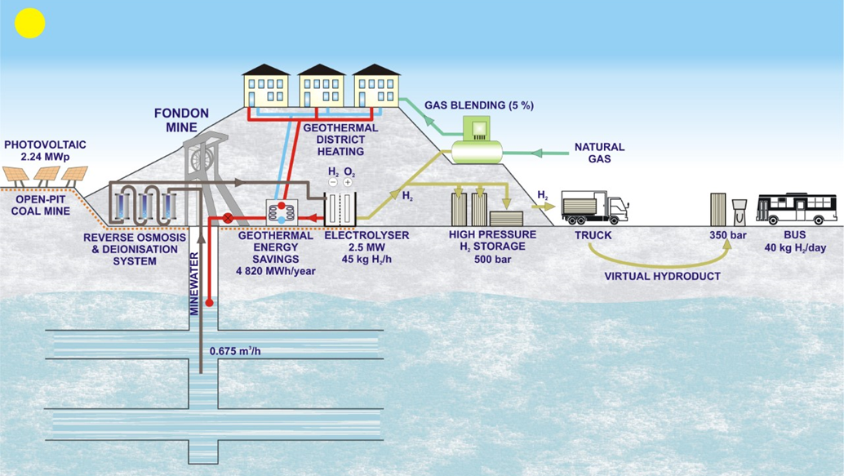
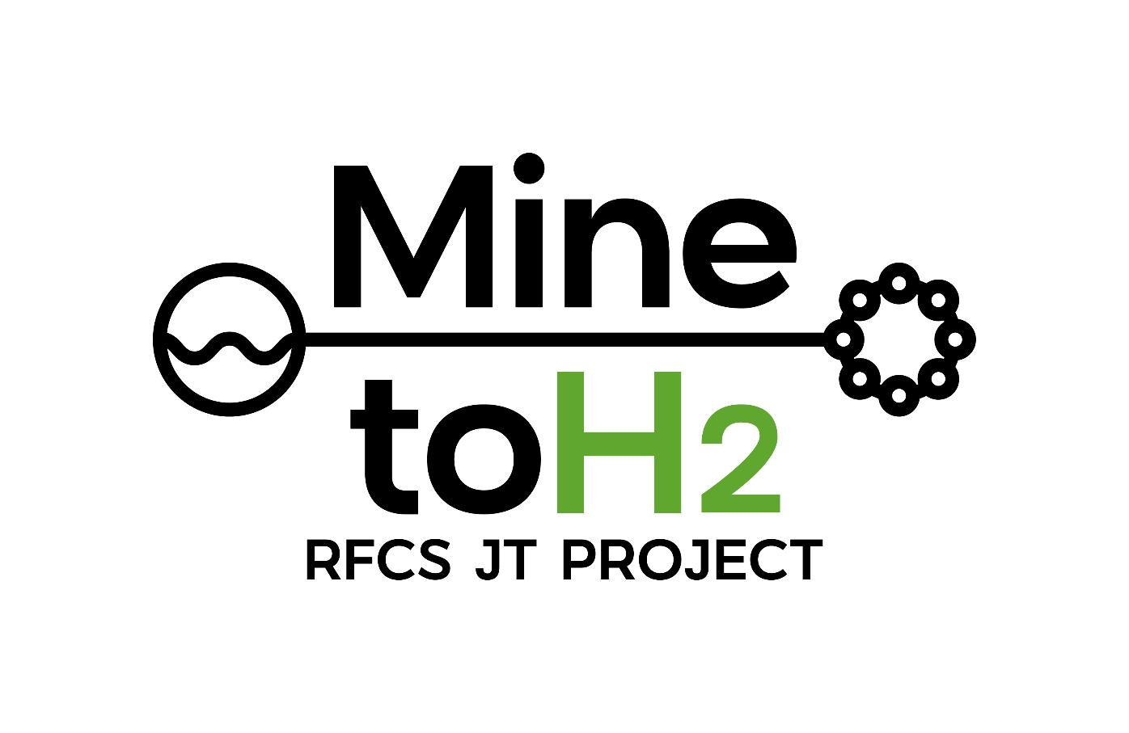
Next steps​
The MINE-TO-H2 Big-ticket project will repurpose a former coal mine through a 2.5 MW Green Hydrogen Plant, scalable up to 5 MW, where green hydrogen for the passenger road transport sector will be produced using circular economy actions.
Notes:
To ensure the accessibility of this presentation to blind users who use a screen reader,
if you translate this presentation or include parts not in English, make sure the proofing language is set to the right one (Review > Language > Set proofing Language). This will make sure the screen reader uses the right pronunciation.

Slide 13

Next steps​
The CRMsDataSpace project aims to create a Common European Data Space on Critical Raw Materials (CRMs) for the Green Deal, focusing on recovering valuable raw materials from closed extractive coal waste facilities. This seeks to enhance Europe's autonomy in securing critical raw materials.
Notes:
To ensure the accessibility of this presentation to blind users who use a screen reader,
if you translate this presentation or include parts not in English, make sure the proofing language is set to the right one (Review > Language > Set proofing Language). This will make sure the screen reader uses the right pronunciation.

Slide 14
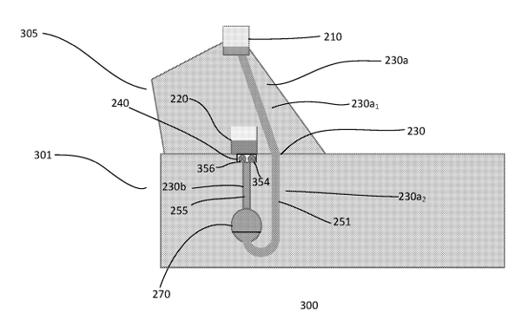
Intellectual property strategy
Poland and Spanish patents EP 3 768 967 on a “Pumped Hydro Energy Storage System and Method” were granted to Magellan & Barents, partner of the GreenJOBS Project, to support the adoption of Unconventional pumped hydro storage by Polish and Spanish mining companies interested in this energy storage alternative within the exploitation plan of the GreenJOBS Project (Patent Office of the Republic of Poland and Spanish Patent and Trademark Office, November 2024).
Notes:
To ensure the accessibility of this presentation to blind users who use a screen reader,
if you translate this presentation or include parts not in English, make sure the proofing language is set to the right one (Review > Language > Set proofing Language). This will make sure the screen reader uses the right pronunciation.

Slide 15

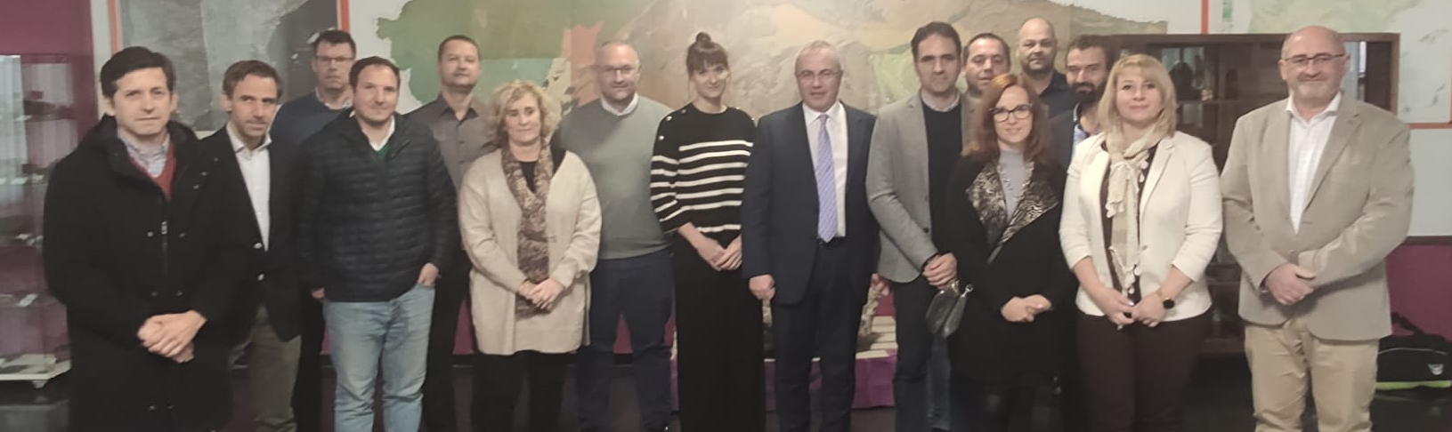
Thank you for your attention!
Pedro Riesgo Fernández, University of Oviedo
15

