Slide 1











GreenJOBS
Leveraging the competitive advantages of end-of-life underground coal mines to maximise the creation of green and quality jobs
Coordinator:
UNIVERSITY OF OVIEDO
Call:​ RFCS-2021
Start date:​ 01/07/2022
End date: 31/12/2025​
Total budget: 2,202,647 €

Slide 2
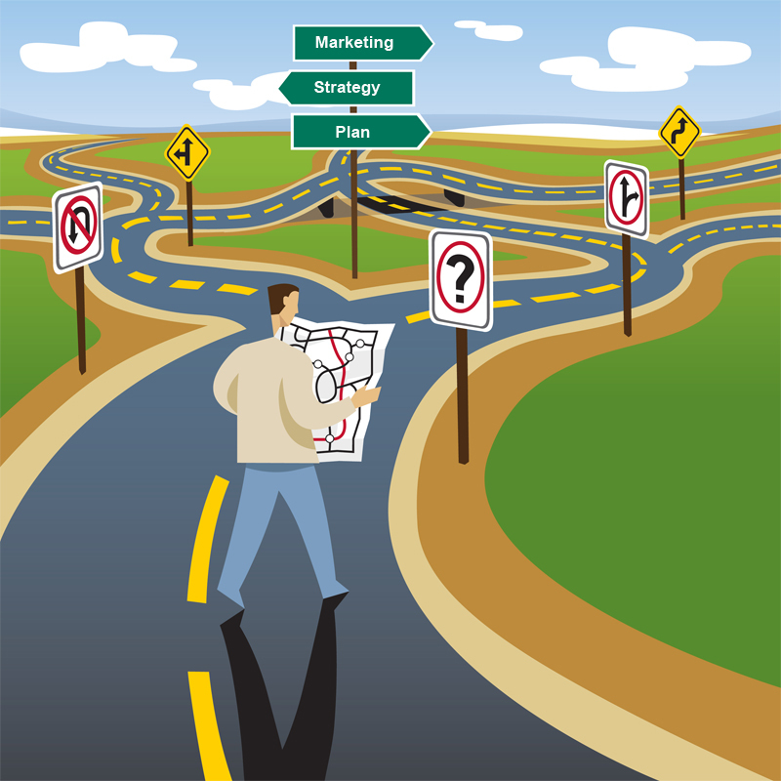
Problem identification
Before GreenJOBS, there was no guidance focused on operating underground coal mining companies to understand, evaluate, design, and implement alternative economic activities within their future closing period, i.e., to have a holistic and long-term approach:
Leaving behind short-term patchwork.
Promoting sustainable local economic growth.
Maximising the number of green and quality jobs.
Notes:
To ensure the accessibility of this presentation to blind users who use a screen reader,
if you translate this presentation or include parts not in English, make sure the proofing language is set to the right one (Review > Language > Set proofing Language). This will make sure the screen reader uses the right pronunciation.

Slide 3
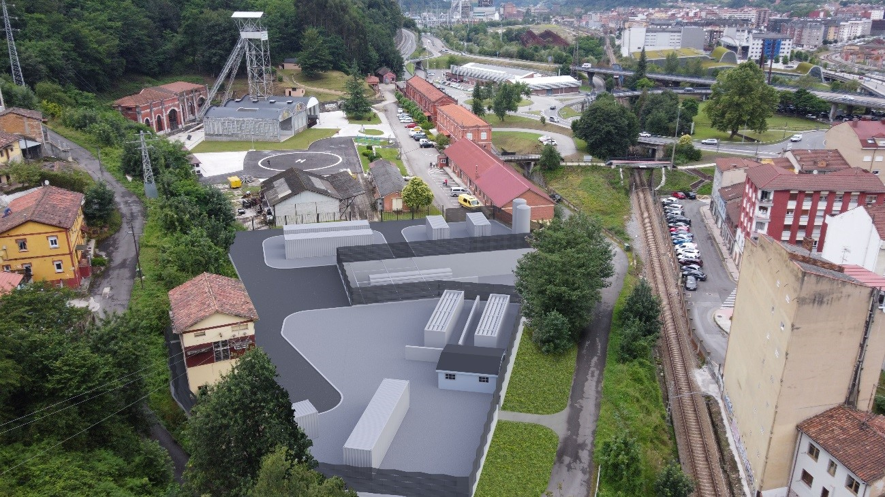
Problem identification
There were no studies on repurposing end-of-life underground coal mines, leveraging their competitive advantages:
Mine water.
Connections to the grid.
Large waste heap areas.
Very deep shafts and galleries.
Fine coal waste.
Notes:
To ensure the accessibility of this presentation to blind users who use a screen reader,
if you translate this presentation or include parts not in English, make sure the proofing language is set to the right one (Review > Language > Set proofing Language). This will make sure the screen reader uses the right pronunciation.

Slide 4
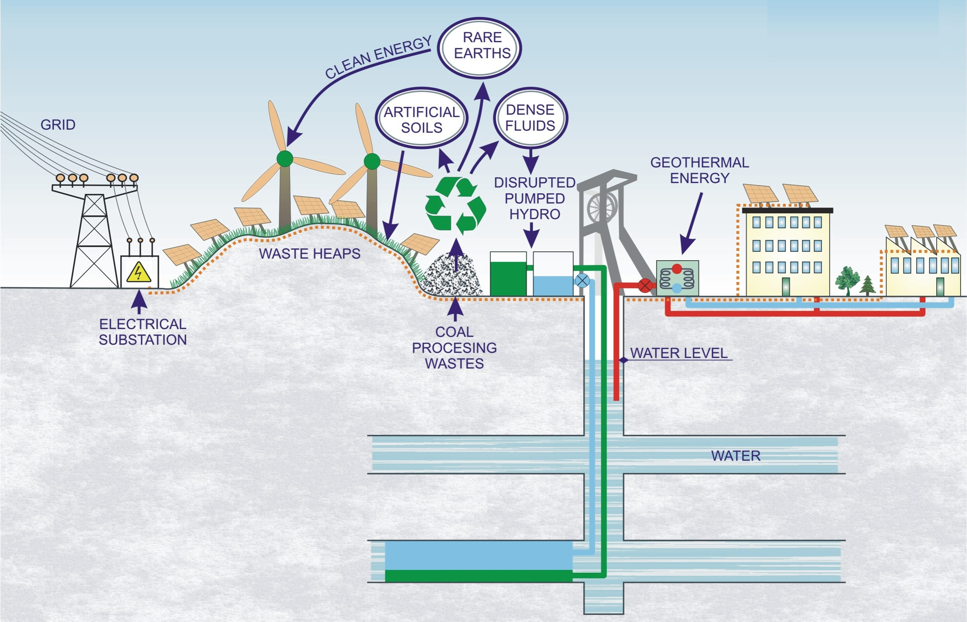
Main results 1/4
A Virtual Power Plant business plan where the energy locally produced will be sold to the grid or to companies located near the mines (e.g., Eco-industrial parks).
Notes:
To ensure the accessibility of this presentation to blind users who use a screen reader,
if you translate this presentation or include parts not in English, make sure the proofing language is set to the right one (Review > Language > Set proofing Language). This will make sure the screen reader uses the right pronunciation.

Slide 5
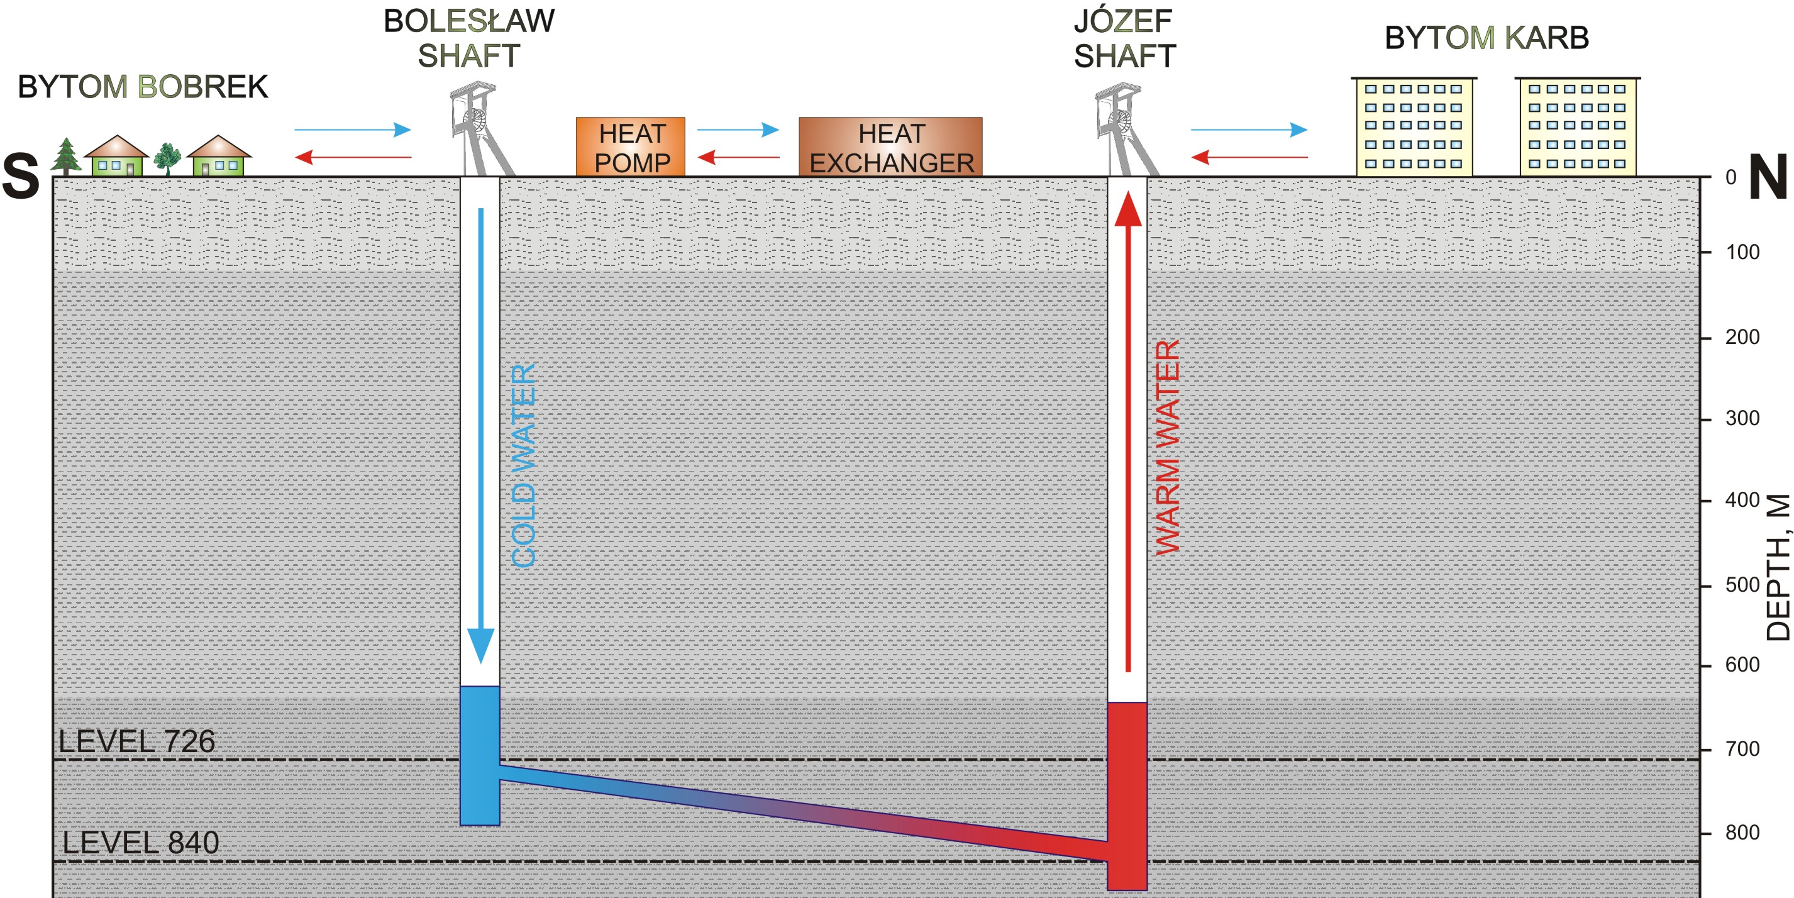
The Bobrek – Piekary mine ​
The temperature of the mine water is more than 25 °C, with a pumping capacity: > 5,000 m³/day
Notes:
To ensure the accessibility of this presentation to blind users who use a screen reader,
if you translate this presentation or include parts not in English, make sure the proofing language is set to the right one (Review > Language > Set proofing Language). This will make sure the screen reader uses the right pronunciation.

Slide 6
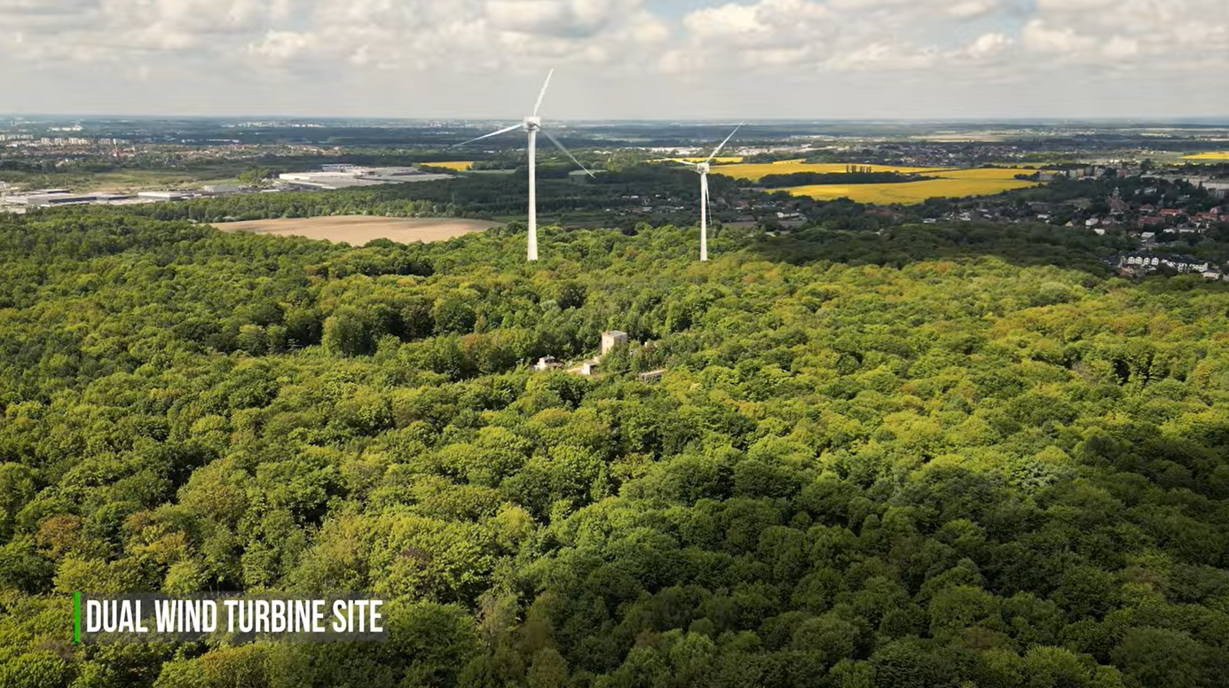
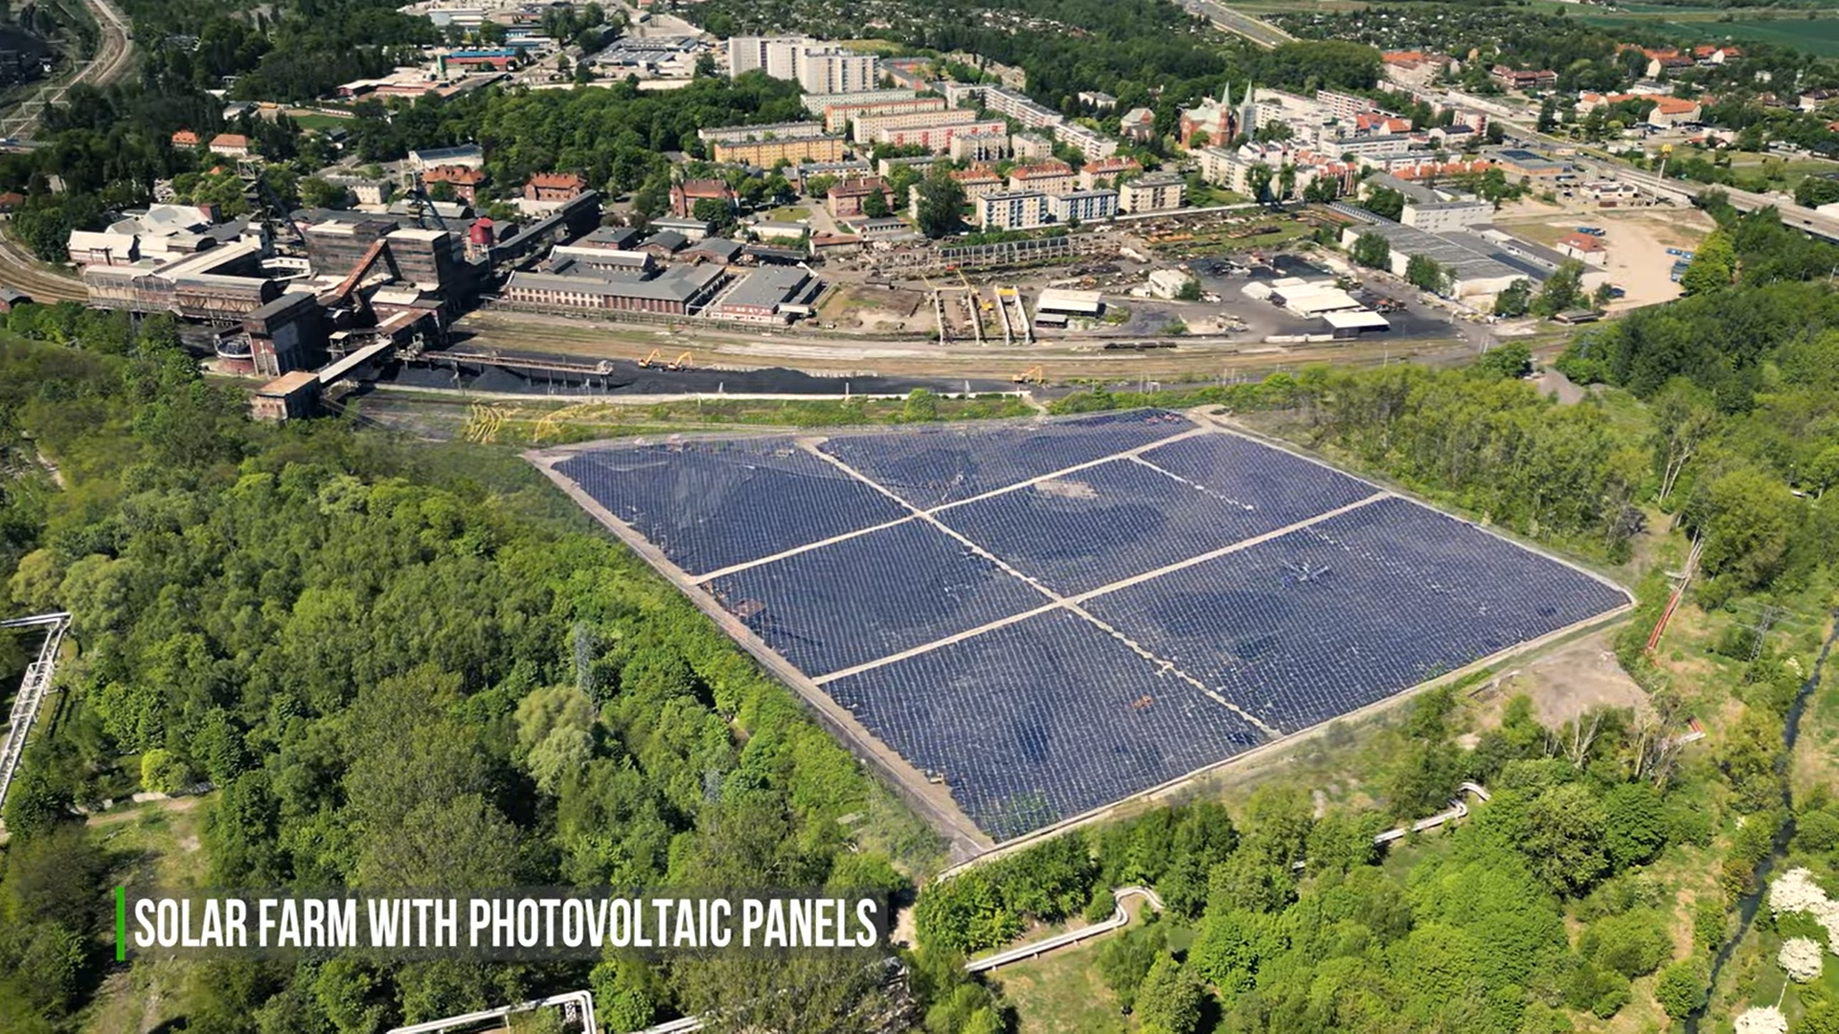
The Bobrek – Piekary mine ​
Bobrek coal mine
Ignacy Shaft of Bobrek mine
Notes:
To ensure the accessibility of this presentation to blind users who use a screen reader,
if you translate this presentation or include parts not in English, make sure the proofing language is set to the right one (Review > Language > Set proofing Language). This will make sure the screen reader uses the right pronunciation.

Slide 7
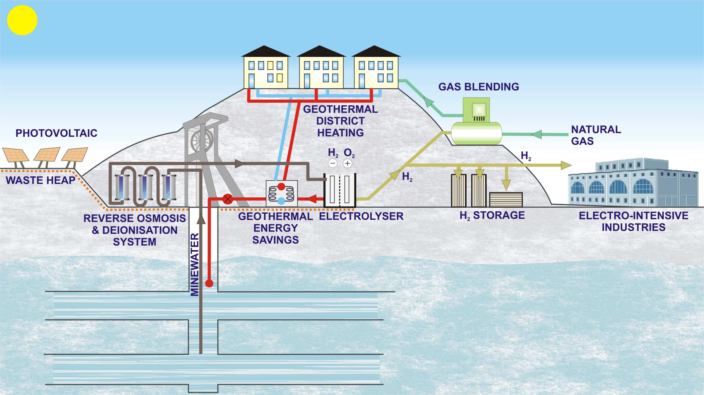
Main results 2/4
A business plan for a Green Hydrogen Plant, where renewable hydrogen will be produced by electrolysis of mine water and green electricity.
Notes:
To ensure the accessibility of this presentation to blind users who use a screen reader,
if you translate this presentation or include parts not in English, make sure the proofing language is set to the right one (Review > Language > Set proofing Language). This will make sure the screen reader uses the right pronunciation.

Slide 8
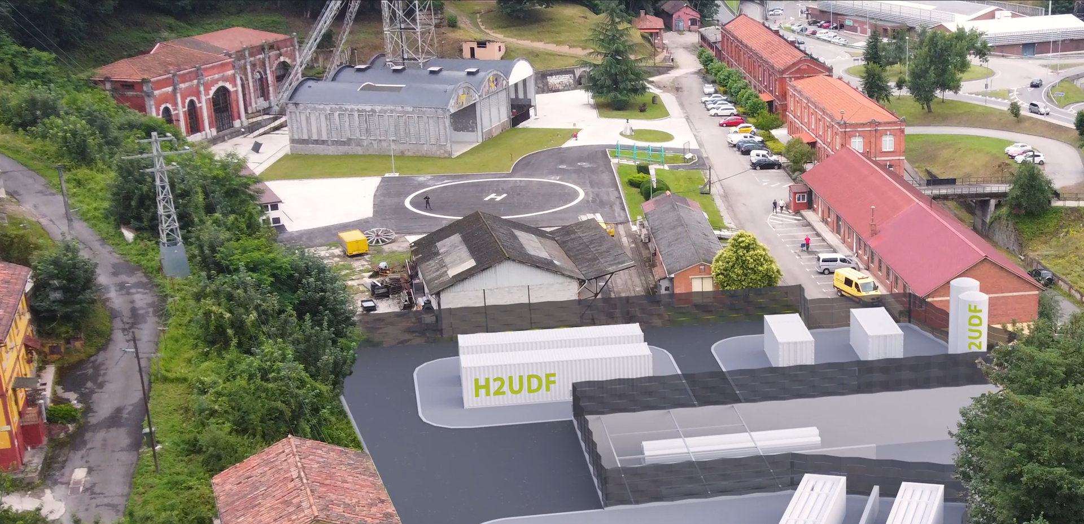

Mine-to-H2 Big Ticket project​
The Mine-to-H2 Big-ticket project will repurpose a former coal mine (Fondón mine of HUNOSA) through a 2.5 MW Green Hydrogen Plant, scalable up to 5 MW, where green hydrogen for the passenger road transport sector will be produced using circular economy actions.
Notes:
To ensure the accessibility of this presentation to blind users who use a screen reader,
if you translate this presentation or include parts not in English, make sure the proofing language is set to the right one (Review > Language > Set proofing Language). This will make sure the screen reader uses the right pronunciation.

Slide 9
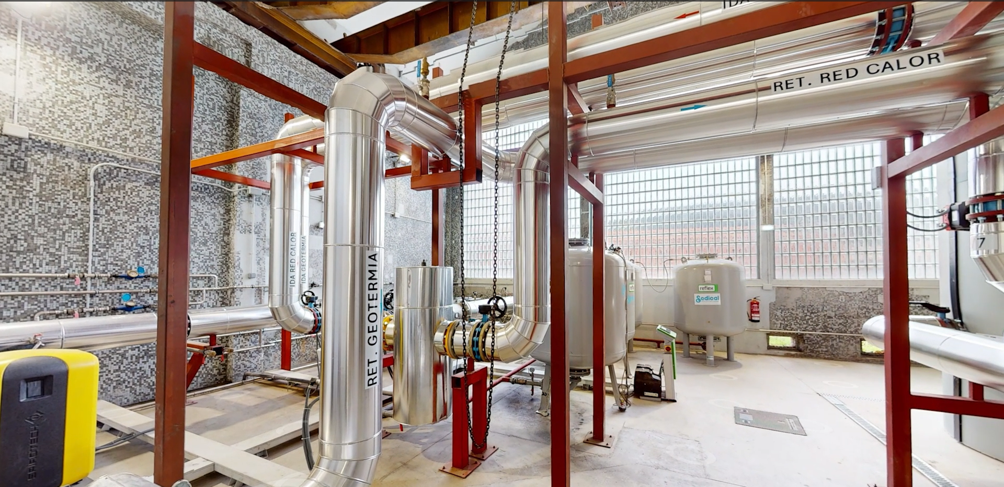
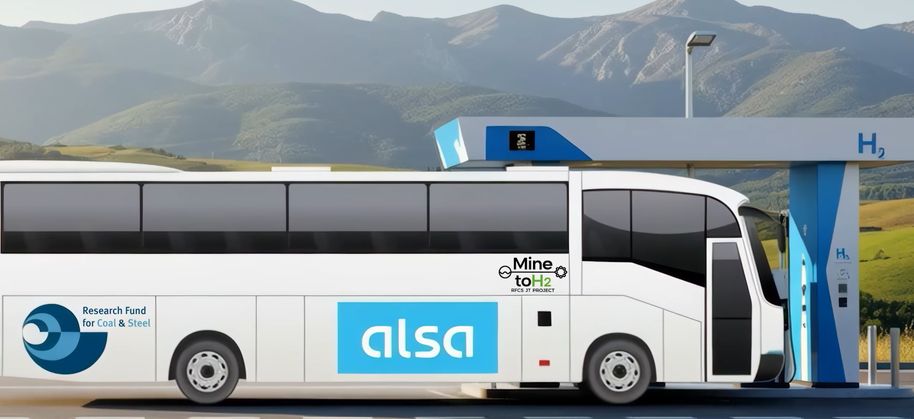
Mine-to-H2 Big Ticket project​
Notes:
To ensure the accessibility of this presentation to blind users who use a screen reader,
if you translate this presentation or include parts not in English, make sure the proofing language is set to the right one (Review > Language > Set proofing Language). This will make sure the screen reader uses the right pronunciation.

Slide 10
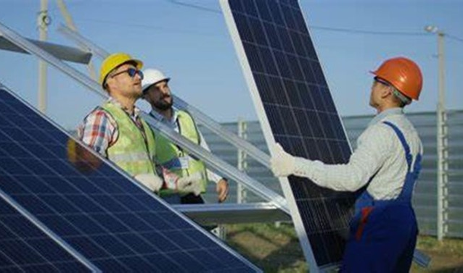
Main results 3/4
Training and re-skilling programmes addressing the skill gaps of former coal mining workers to facilitate the development of the business alternatives.
Notes:
To ensure the accessibility of this presentation to blind users who use a screen reader,
if you translate this presentation or include parts not in English, make sure the proofing language is set to the right one (Review > Language > Set proofing Language). This will make sure the screen reader uses the right pronunciation.

Slide 11
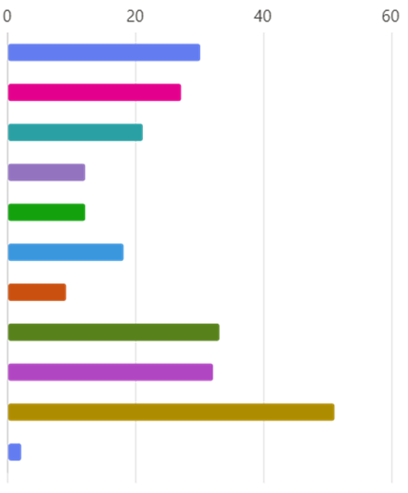
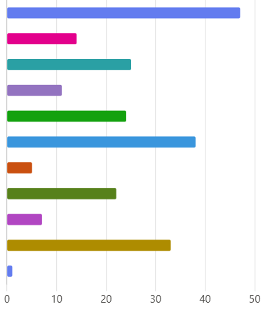

What factors influence the acceptance of lower wages?
Long-term job security
Better working environment and reduced occupational risks
Career develop. and promotion prospects
Access to training and opportunities to improve skills
Additional benefits e.g.: additional health insurance, additional holidays, etc.
Shorter travel time and convenient location
Access to retraining support and mentoring programs from the employer
Possibility of flexible working hours and better conditions for family life
Personal job satisfaction, sense of professional fulfillment
I do not accept a lower salary
Others
SLOVENIA
POLAND
Notes:
To ensure the accessibility of this presentation to blind users who use a screen reader,
if you translate this presentation or include parts not in English, make sure the proofing language is set to the right one (Review > Language > Set proofing Language). This will make sure the screen reader uses the right pronunciation.

Slide 12
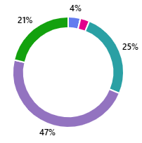
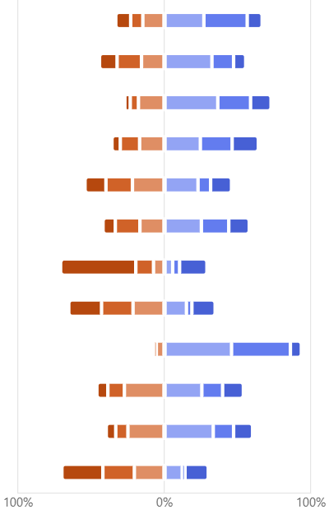
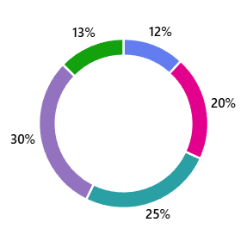
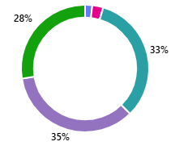
What influence flexibility of mine workers?
Very low impact Low impact Negligible, moderate impact High impact
Family situation / family care
Usefulness of current skills in a new job related to the “Green” economy and technologies
Health status
Ability to learn about and use new technologies
Lack of job opportunities in the local labor market
Lack of offers compatible with my education
Lack of experience / insufficient experience
Lack of contacts and connections
Gender discrimination
Readiness to work in a changing work environment
Poor professional background
Low salary offered
Lack of relevant certificates and authorisations
Age
Lack of experience in the recruitment process (lack of skills in preparing CVs, conducting interviews)
1 - poor
2
3
4
5 - excellent
100%
0%
100%
Notes:
To ensure the accessibility of this presentation to blind users who use a screen reader,
if you translate this presentation or include parts not in English, make sure the proofing language is set to the right one (Review > Language > Set proofing Language). This will make sure the screen reader uses the right pronunciation.

Slide 13
Occupational mapping
across the RES value chain
Given the technological diversity and varying maturity levels across renewable energy domains, including
geothermal energy,
photovoltaic (PV) / solar energy,
wind power (onshore and offshore),
unconventional pumped hydro,
battery systems,
green hydrogen
the occupational landscape of RES is inherently multidimensional.
ESCO = European Skills, Competences, Qualifications and Occupations
Mining Occupation | Closest RES Occupation | RES Sector | Justification (based on ESCO)
Mining electrician | Geothermal technician / Solar technician / Wind farm technician | a, b, c | Overlap in electrical maintenance, safety procedures, troubleshooting
Mine manager | Renewable energy engineer / HSE manager / Plant manager | all | Leadership, project management, safety, financial optimization
Quarry manager | Solar/wind/hydro plant operator | b, c, d | Site operations, safety, equipment management, environmental impact
Underground miner | Battery assembler / Solar installer / Hydro technician | b, d, e | Equipment operation, minor repairs, physical endurance
Surface mine plant operator | Wind farm technician / Solar field technician | b, c | Machine operations, inspection, troubleshooting
Heavy equipment operator | Offshore energy technician / Wind technician | c, d | Hydraulic/pump operation, mechanical systems, maintenance
Shotfirer | Hydro plant operator / Battery assembler (safety focus) | d, e | Safety, electrical knowledge, risk mitigation, explosives-related safety skills
Occupational mapping of some mining jobs across the RES value chain
Notes:
To ensure the accessibility of this presentation to blind users who use a screen reader,
if you translate this presentation or include parts not in English, make sure the proofing language is set to the right one (Review > Language > Set proofing Language). This will make sure the screen reader uses the right pronunciation.

Slide 14
Training & re-skilling programmes
Key Occupation | Training Programme | Mining Profile | EQF Level | Training Description | Modules / Microcredentials
Wind Turbine Assistant | Assistant in Wind Turbine Ground Operations | General plant assistant, shaft worker | 2–3 | Basic training for supporting wind turbine operations at ground level, including logistics and safety. | • Basic wind safety and PPE (personal protective equipment) • Manual handling and logistics • Ground signal communication
Maintenance Technician | Wind Turbine Maintenance Technician | Electrical or mechanical maintenance worker | 4 | Training in troubleshooting and maintaining mechanical/electrical systems in wind turbines. | • Electrical systems basics • Mechanical diagnostics • Preventive maintenance routines
Rotor Blade Inspector | Blade Damage Inspection and Minor Repairs | Surface technician, mechanical assistant | 4 | Specialised training for visual and ultrasonic inspection of rotor blades and minor structural repairs. | • Blade inspection techniques • Composite repair methods • Working at height certification
Wind Project Supervisor | Supervisor for Onshore Wind Farm Operations | Foreman, crew coordinator | 5 | Planning, supervising, and reporting on wind turbine installation and maintenance tasks. | • Project coordination • Health and safety leadership • Technical documentation
Advanced Wind Energy Technician | Advanced Design and Integration of Wind Energy Systems | Requires prior engineering background | 5 | Advanced technical training in wind turbine system optimisation, including SCADA-based monitoring, performance improvement, and integration into electrical networks. Focus on practical design tools and operational data analysis | •SCADA systems and performance data analysis (Supervisory Control and Data Acquisition) •Grid connection and compliance •Wind farm layout and optimisation tools
Programme Title | Assistant in Wind Turbine Ground Operations
Key Occupation | Wind Turbine Assistant
Target Mining Profile | General Plant Assistant, Shaft Worker
Renewable Energy Sector | Wind Energy
EQF Level | 2–3
Total Duration | 120 hours (4 weeks full-time / 8 weeks part-time)
Delivery Mode | Hybrid (Online + In-Person Practical Training)
Certification | 3 Microcredentials (1 per module)
Training Objectives | 1. Enable safe, effective ground-level support in wind energy operations. 2. Facilitate the transition of coal workers to the renewable sector. 3. Provide stackable training for progressive upskilling.
Learning Outcomes | 1. Use PPE and follow wind farm safety protocols. 2. Assist in logistics and manual handling of components. 3. Apply ground signalling techniques to coordinate with technical teams.
Assessment Methods | 1. Knowledge Test (30%) 2. Practical Demonstration (40%) 3. Team-Based Scenario (30%)
Recognition of Prior Learning (RPL) | Available for relevant mining experience in safety procedures and logistics operations.
Progression Pathway | Leads to mid-level training (e.g. Wind Turbine Technician – EQF 4)
Module Title | Description | Duration | Key Competencies Acquired | Microcredential Awarded
Wind Energy Training Programmes
EQF = European Qualifications Framework
Example of a training plan designed for the wind energy sector
Notes:
To ensure the accessibility of this presentation to blind users who use a screen reader,
if you translate this presentation or include parts not in English, make sure the proofing language is set to the right one (Review > Language > Set proofing Language). This will make sure the screen reader uses the right pronunciation.

Slide 15
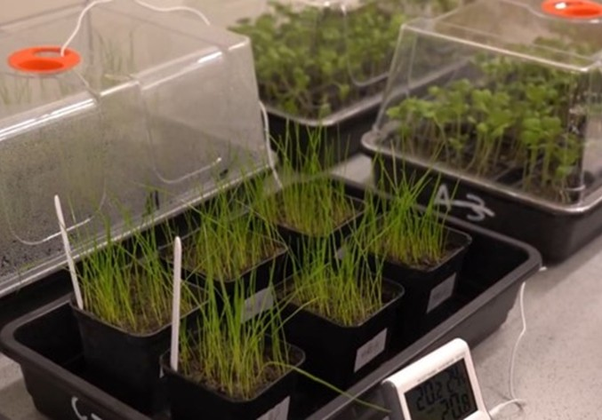
Main results 4/4
Three circular economy technologies:
The development of soil substitutes to restore waste heaps before installing photovoltaic/wind.
The development of unconventional pumped hydro energy storage.
The recovery of rare earths, critical raw materials for the EU.
Notes:
To ensure the accessibility of this presentation to blind users who use a screen reader,
if you translate this presentation or include parts not in English, make sure the proofing language is set to the right one (Review > Language > Set proofing Language). This will make sure the screen reader uses the right pronunciation.

Slide 16
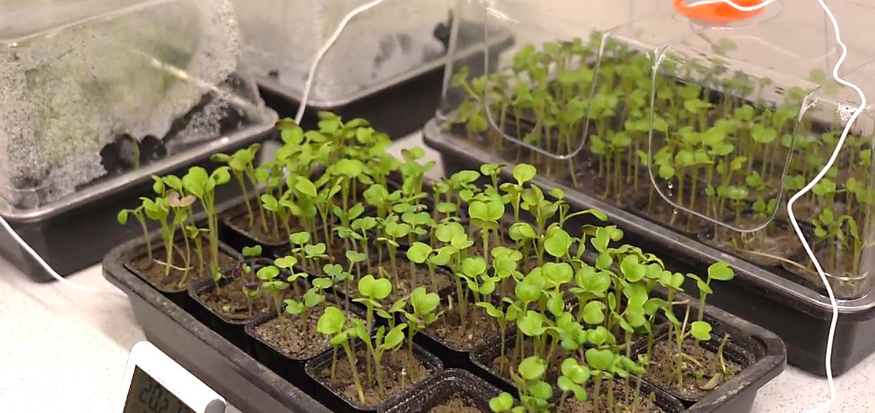
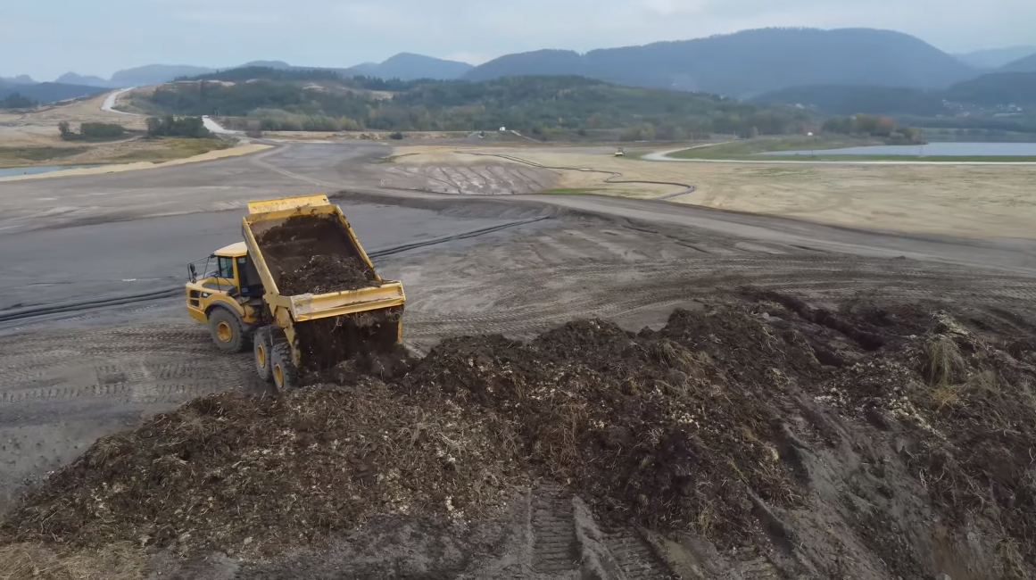
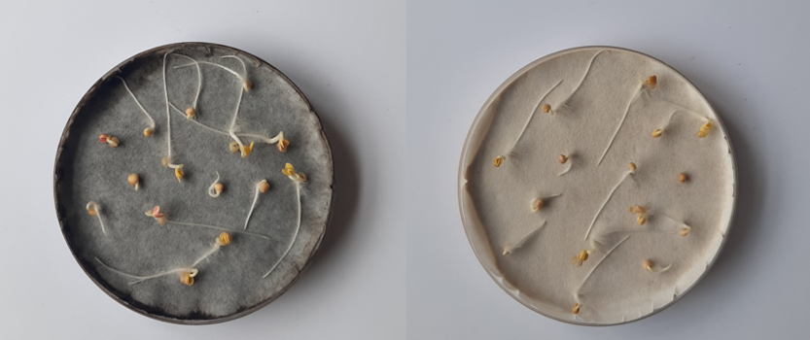
Development of soil substitutes to restore waste heaps in Slovenia ​
Soil substitutes for the reclamation of post-mining areas
Notes:
To ensure the accessibility of this presentation to blind users who use a screen reader,
if you translate this presentation or include parts not in English, make sure the proofing language is set to the right one (Review > Language > Set proofing Language). This will make sure the screen reader uses the right pronunciation.

Slide 17
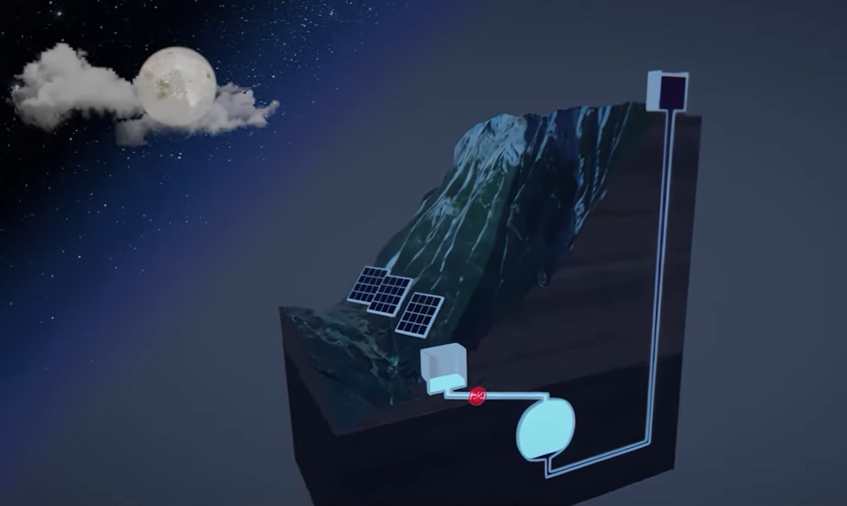
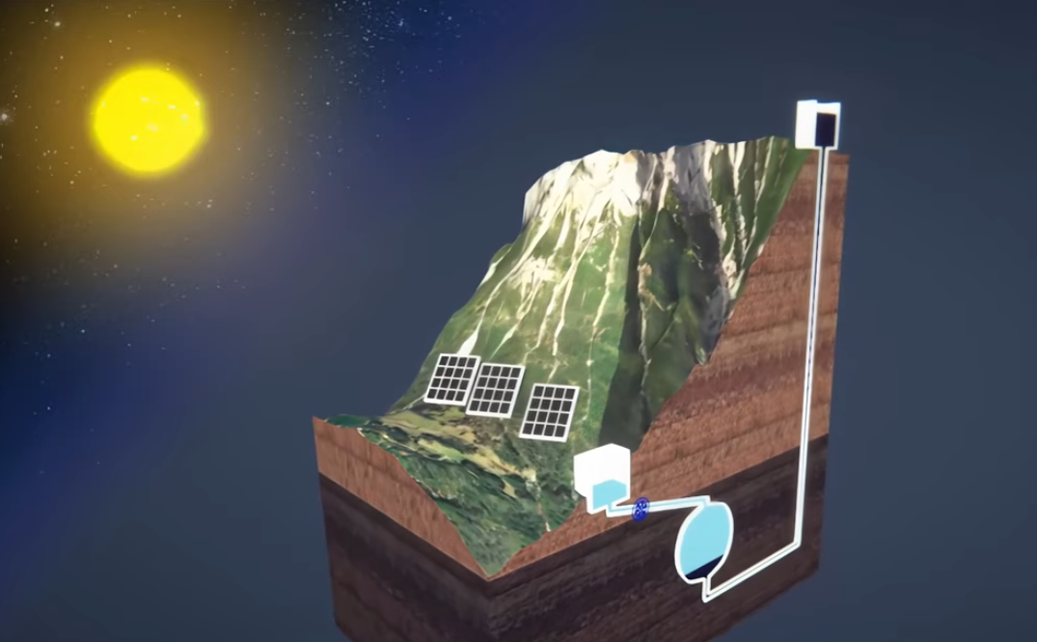
Development of unconventional pumped hydro energy storage using dense fluids​
First, energy storage will be obtained by pumping water into the cavern with renewable energy when it has lower prices. The water pushes the dense fluid towards the upper tank.
Second, energy recovery will be achieved by releasing dense fluid, which pushes the water in the cavern through the turbine.
Notes:
To ensure the accessibility of this presentation to blind users who use a screen reader,
if you translate this presentation or include parts not in English, make sure the proofing language is set to the right one (Review > Language > Set proofing Language). This will make sure the screen reader uses the right pronunciation.

Slide 18
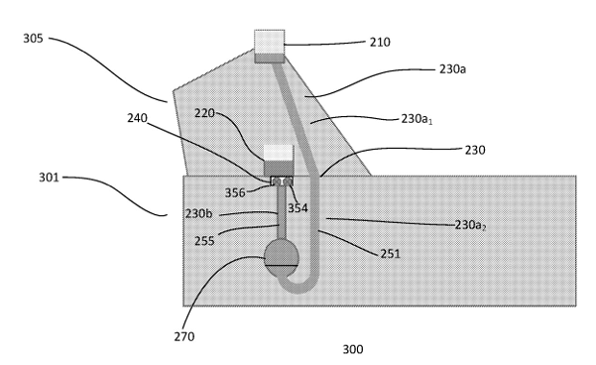
Development of unconventional pumped hydro energy storage using dense fluids ​
Poland and Spanish patents EP 3 768 967 on a “Pumped Hydro Energy Storage System and Method” were granted to Magellan & Barents, partner of the GreenJOBS Project, to support the adoption of Unconventional pumped hydro storage by Polish and Spanish mining companies interested in this energy storage alternative within the exploitation plan of the GreenJOBS Project (Patent Office of the Republic of Poland and Spanish Patent and Trademark Office, November 2024).
Notes:
To ensure the accessibility of this presentation to blind users who use a screen reader,
if you translate this presentation or include parts not in English, make sure the proofing language is set to the right one (Review > Language > Set proofing Language). This will make sure the screen reader uses the right pronunciation.

Slide 19
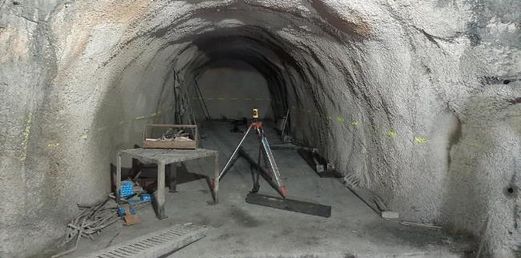
Development of unconventional pumped hydro energy storage using dense fluids ​
DenStorMine project:
Large scale energy storage in coal mines using dense fluids from inert mine waste.
Design outline of the confiner
Detail of the finished slab, where the reinforcement and sealing of the gallery can also be seen
Notes:
To ensure the accessibility of this presentation to blind users who use a screen reader,
if you translate this presentation or include parts not in English, make sure the proofing language is set to the right one (Review > Language > Set proofing Language). This will make sure the screen reader uses the right pronunciation.

Slide 20
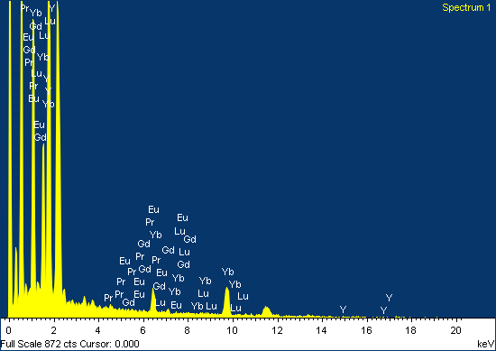
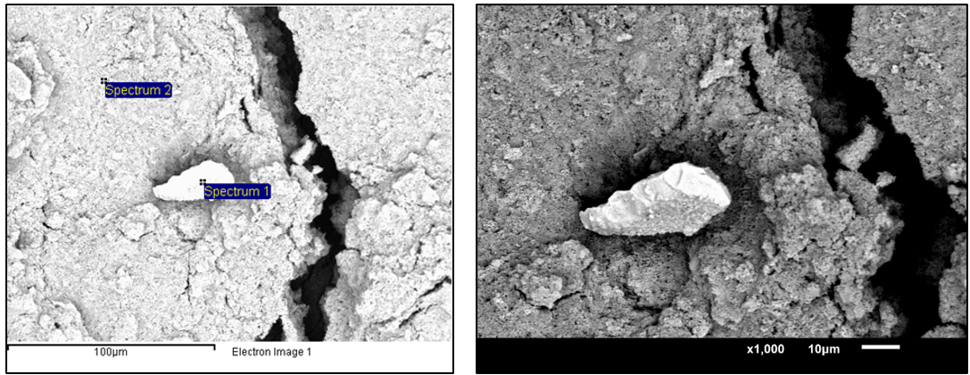
The recovery of rare earths, critical raw materials for the EU​
Rare earth concentrations from coal wastes range from 150-310 ppm (0.015-0.031%). For a mine to be mineable, concentrations between 1 and 2% are required. This suggests that the amount of rare earths present in the waste heaps is too low to be economically viable.
Mechanical separation methods, such as granulometric concentration, gravimetric, magnetic, and electric separators, and froth flotation, were used.
We are currently testing hydrometallurgical concentration; however, the results are not yet available.
Scanning electron microscopy (SEM) images
X-ray energy dispersive spectrum (EDS) image of the “Spectrum 1”
Notes:
To ensure the accessibility of this presentation to blind users who use a screen reader,
if you translate this presentation or include parts not in English, make sure the proofing language is set to the right one (Review > Language > Set proofing Language). This will make sure the screen reader uses the right pronunciation.

Slide 21


The recovery of rare earths, critical raw materials for the EU​
The CRMsDataSpace project aims to create a Common European Data Space on Critical Raw Materials (CRMs) for the Green Deal, focusing on recovering valuable raw materials from closed extractive coal waste facilities. This seeks to enhance Europe’s autonomy in securing critical raw materials.
Notes:
To ensure the accessibility of this presentation to blind users who use a screen reader,
if you translate this presentation or include parts not in English, make sure the proofing language is set to the right one (Review > Language > Set proofing Language). This will make sure the screen reader uses the right pronunciation.

Slide 22

Thank you very much for your attention
www.greenjobsproject.eu
Notes:
To ensure the accessibility of this presentation to blind users who use a screen reader,
if you translate this presentation or include parts not in English, make sure the proofing language is set to the right one (Review > Language > Set proofing Language). This will make sure the screen reader uses the right pronunciation.

