Slide 1







New business models based on renewable energies: the example of the GreenJOBS project Nowe modele biznesowe oparte na energii odnawialnej: przykład projektu GreenJOBS
ADAPTACJA KOPALŃ DO PEŁNIENIA NOWYCH FUNKCJI – UWARUNKOWANIA PRAWNE, TECHNICZNE, SPOŁECZNE I ŚRODOWISKOWE
Dr hab. inż. Alicja Krzemień, prof. GIG-PIB

Slide 2



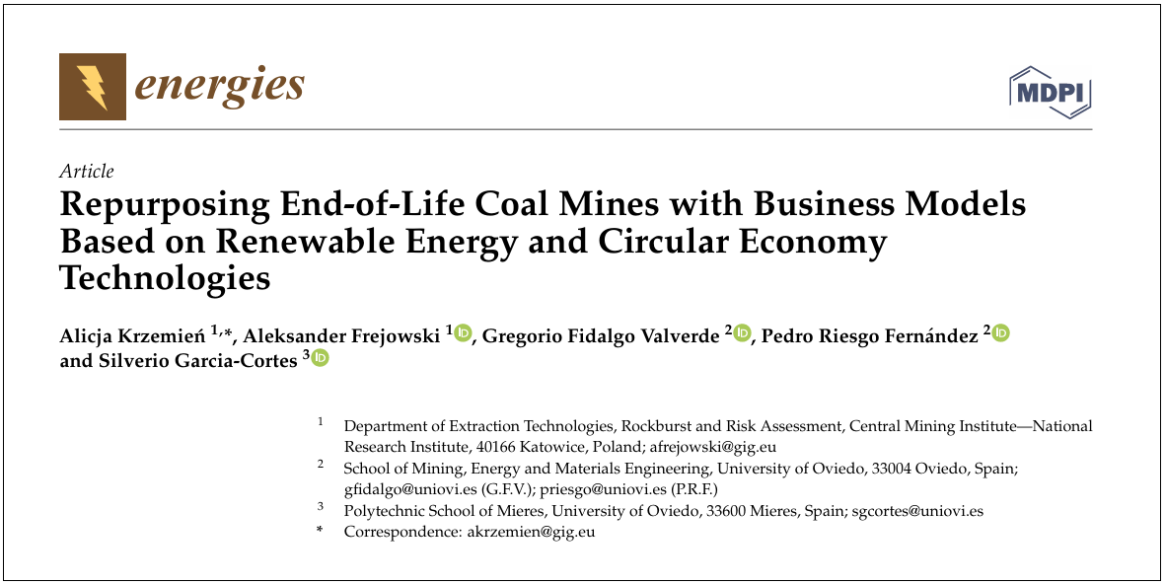

POTENTIALS Project
Synergistic POTENTIALS of end-of-life coal mines and coal-fired power plants, along with closely related neighbouring industries: update and re-adoption of territorial just transition plans
www.potentialsproject.eu

Slide 3
Aim of POTENTIALS
To identify and assess the synergistic opportunities of coupled end-of-life coal mine sites and coal-fired power plants by means of a prospective analysis, enabling to develop business models that rely on renewable energy, contribute to the circular economy or scale energy storage, guaranteeing a sustainable and combined use of assets and resources, and supporting the update and re-adoption of territorial just transition plans.
The partners of the project were: Główny Instytut Górnictwa (POLAND); VGB PowerTech e.V. (GERMANY); University of Oviedo (SPAIN); Centre for Research and Technology - Hellas (GREECE); Hulleras del Norte, S.A. (SPAIN); and Technische Hochschule Georg Agricola University (GERMANY).

Slide 4
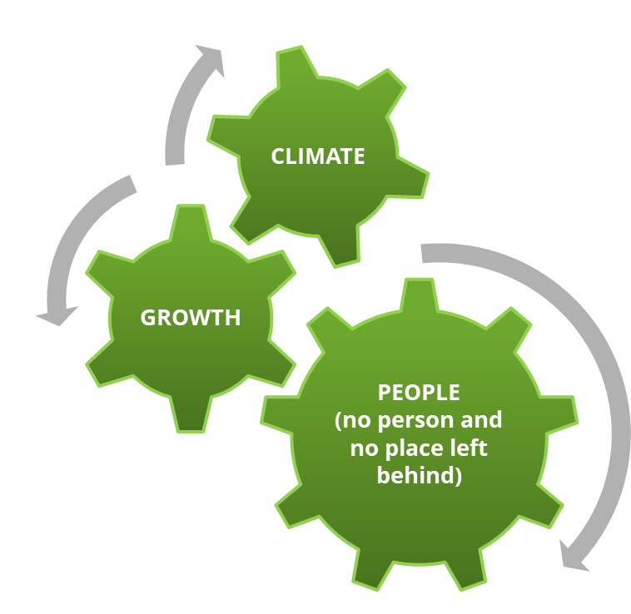
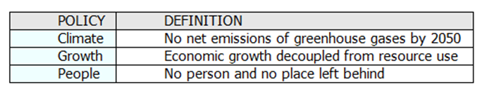
EU Green Deal policies
A justification approach was initially based on evaluating policies related to the European Green Deal and possible actions/micro-actions.

Slide 5
MENTIMETER on Actions and Micro-actions

Slide 6


Actions and Micro-actions
Virtual power plant
Green hydrogen plant
Eco-industrial park
Cultural heritage and sports/recreation areas
Floating PV panels at flooded open-pit coal mines
Fisheries in flooded open-pit mines
Combined-cycle gas turbine power plant (natural gas)
Mine gas utilization for gas-powered CHP power units
Small modular reactors
Biofules combustion energy plants
Moltens salt plant
Agrophotovoltaics at former open-pit coal mine areas
Ancillary services provided by batteries
Recovery of resources from coal mining waste heaps
Usage of CH₄ from degasification units in closed mines
Circular mining technologies for pumped water material recovery
Forest retoration at former open-pit coal mines
Large-scale IT infrastructure – power plant
Geothermal energy
Storage of energy using weights
Storage of energy using dense fluids
Storage of energy in mine shaft
ACTIONS
MICRO-ACTIONS

Slide 7
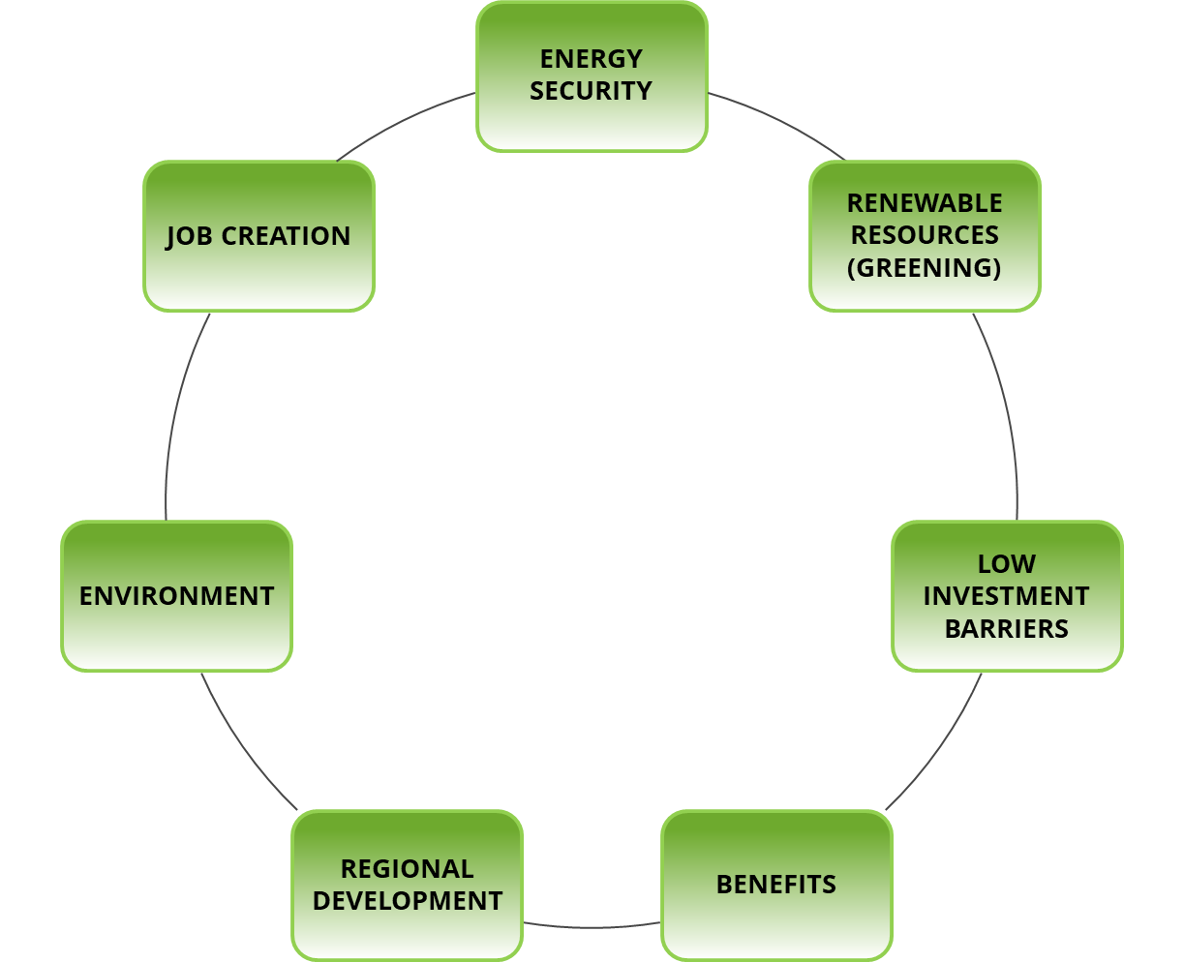
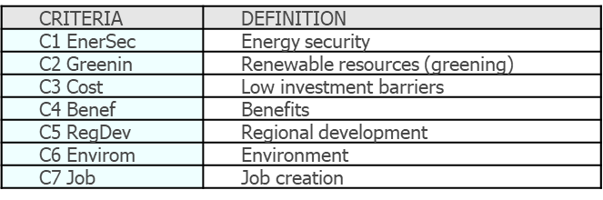
Criteria used for the evaluation
The evaluation criteria emanated from the goal and objectives of the study.

Slide 8
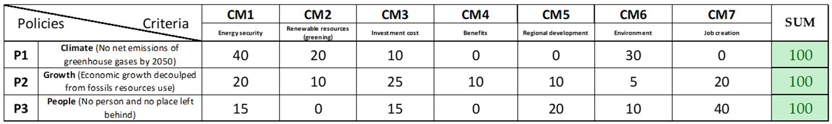
Evaluation of policies respect to criteria
Using MULTIPOL software (MULTIcriteria and POLicy, developed by the Institut d’Innovation Informatique pour l’Entreprise 3IE), matrix values were assigned. As this concerns the set of criteria weights, the row sum must always equal 100.

Slide 9
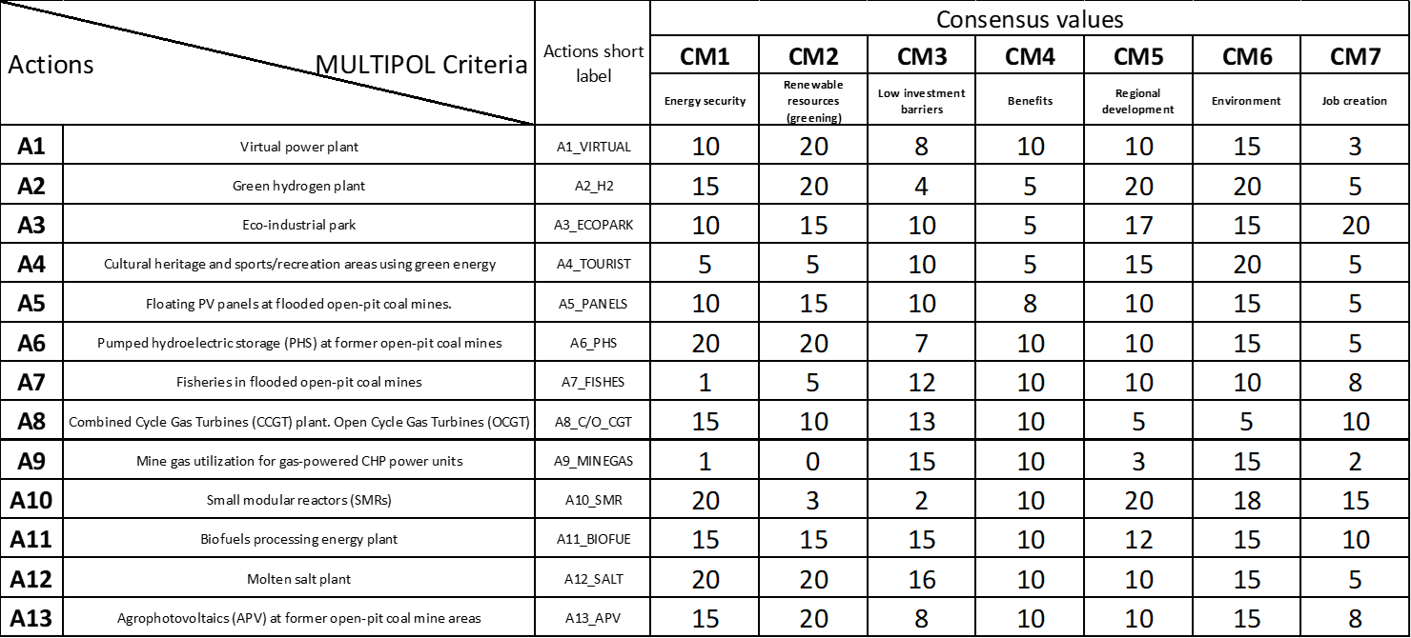
Evaluation of actions respect to criteria
Then, the scoring of actions with respect to criteria from 0 to 20 is made.

Slide 10
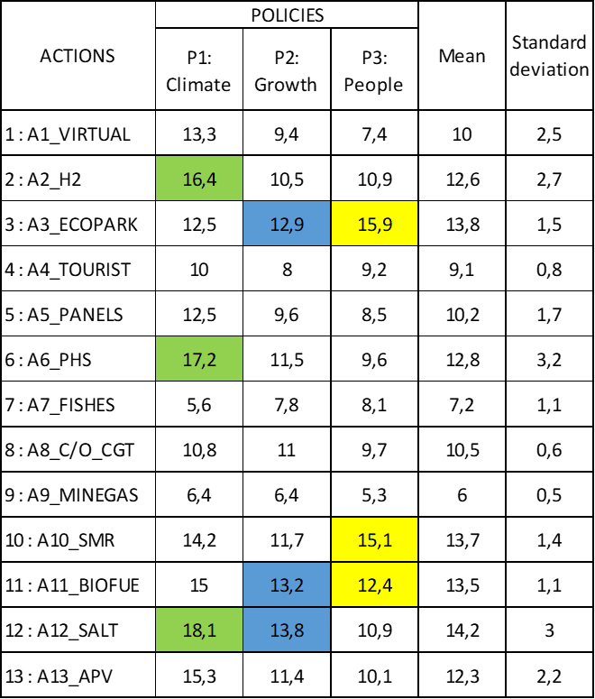
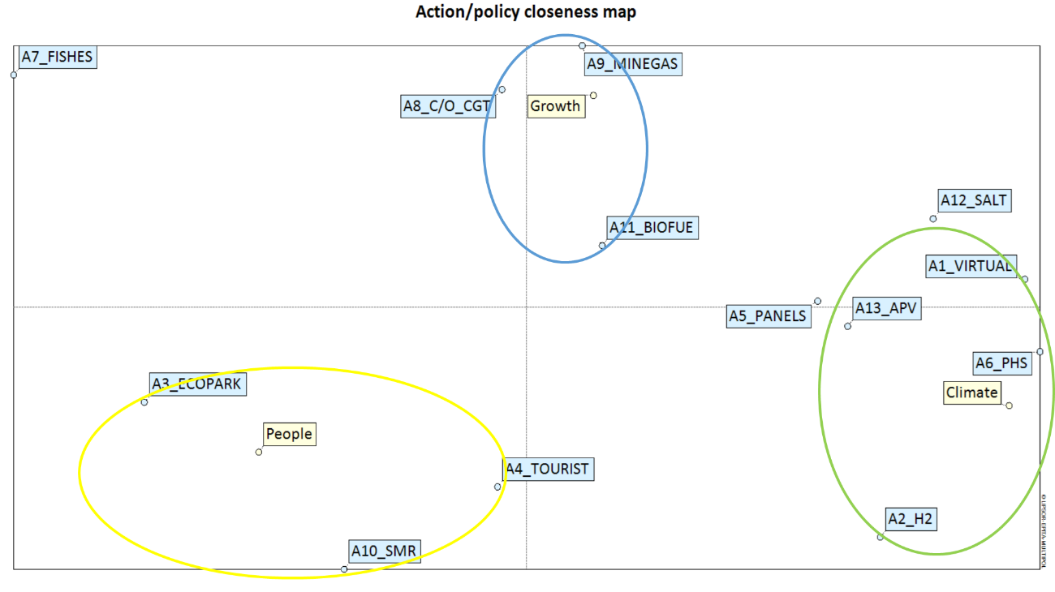
Evaluation of actions related to policies

Slide 11
Evaluation of micro-actions related to policies

Slide 12
Justifying the business models choice
Technical criteria or relevant variables for scenario development.
Technology Readiness Level (TRL), to assess the maturity of new technologies.
European taxonomy, which establishes environmentally sustainable economic activities.
Synergistic potential (mines, power plants and nearby industries).
Circular economy, which enables resources to maintain their highest value for as long as possible.
Sector coupling, to improve the efficiency and flexibility of energy systems.

Slide 13
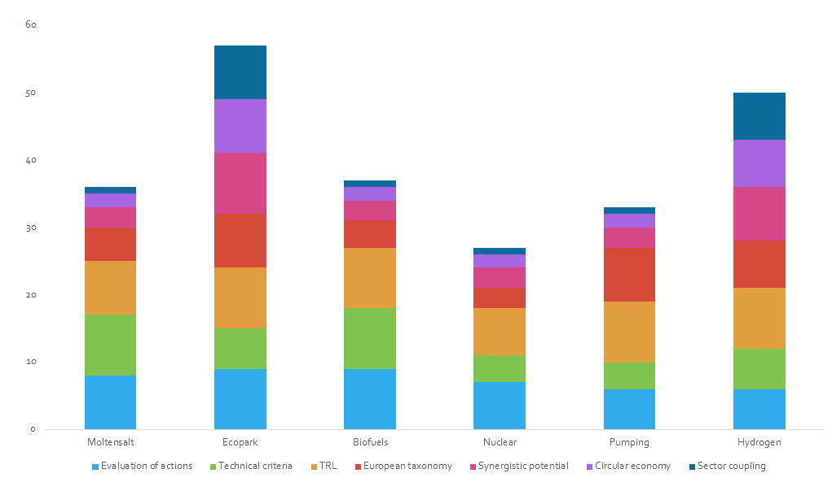
Business model choices
(actions)

Slide 14
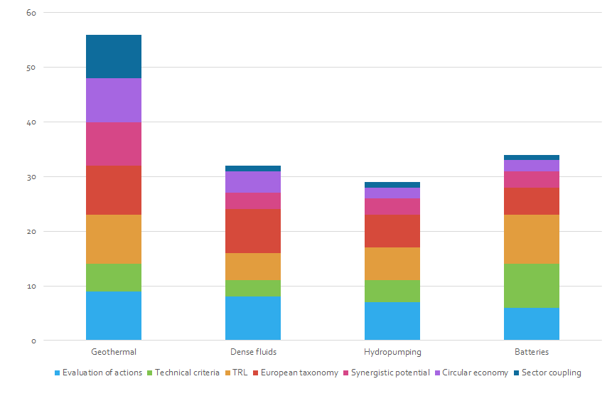
Business model choices
(micro-actions)

Slide 15
Eco-industrial park: the selected scenario
Eco-industrial parks (with virtual power plant) as an integrated alternative to be developed within coupled end-of-life coal mine sites and coal-fired power plants along with surrounding residential/industrial areas for sustainable renewable energy generation (geothermal and photovoltaic/wind), storage technologies, circular economy contributions and synergies for reducing waste and pollution by promoting short distance transport and optimising the park’s material, resource, and energy flows, producing the goods needed for the industrial transition in Europe and cooperating to its achievement.

Slide 16
Eco-industrial park: base and support
Eco-industrial parks should be based on district networks that allow multiple energy sources to be connected to various energy consumption points, helping to increase photovoltaic deployment by transforming heat and power energy customers into prosumers or customers with excess electricity from solar panels on their roofs. Eco-industrial parks should be supported by pursuing financial privileges and other benefits to boost and diversify the area’s economy, attracting external investment, such as tax exemptions for industries and access to preferential credits from national authorities, European Investment Bank, etc.
.

Slide 17
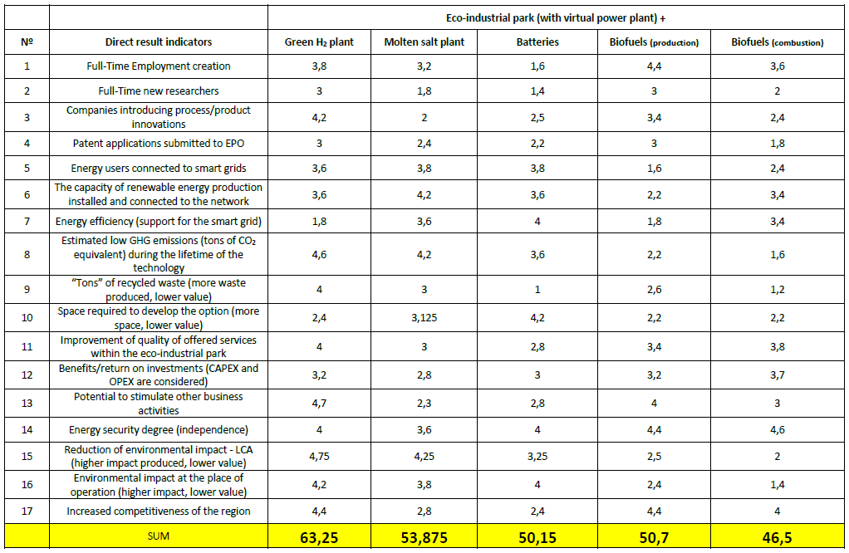
Business models result indicators

Slide 18
Operation envisaged by a just transition plan
Promote individual projects within the above-mentioned initiatives
Creation of innovation poles and centers using existing infrastructures, such as former coal mines
Lower
economic
reactivation
and fixing
of population
©
Artificial Intelligence (AI)
Higher economic
reactivation
and fixing
of population
Project 1
Project 2
Agri-food industry
Data storage, valorization and cybersecurity
Industrial innovation

Slide 19
An initiative that stimulates the regional economy and maintains employment
Circular economies
Virtual Power Plant with geothermal
Eco-industrial parks
Financial privileges
Green hydrogen & RE storage
Reducing waste & pollution

Slide 20
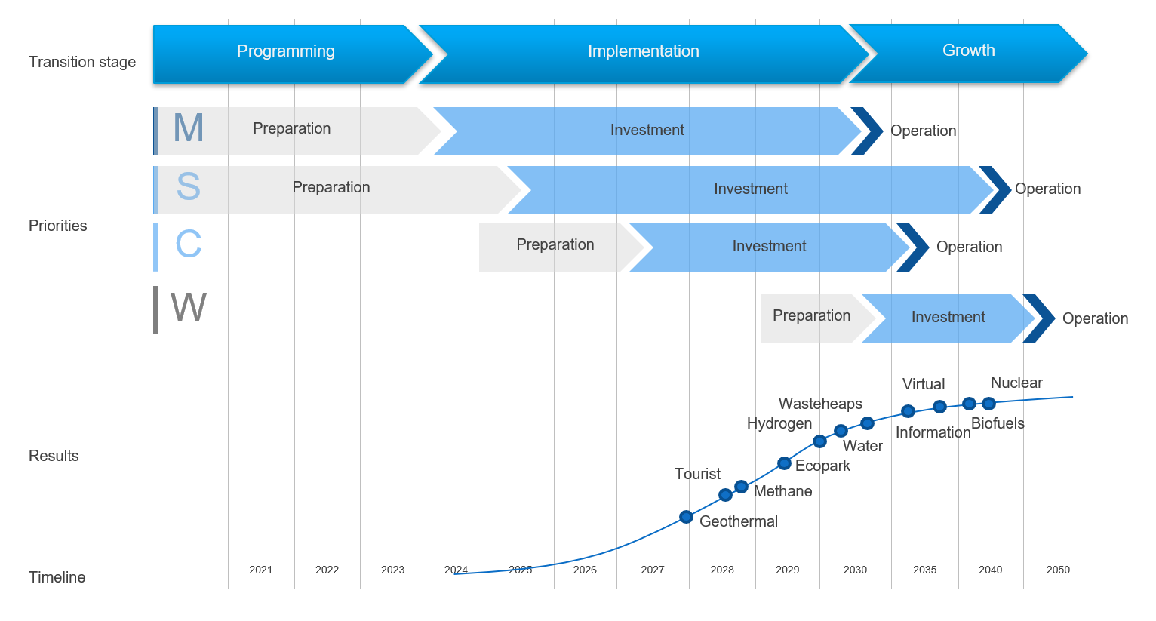
Roadmap
Evaluation against
operational objectives:
MoSCoW
Must (60%)
Should & Could (20%)
Won’t

Slide 21
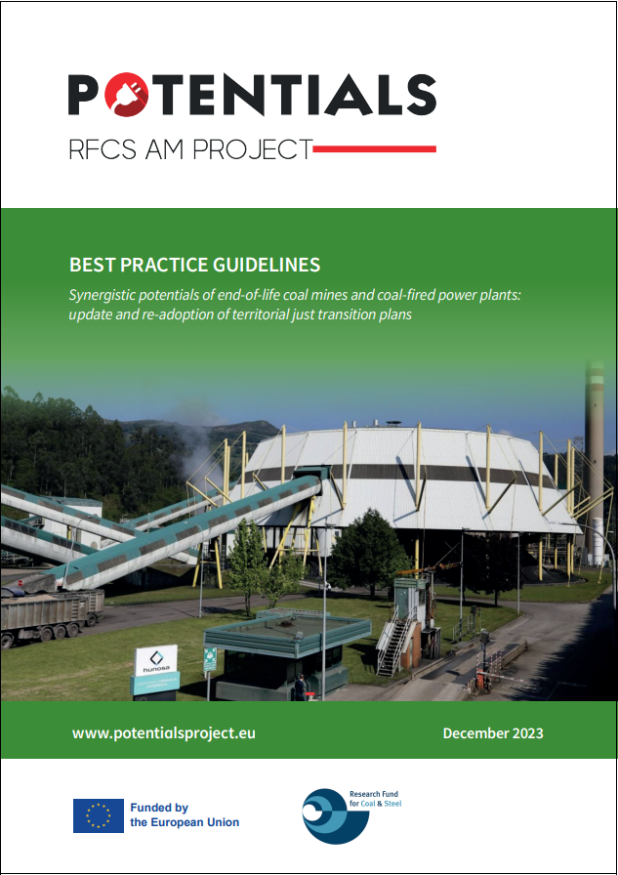
Best practice guidelines
https://potentialsproject.uniovi.es/wp-content/uploads/2024/02/POTENTIALS_BEST-PRACTICE-GUIDELINES.pdf

Slide 22
Conclusions
The prioritisation of business models concerning the goals of a territorial just transition plan indicates that the most desirable models during the plan’s update phase will be those aiming to establish or transform existing eco-industrial parks in the region.
Combining sustainable energy generation technologies with energy storage in a single business model, integrated with economic activities and projects, presents a unique opportunity for employment growth and innovation in the region.

Slide 23
Conclusions
Without the integration of energy production, areas used for tourism and/or recreational activities are not self-sustaining and challenging to maintain. Introducing sustainable energy-related solutions can lead to increased interest and better utilisation of such areas, not only for tourism purposes but also for economic development.
The energy transformation of regions requires the provision of new energy production and storage sources. One of the recommended solutions in feasibility studies is introducing a green hydrogen plant where renewable hydrogen will be produced through electrolysis of mine water and electricity from renewable sources.

Slide 24
Conclusions
The potential of the areas and the existing infrastructure favour such a solution, which would achieve employment and economic revitalisation goals and promote environmentally friendly mobility and new R&D directions.
Finally, it is essential to consider diverse business models based on sustainable development principles, eco-innovation, circular economy models, or clean technology-based models. Collaboration and dialogue among stakeholders, including entrepreneurs, government institutions, and civil society organisations, are crucial to ensure that business models are well integrated in the update of the Just Transition Plan.

Slide 25


GreenJOBS Project
Leveraging the competitive advantages of end-of-life underground coal mines to maximise the creation of green and quality jobs.
www.greenjobsproject.eu

Slide 26
Problems tackled by GreenJOBS
Before GreenJOBS, there was no guidance focused on operating underground coal mining companies to understand, evaluate, design, and implement alternative economic activities within their future closing period, i.e., to have a holistic and long-term approach:
Leaving behind short-term patchwork.
Promoting sustainable local economic growth.
Maximising the number of green and quality jobs.

Slide 27
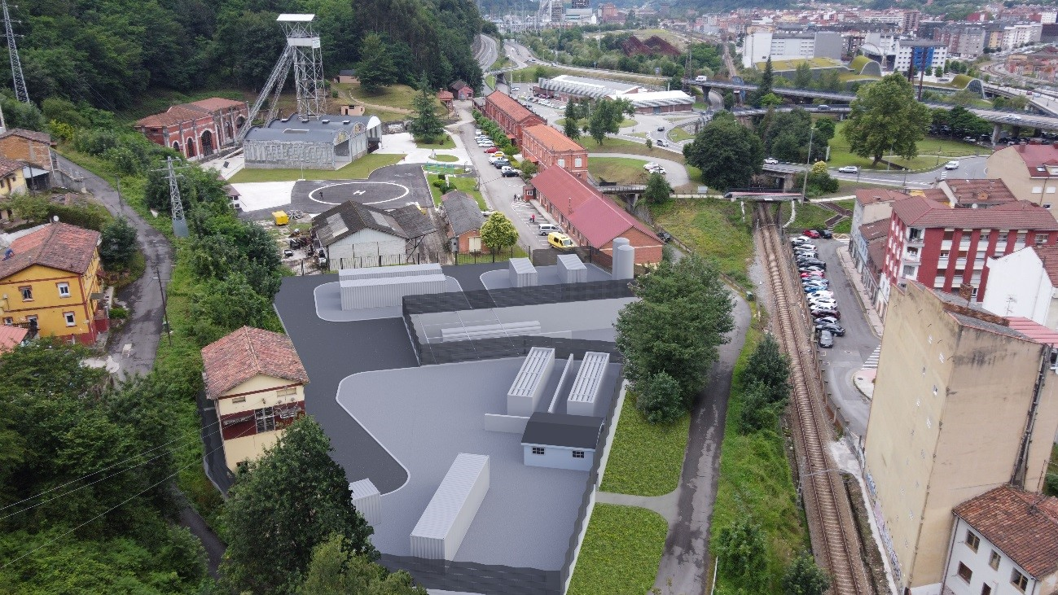
Problems tackled by GreenJOBS
There were no studies on repurposing end-of-life underground coal mines, leveraging their competitive advantages:
Mine water.
Connections to the grid.
Large waste heap areas.
Very deep shafts and galleries.
Fine coal waste.

Slide 28
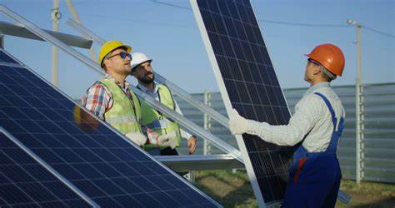
Main objectives
To develop for coal mining companies innovative business plans for deploying emerging renewable energy and circular economy technologies to facilitate their exploitation.
To plan and disseminate among mining companies and regional authorities in the coal regions in transition, training and re-skilling programmes addressing former coal mining.

Slide 29
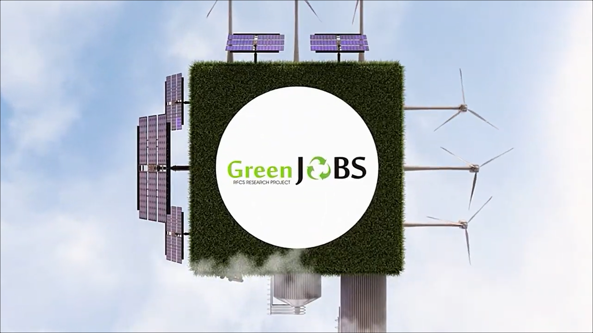
GreenJOBS video
https://www.youtube.com/watch?v=qPC7ojdDPrc

Slide 30
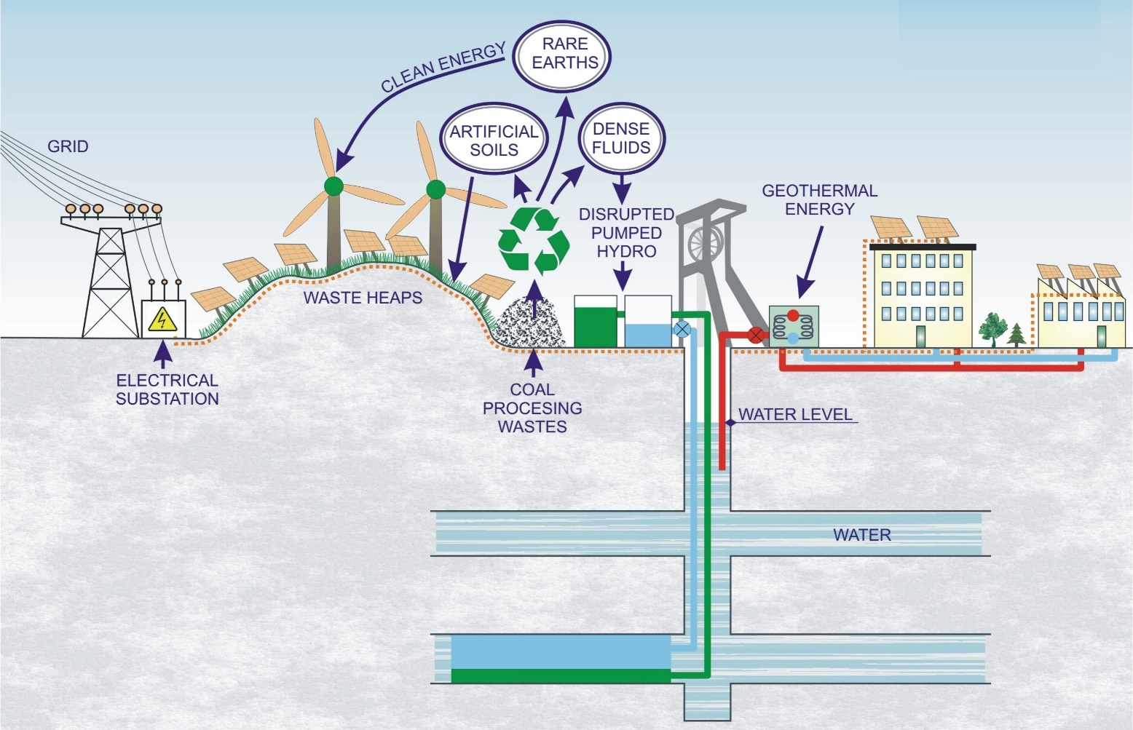
Main results
Two innovative business plans:
A Virtual Power Plant where the energy locally produced will be sold to the grid or used to power industries or companies close to mines.

Slide 31
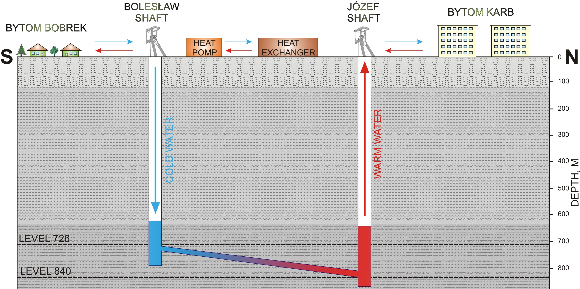
The Bobrek – Piekary mine
The temperature of the mine water is more than 25 °C, with a pumping capacity: > 5,000 m³/day

Slide 32
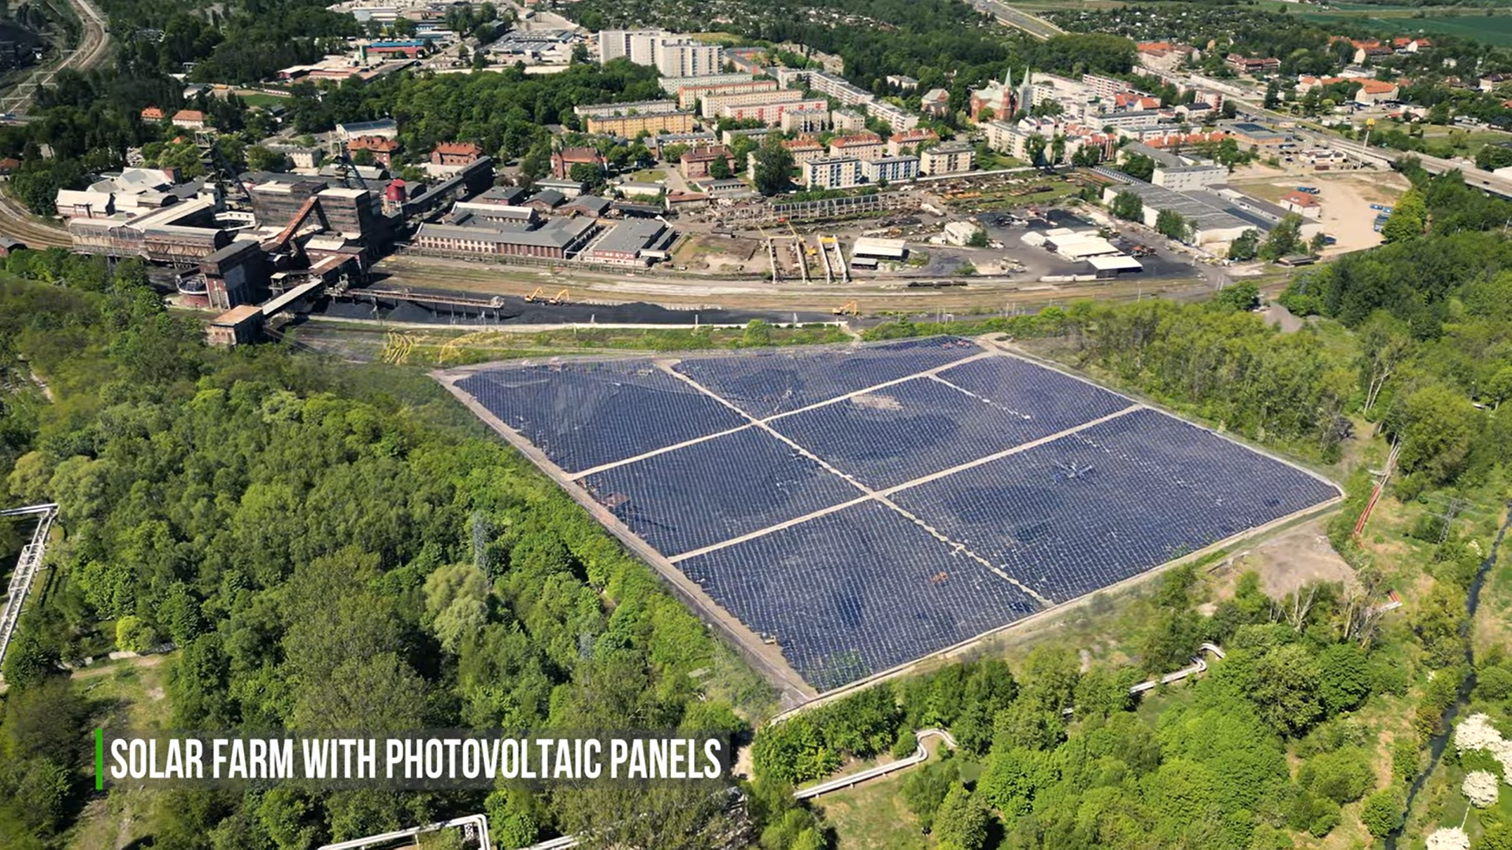
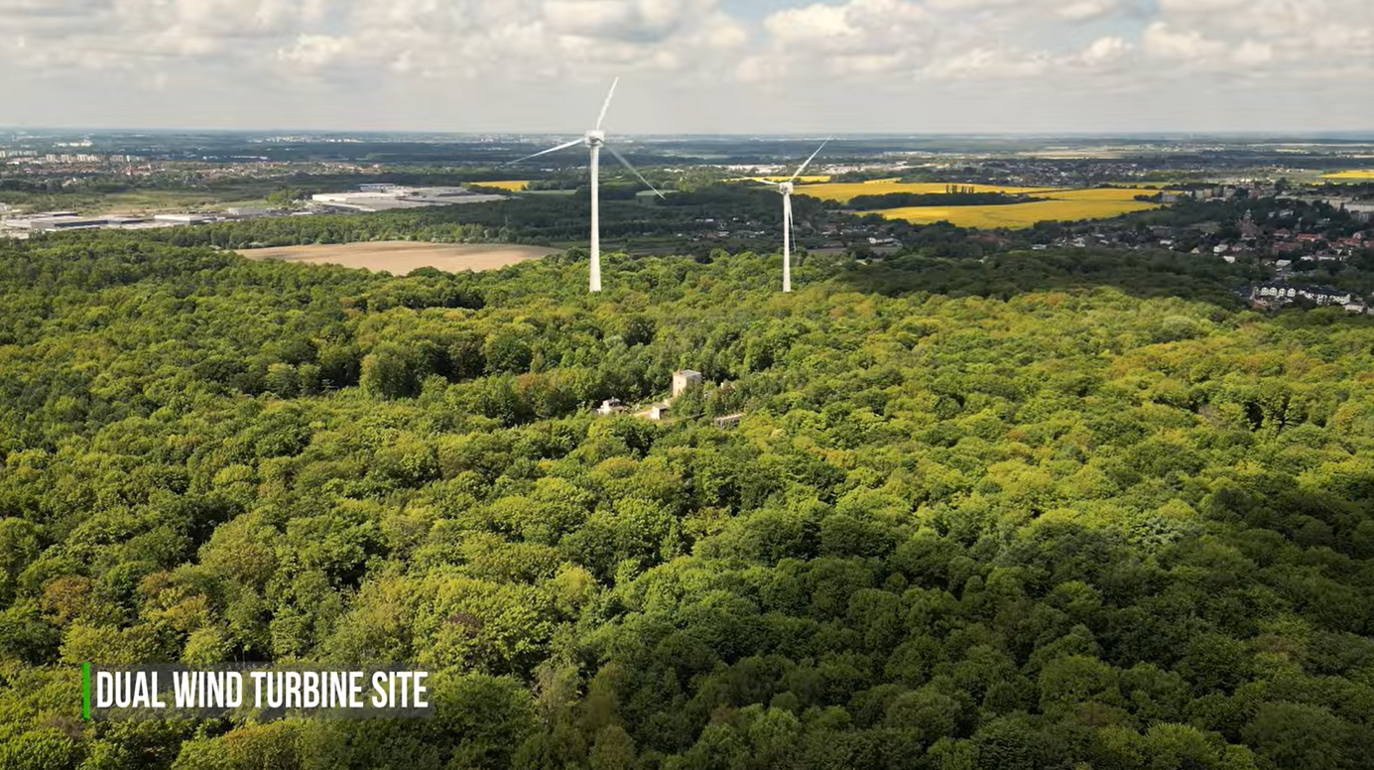
The Bobrek – Piekary mine
Ignacy Shaft of Bobrek mine
Bobrek coal mine

Slide 33
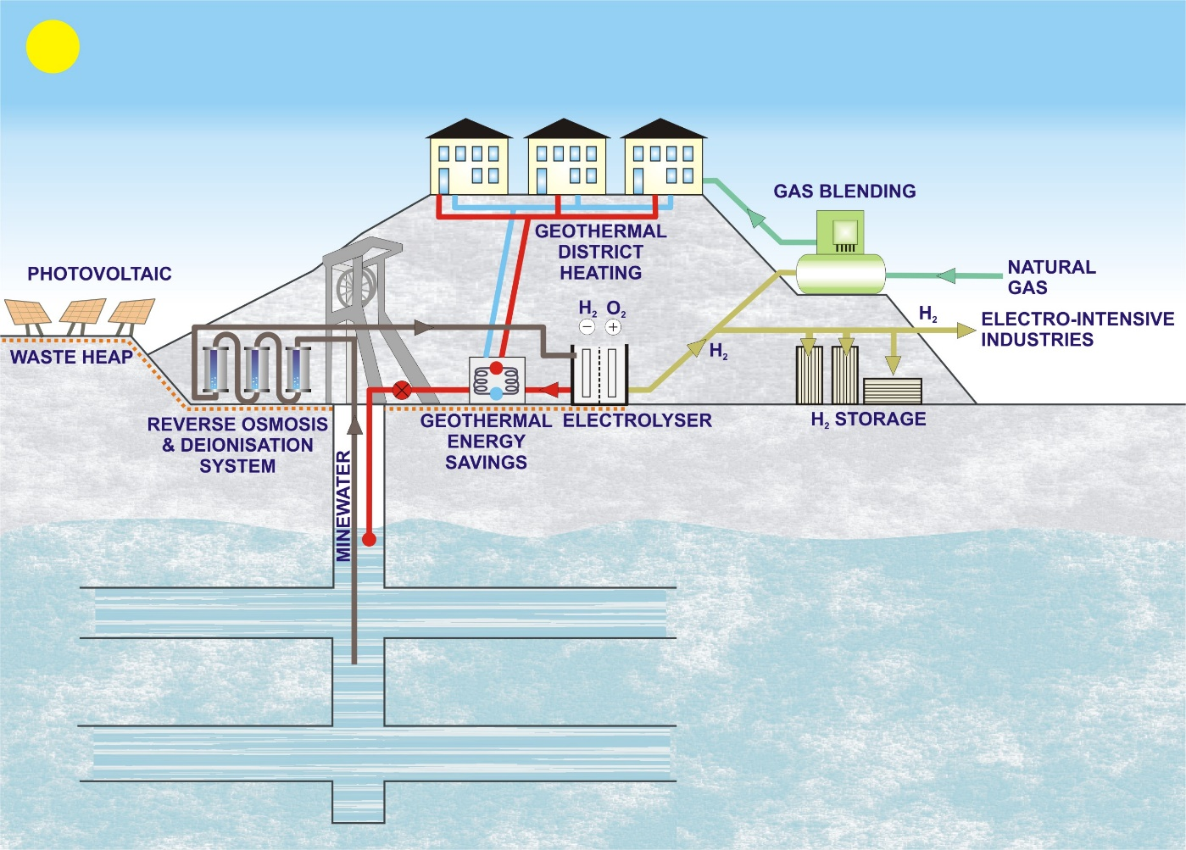
Main results
Two innovative business plans:
A Green Hydrogen Plant where renewable hydrogen will be produced by electrolysis of mine water and green electricity.

Slide 34
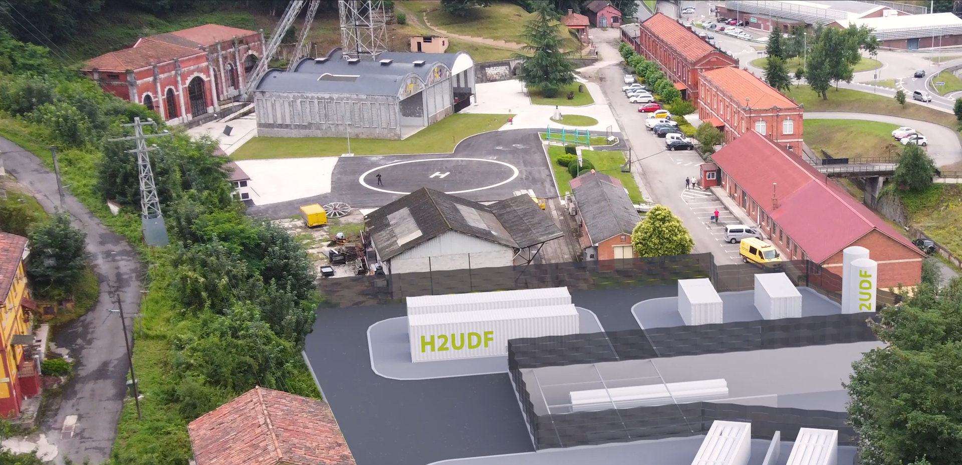

Mine-to-H2 Big Ticket project
The Mine-to-H2 Big-ticket project will repurpose a former coal mine through a 2.5 MW Green Hydrogen Plant, where green hydrogen for the passenger road transport sector will be produced using circular economy actions.

Slide 35
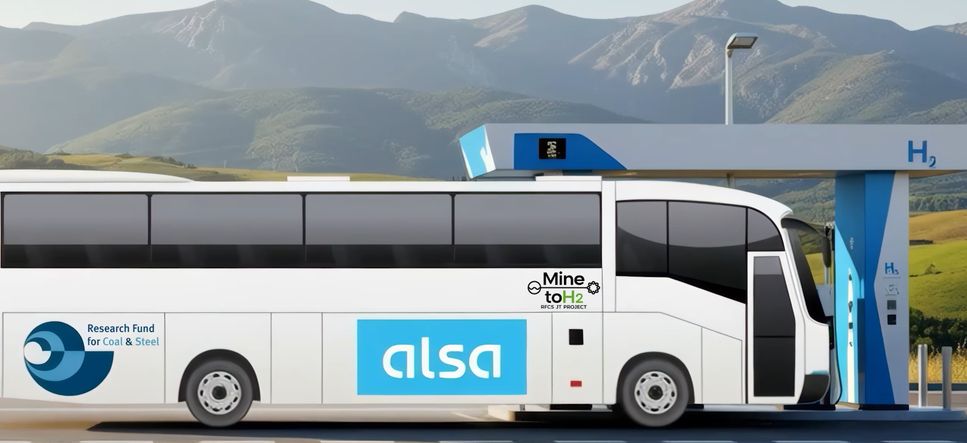
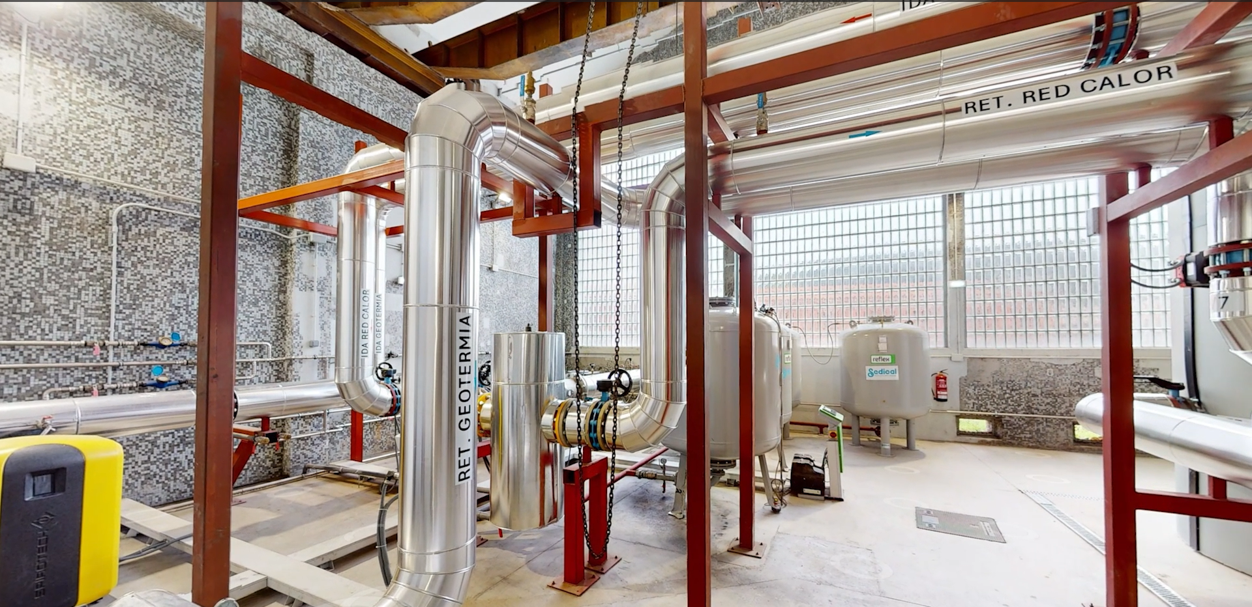
Mine-to-H2 Big Ticket project

Slide 36
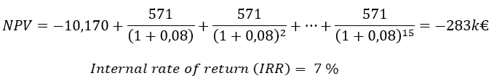
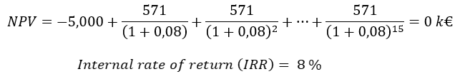
Mine-to-H2 Big Ticket project
The economic assessment of hydrogen production via electrolysis showed that the investment is not feasible unless a specific subvention of at least 50% is obtained for developing the Green Hydrogen Plant.

Slide 37
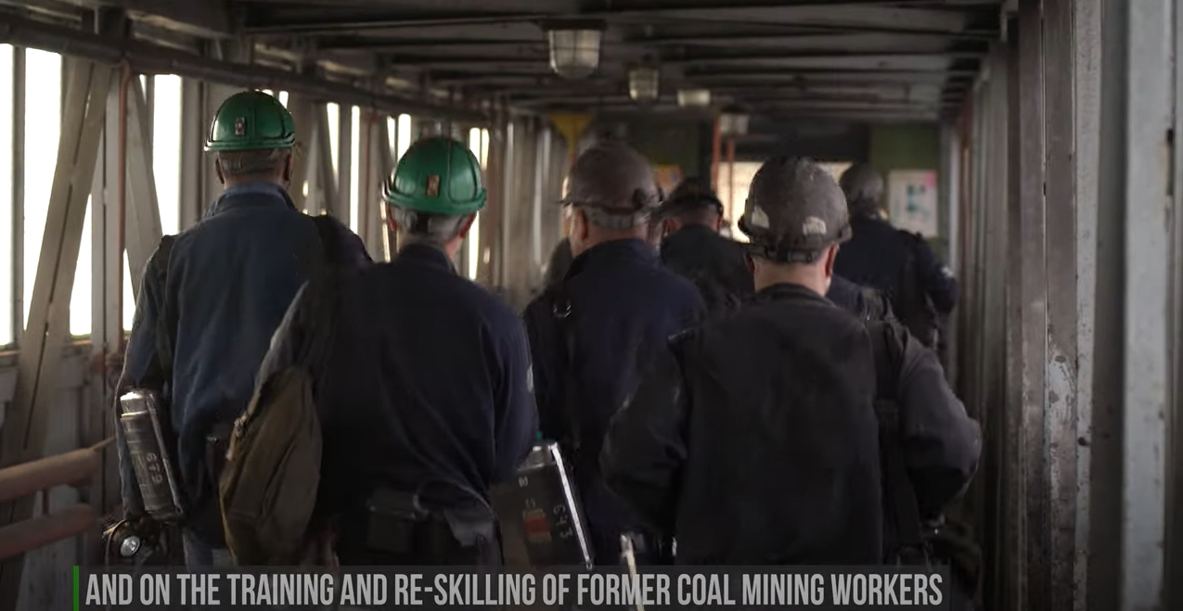
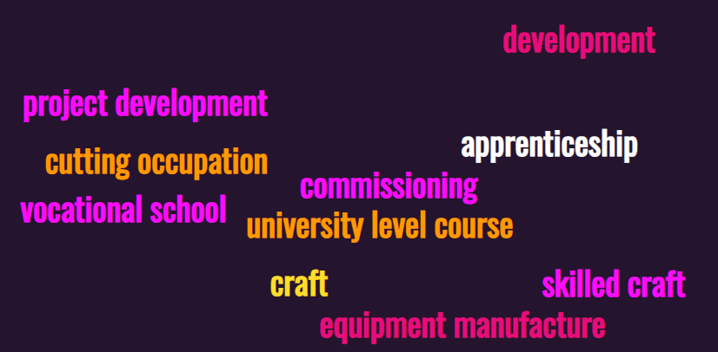
Main results
Training and re-skilling programmes in each of the stages of the value chains and according to the skill levels required, addressing the skill gaps of former coal mining workers to facilitate the development of the business alternatives.

Slide 38
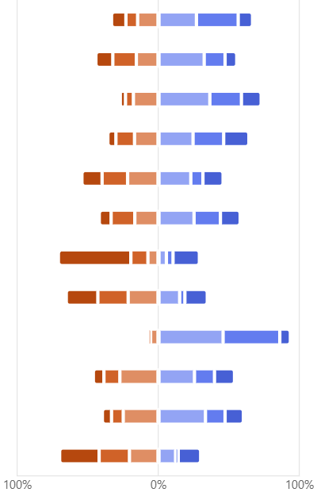
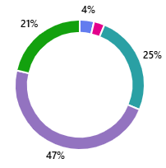
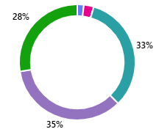
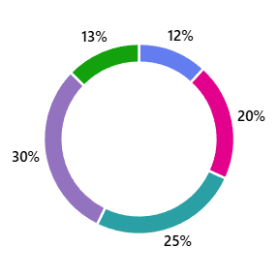

What influence flexibility of mine workers?
Family situation / family care
Ability to learn about and use new technologies
Readiness to work in a changing work environment
Health status
Lack of job opportunities in the local labor market
Lack of offers compatible with my education
Lack of experience / insufficient experience
1 - poor
2
3
4
5 - excellent
Lack of contacts and connections
Gender discrimination
Poor professional background
Low salary offered
Usefulness of current skills in a new job related to the “Green” economy and technologies
Lack of relevant certificates and authorisations
Age
Lack of experience in the recruitment process (lack of skills in preparing CVs, conducting interviews)

Slide 39
MENTIMETER on factors influencing acceptance of lower wages

Slide 40
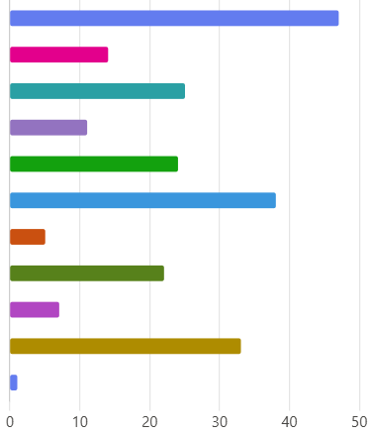
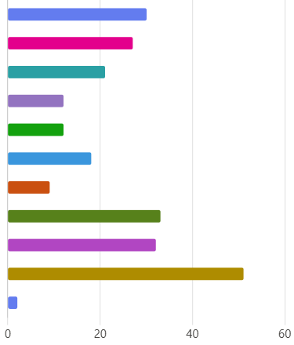
What factors influence the acceptance of lower wages?
Long-term job security
Better working environment and reduced occupational risks
Career develop. and promotion prospects
Access to training and opportunities to improve skills
Additional benefits e.g.: additional health insurance, additional holidays, etc.
Shorter travel time and convenient location
Access to retraining support and mentoring programs from the employer
Possibility of flexible working hours and better conditions for family life
Personal job satisfaction, sense of professional fulfillment
I do not accept a lower salary
Others
SLOVENIA
POLAND

Slide 41
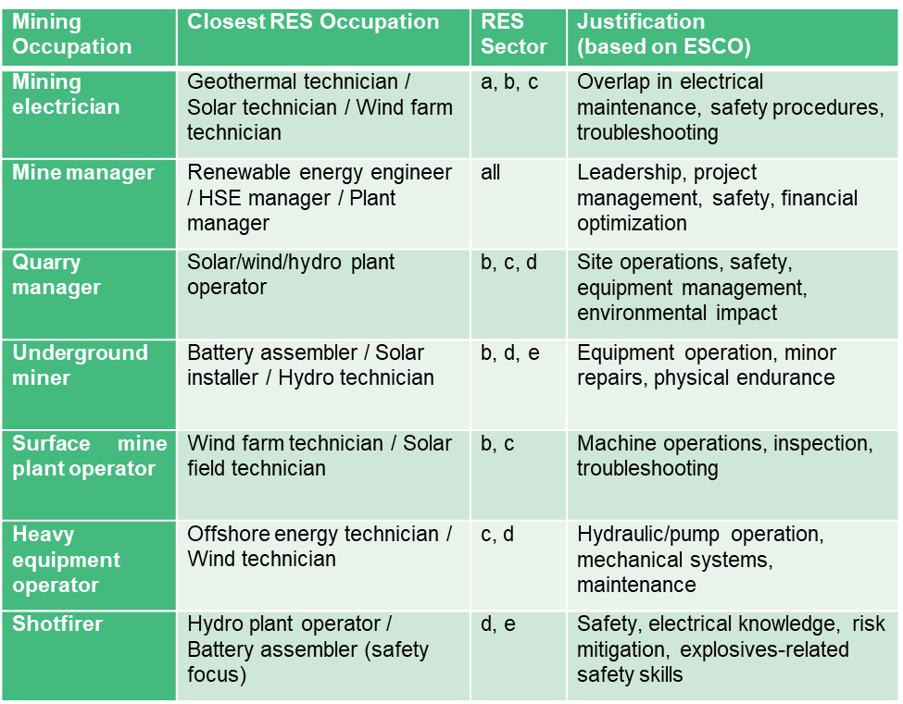
Occupational mapping across the RES value chain
Given the technological diversity and varying maturity levels across renewable energy domains, including (a) geothermal energy, (b) photovoltaic (PV) / solar energy, (c) wind power (onshore and offshore), (d) unconventional pumped hydro, (e) battery systems, and (f) green hydrogen — the occupational landscape of RES is inherently multidimensional.
ESCO = European Skills, Competences, Qualifications and Occupations

Slide 42
Training & re-skilling programmes
Example of a training plan designed for the wind energy sector
Wind Energy Training Programmes EQF = European Qualifications Framework

Slide 43
Something you may recognise?
Overview of Cross-Sectoral Academic Programmes

Slide 44
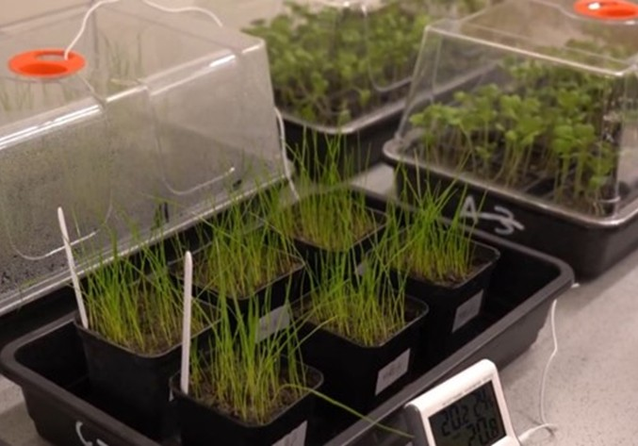
Main results
Three circular economy technologies:
The development of soil substitutes to restore waste heaps before installing photovoltaic/wind.
The development of dense fluids for unconventional pumped hydro energy storage.
The recovery of rare earths, critical raw materials for the EU.

Slide 45
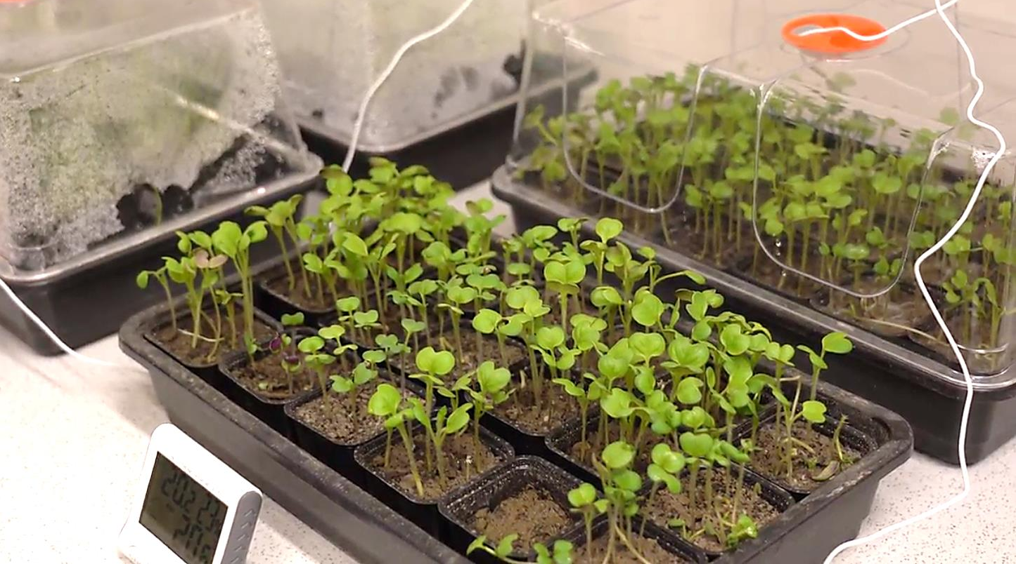
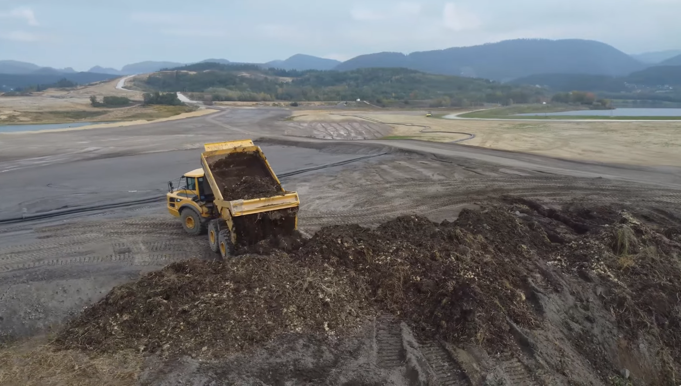
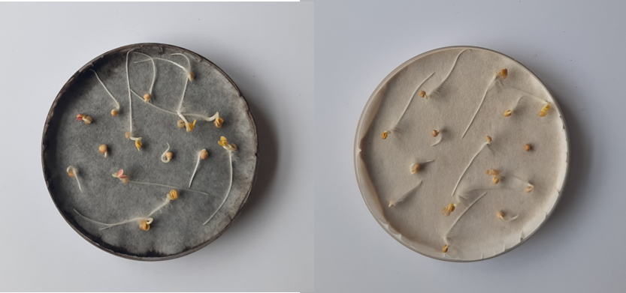
Development of soil substitutes in Slovenia

Slide 46
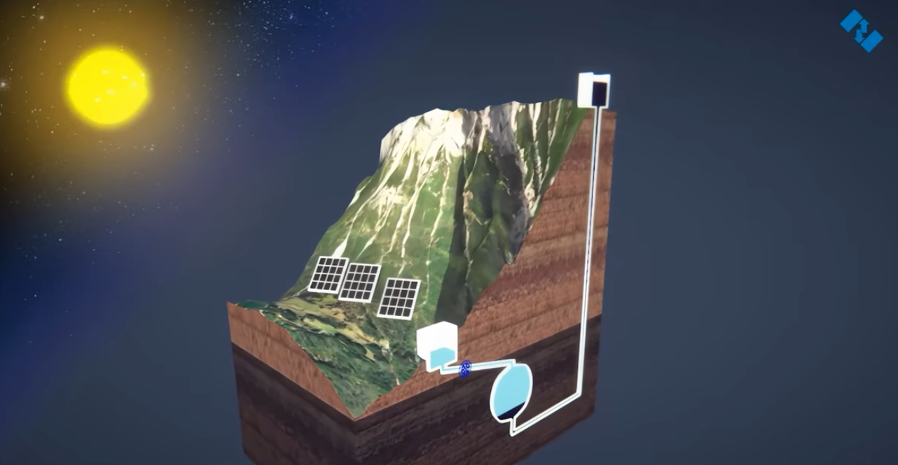
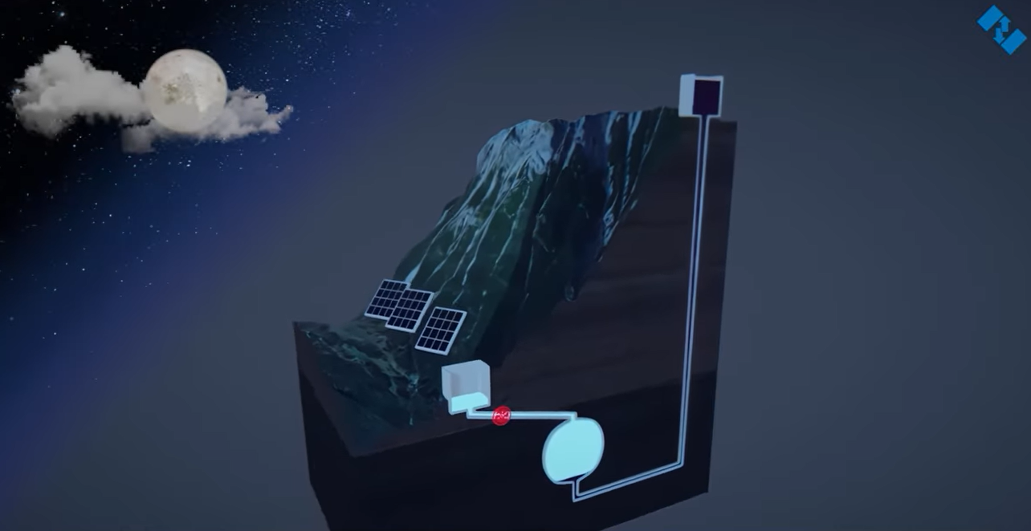
Unconventional pumped hydro energy storage using dense fluids
Second, energy recovery will be achieved by releasing dense fluid, which pushes the water in the cavern through the turbine.
First, energy storage will be obtained by pumping water into the cavern with renewable energy when it has lower prices. The water pushes the dense fluid towards the upper tank.

Slide 47
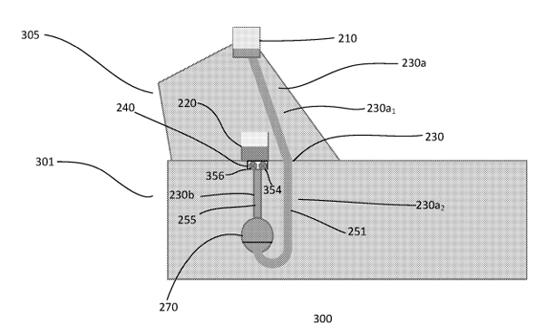
Unconventional pumped hydro energy storage using dense fluids
Poland and Spanish patents EP 3 768 967 on a “Pumped Hydro Energy Storage System and Method” were granted to Magellan & Barents, partner of the GreenJOBS Project, to support the adoption of Unconventional pumped hydro storage by Polish and Spanish mining companies interested in this energy storage alternative within the exploitation plan of the GreenJOBS Project (Patent Office of the Republic of Poland and Spanish Patent and Trademark Office, November 2024).

Slide 48
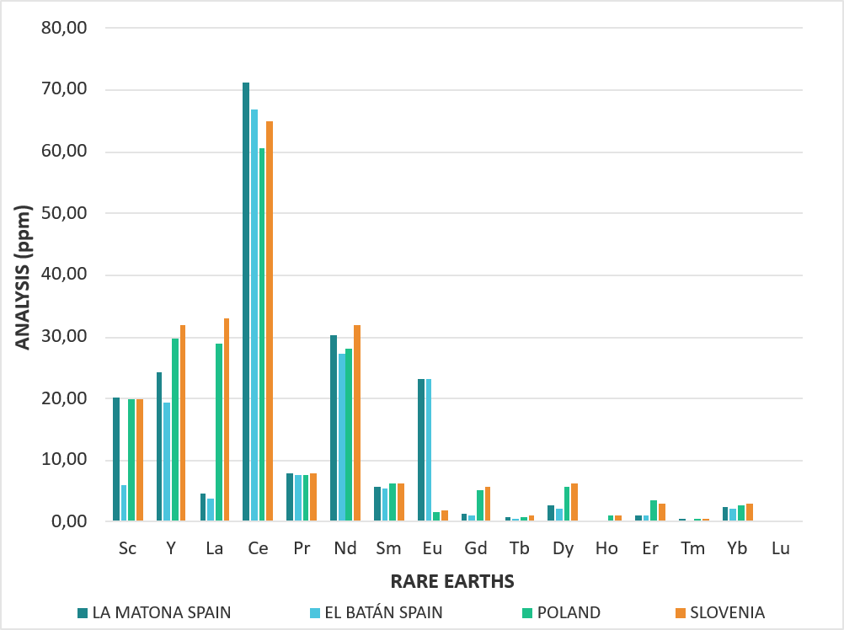
The recovery of rare earths
Rare earth concentrations from coal wastes range from 150-310 ppm (0.015-0.031%). For a mine to be mineable, concentrations between 1 and 2% are required. This suggests that the amount of rare earths present in the waste heaps in the three studied countries (ES, PL, SI) is too low to be economically viable.

Slide 49
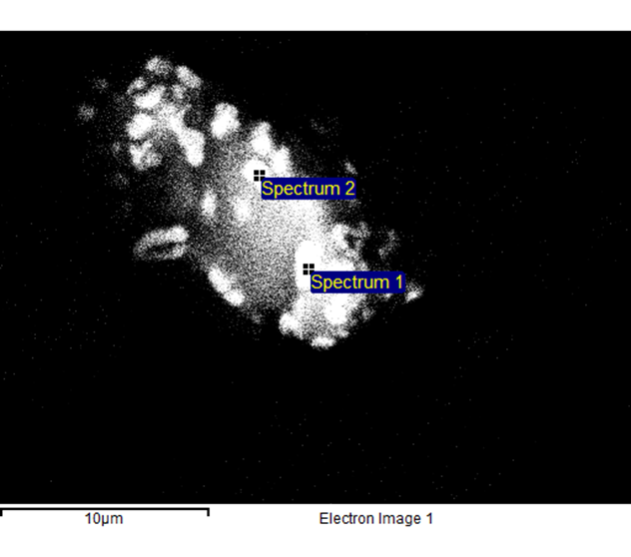
The recovery of rare earths
Mechanical separation methods, such as granulometric concentration, gravimetric, magnetic, and electric separators, and froth flotation, were used.
Scanning Electron Microscopy (SEM) image of a particle size of 20 microns. REE targets are 0.5-1 microns.
We are currently testing hydrometallurgical concentration; however, the results are not yet available.

Slide 50

A new project has started
The CRMsDataSpace project aims to create a Common European Data Space on Critical Raw Materials (CRMs) for the Green Deal, focusing on recovering valuable raw materials from closed extractive coal waste facilities. This seeks to enhance Europe's autonomy in securing critical raw materials.

Slide 51
Conclusions
The prioritisation of eco-industrial park concepts—integrating energy production, storage, and industrial activity—was validated as the preferred route for regional transition planning, enabling the combination of employment creation, innovation, and sustainable development.
Two main innovative business models can be used to achieve this goal: A Virtual Power Plant, facilitating local renewable electricity generation for sale to the grid or utilisation by nearby industries, and a Green Hydrogen Plant, producing hydrogen from mine water and renewable electricity to serve the transport sector, tied to broader circular economy objectives.

Slide 52
Conclusions
Economic feasibility analyses revealed that green hydrogen production, while technologically sound, remains financially unviable without significant subsidies (at least 50% support required), highlighting the ongoing necessity of favourable policy engagement to enable clean energy transitions in former coal areas..
The project underscored the importance of tailored training and reskilling programs for former mine workers—including all segments of the renewable energy value chain—to ensure local workforce inclusion. Factors influencing worker transition included technology readiness, willingness to adapt, local job availability, and supportive measures such as flexible work conditions and retraining support.

Slide 53
Conclusions
Circular economy initiatives, such as developing soil substitutes from mining waste, exploring unconventional pumped hydro energy storage with patented dense fluids, and evaluating options for critical raw material recovery, provided diversified pathways for reusing former mining infrastructures for environmental and economic benefit.
Finally, despite some technical limitations, such as the insufficient concentration of rare earth elements in coal wastes for economically feasible recovery, the broader implementation of circular models enriches the just transition framework and supports EU Green Deal policy objectives.

Slide 54
DziękujEMY za uwagę
Dr hab. inż. Alicja Krzemień, prof. GIG-PIB
akrzemien@gig.eu
GIG-PIB, Zakład Technologii Eksploatacji, Tąpań i Oceny Ryzyka
EURACOAL, www.euracoal.eu
54

