Slide 1
Repurposing end-of-life underground coal mines by deploying emerging renewable energy and circular economy technologies to promote sustainable local economic growth and maximize the numer of green, quality jobs
Alicja Krzemień
Central Mining Institute - NRI
20th Session of the Group of Experts on
Coal Mine Methane and Just Transition
Safe Operations and Closure of Coal Mines Session

Slide 2
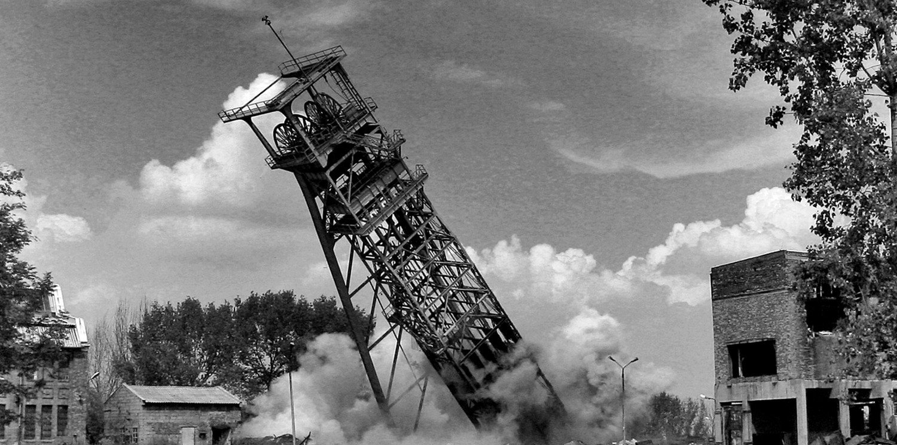
Repurposing end-of-life underground coal mines by deploying emerging renewable energy and circular economy technologies to promote sustainable local economic growth and maximize the numer of green, quality jobs
Closure process
A mining company must eliminate the adverse effects of mining activities after the exploitation of a given deposit has ended.
In particular, they should:
secure or liquidate mining excavations, mining plant, equipment and facilities,
take the necessary measures to protect the environment and reclaim the land after mining activities,
secure the unused part of the mineral deposit.
20th SESSION OF THE GROUP OF EXPERTS ON COAL MINE METHANE AND JUST TRANSITION I 24-25 March 2025 I Palais des Nations I Geneva

Slide 3
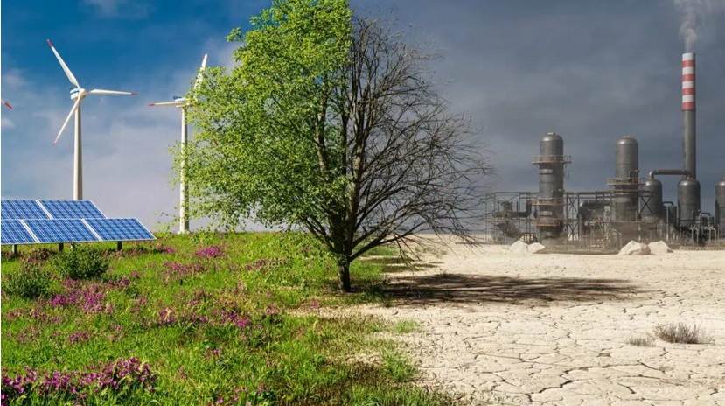
Repurposing end-of-life underground coal mines by deploying emerging renewable energy and circular economy technologies to promote sustainable local economic growth and maximize the numer of green, quality jobs
Objective of partial mine closure
Partial decommissioning means the decommissioning of a designated part of the mining site, redundant for technical or technological reasons, and leaving facilities that can be used for other purposes after the end of the mining site's operations.
The main objective is a fair and socially responsible transformation of the company towards the production and storage of renewable energy from locally available resources using mine infrastructure.
20th SESSION OF THE GROUP OF EXPERTS ON COAL MINE METHANE AND JUST TRANSITION I 24-25 March 2025 I Palais des Nations I Geneva

Slide 4
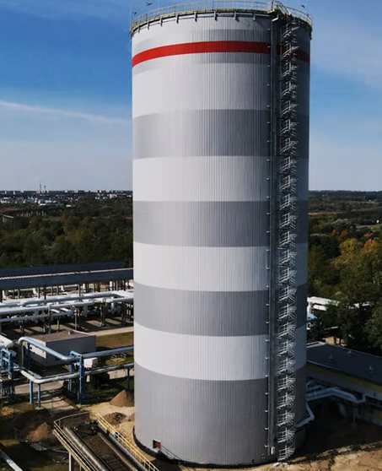
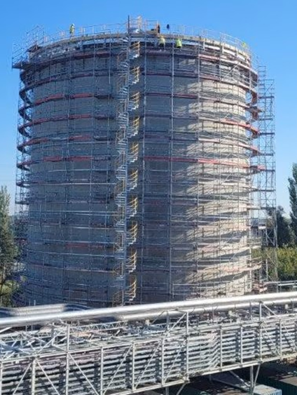
Repurposing end-of-life underground coal mines by deploying emerging renewable energy and circular economy technologies to promote sustainable local economic growth and maximize the numer of green, quality jobs
New functions of preserved infrastructure
Exploiting the energy potential of shafts.
The concept of a designed heat store will consist of:
storage of thermal energy in a vast underground heat reservoir "in a thermos", made in disused shafts,
surplus energy from renewable sources will be used to supply storage during periods of increased production from RES,
The stored heat during periods of demand will supply energy to end consumers via a pre-existent distribution network or a dedicated network.
20th SESSION OF THE GROUP OF EXPERTS ON COAL MINE METHANE AND JUST TRANSITION I 24-25 March 2025 I Palais des Nations I Geneva

Slide 5
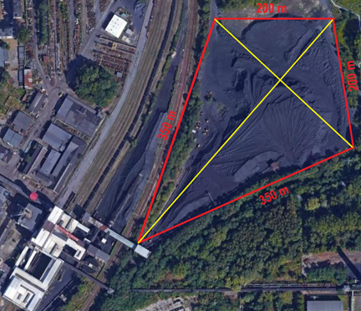
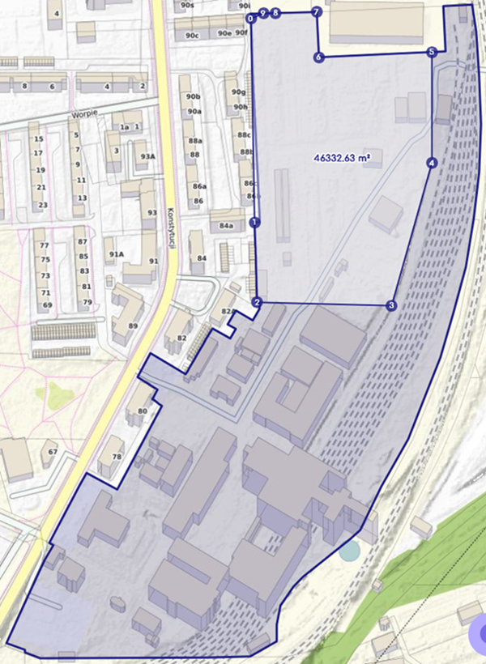
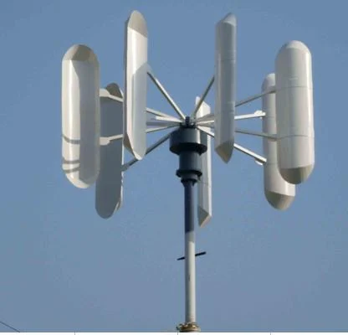
Repurposing end-of-life underground coal mines by deploying emerging renewable energy and circular economy technologies to promote sustainable local economic growth and maximize the numer of green, quality jobs
New functions of preserved infrastructure
Realising the energy potential of land.
Construction of renewable electricity sources:
On the site of a former mine, electricity from renewable sources can be produced.
Photovoltaic installation.
A wind farm using vertical axis wind turbines (VAWTs).
It will provide electricity for the heat pump, and surplus energy can be transferred, e.g., to an energy cluster.
20th SESSION OF THE GROUP OF EXPERTS ON COAL MINE METHANE AND JUST TRANSITION I 24-25 March 2025 I Palais des Nations I Geneva

Slide 6
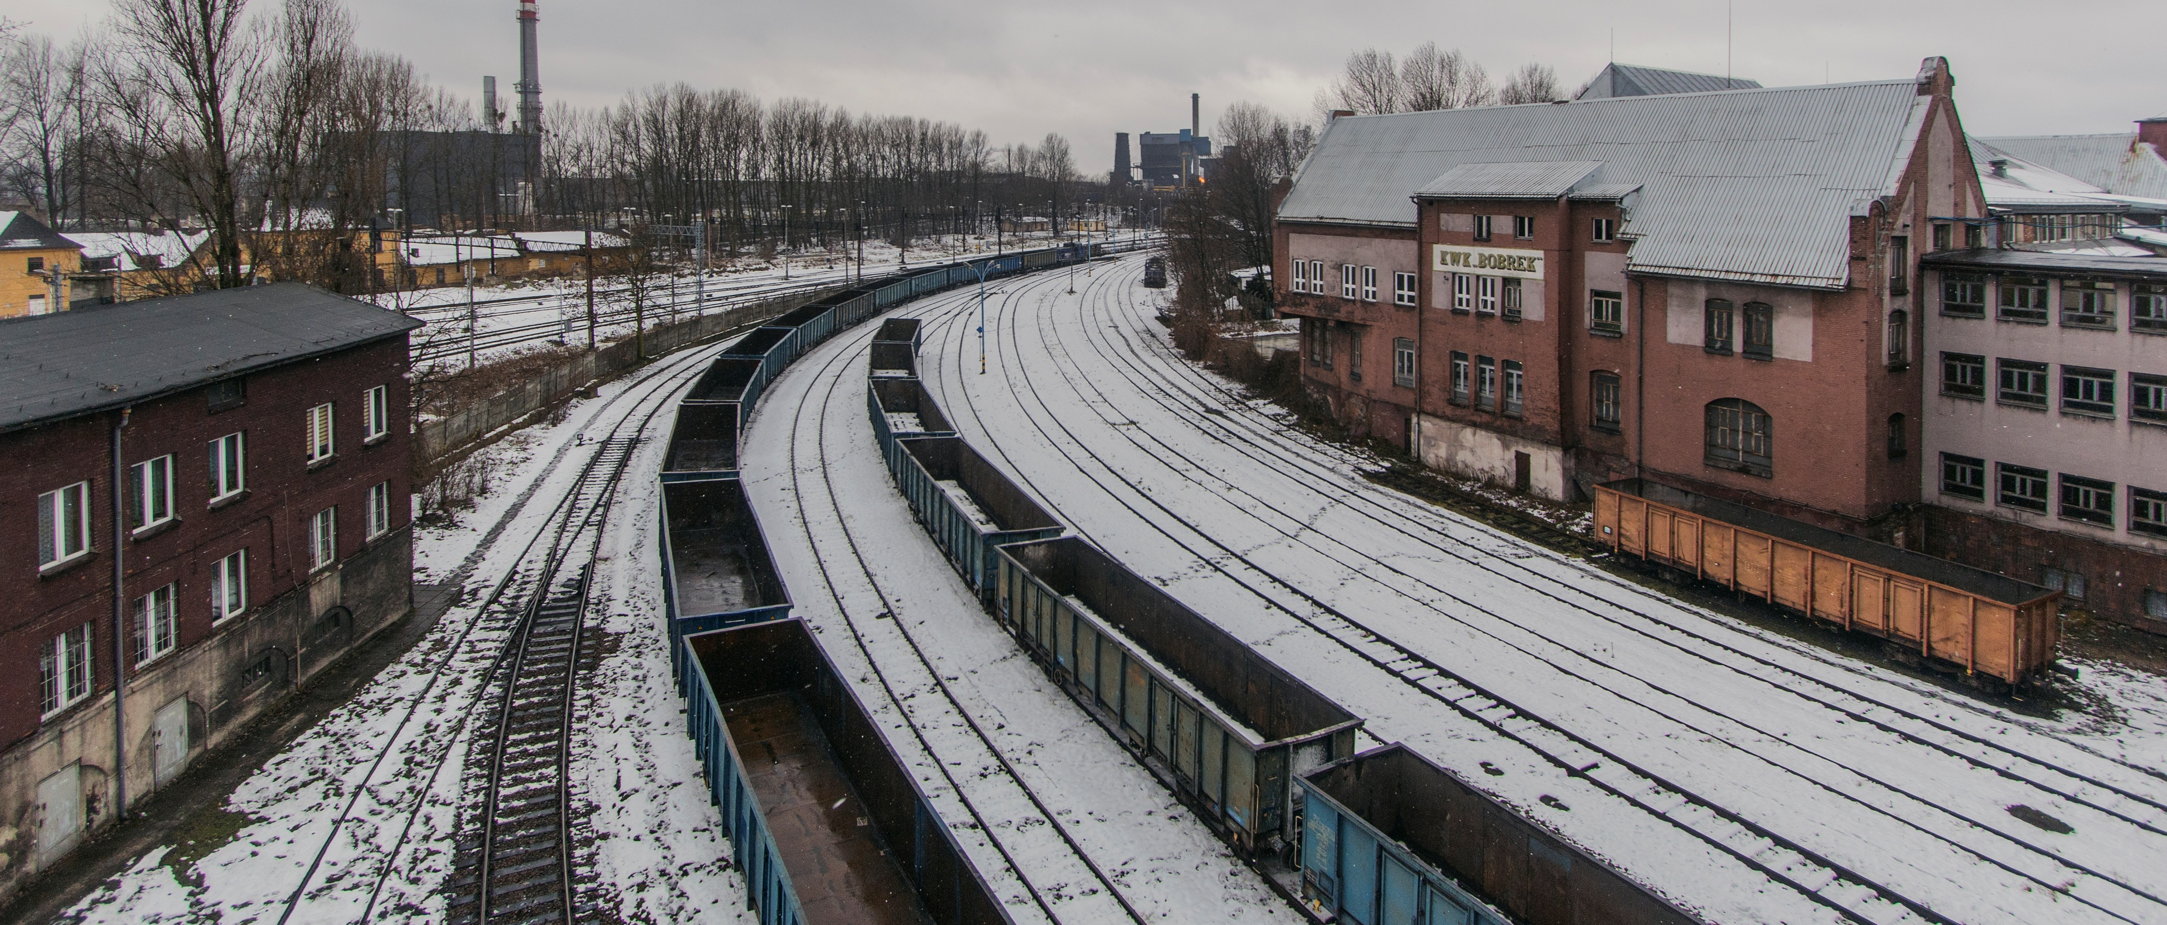
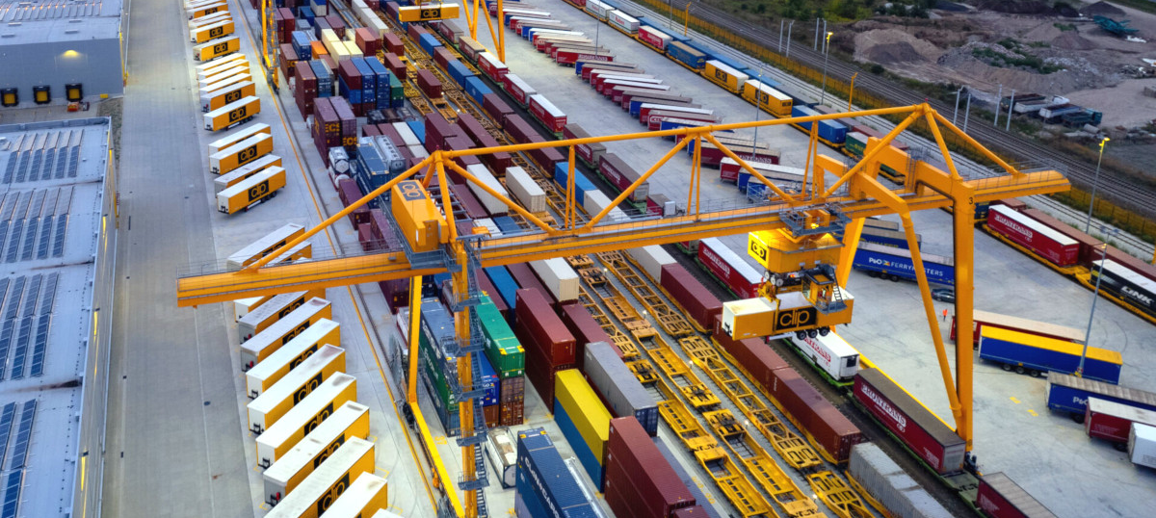
Repurposing end-of-life underground coal mines by deploying emerging renewable energy and circular economy technologies to promote sustainable local economic growth and maximize the numer of green, quality jobs
New functions of preserved infrastructure
Realising the potential of logistics infrastructure.
Rail siding as loading terminal:
Handling potential of the siding: transport of building materials, raw materials, industrial products.
Integration with other forms of transport (e.g. road transport) for efficient logistics.
Opportunity EU directive on a support framework for intermodal freight transport.
20th SESSION OF THE GROUP OF EXPERTS ON COAL MINE METHANE AND JUST TRANSITION I 24-25 March 2025 I Palais des Nations I Geneva

Slide 7
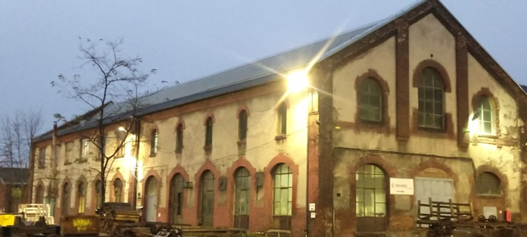
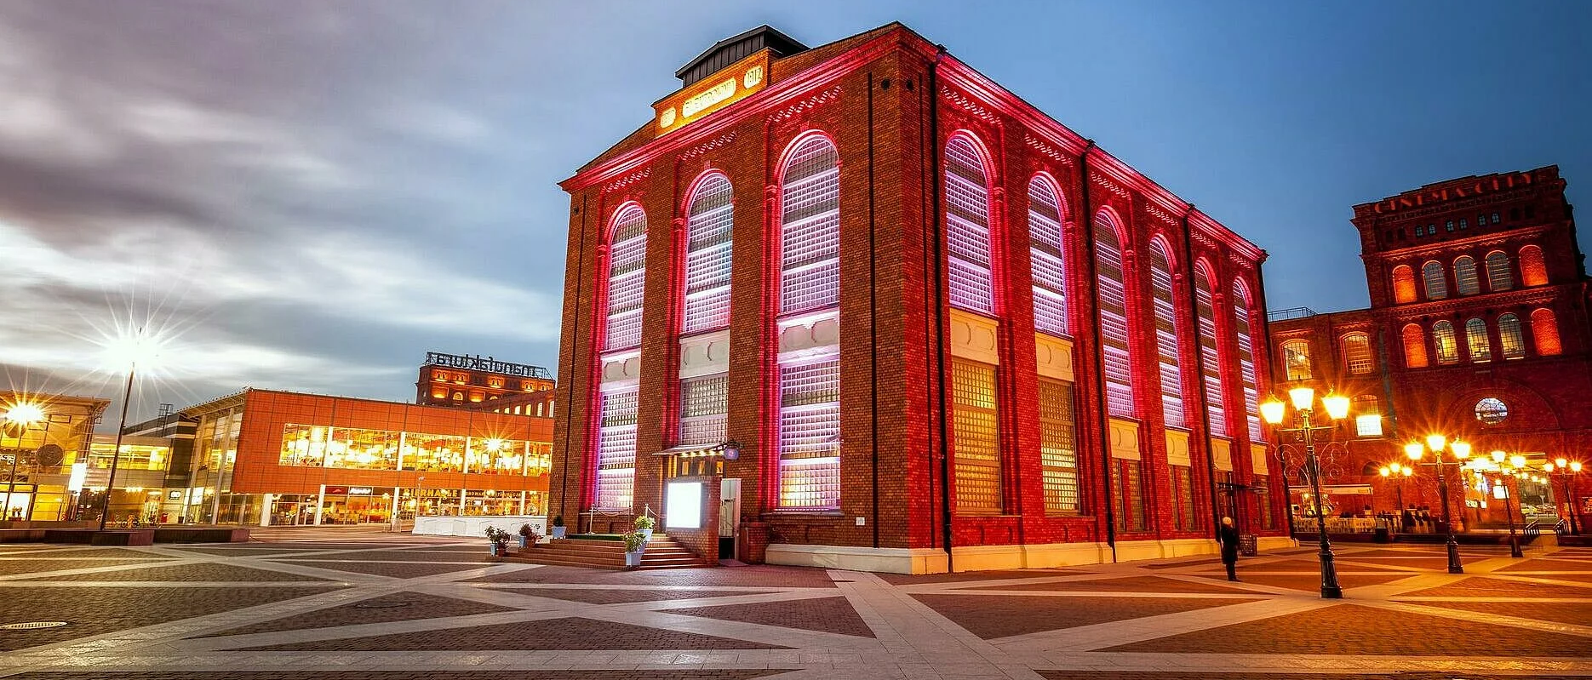
Repurposing end-of-life underground coal mines by deploying emerging renewable energy and circular economy technologies to promote sustainable local economic growth and maximize the numer of green, quality jobs
New functions of preserved infrastructure
Centre for Education and Innovation
Technology hub and start-up
Centre for Culture and the Arts
Research and development centre (R&D)
E-sports and gaming centre
Escape rooms and role-playing games in VR/AR
Development studios and creative hubs
Industrial and educational simulators
20th SESSION OF THE GROUP OF EXPERTS ON COAL MINE METHANE AND JUST TRANSITION I 24-25 March 2025 I Palais des Nations I Geneva

Slide 8
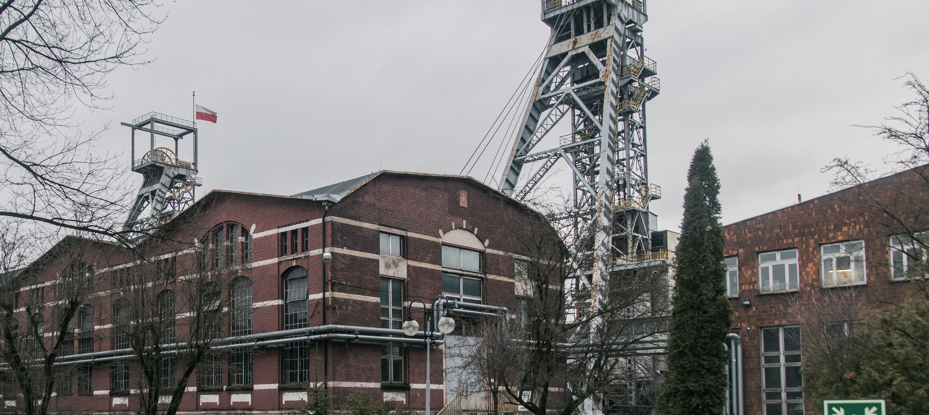
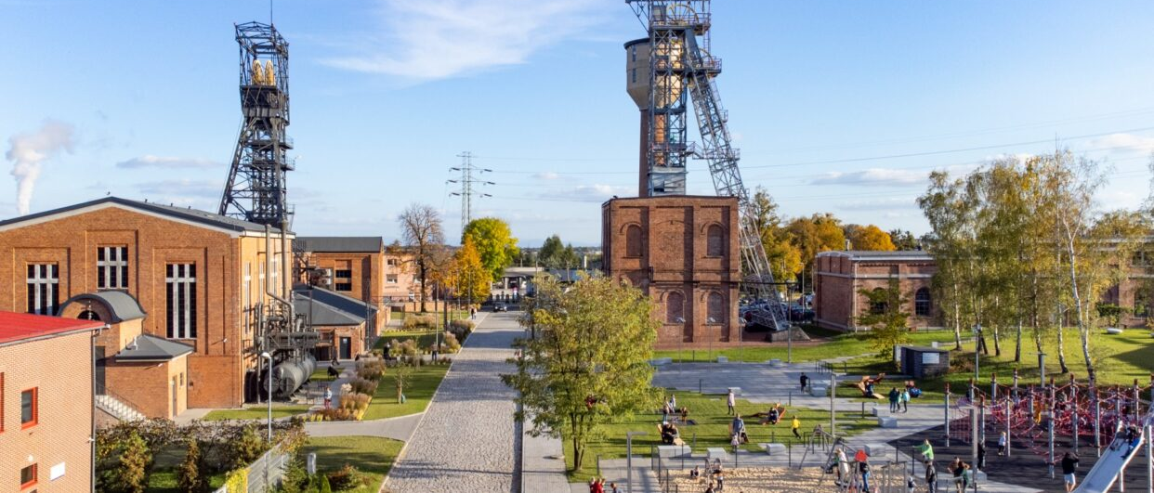
Repurposing end-of-life underground coal mines by deploying emerging renewable energy and circular economy technologies to promote sustainable local economic growth and maximize the numer of green, quality jobs
New functions of preserved infrastructure
Realising the potential of surface facilities.
Construction of renewable electricity sources:
Business incubator,
Support for industry, technology, services,
Revitalising the region and creating new jobs .
20th SESSION OF THE GROUP OF EXPERTS ON COAL MINE METHANE AND JUST TRANSITION I 24-25 March 2025 I Palais des Nations I Geneva

Slide 9
Repurposing end-of-life underground coal mines by deploying emerging renewable energy and circular economy technologies to promote sustainable local economic growth and maximize the numer of green, quality jobs
Benefits of partial mine decommissioning
using existing infrastructure
Reducing decommissioning costs.
Mitigating the negative effects of mine decommissioning.
Re-profiling of activities and creation of new 'green' jobs.
Supporting innovation and competitiveness in the city of Bytom.
Maintaining local identity and protecting the region's cultural heritage.
Urban space revitalisation.
Compliance with the European Union's climate neutrality policy.
Support for the energy transition.
Building public acceptance of the decarbonisation process.
A model example of equitable transformation, combining economic, social and environmental benefits.
20th SESSION OF THE GROUP OF EXPERTS ON COAL MINE METHANE AND JUST TRANSITION I 24-25 March 2025 I Palais des Nations I Geneva

Slide 10
Repurposing end-of-life underground coal mines by deploying emerging renewable energy and circular economy technologies to promote sustainable local economic growth and maximize the numer of green, quality jobs
Negative consequences of complete mine closure.
Loss of investment potential.
Exclusion of opportunities to use available resources to implement projects that are in line with EU climate objectives.
Challenging the idea of transformation of the mining sector.
No public acceptance of decommissioning without an alternative.
Deterioration of the region's image.
Reducing the competitiveness of the city of Bytom.
Irreparable economic, social and environmental damage.
20th SESSION OF THE GROUP OF EXPERTS ON COAL MINE METHANE AND JUST TRANSITION I 24-25 March 2025 I Palais des Nations I Geneva

Slide 11
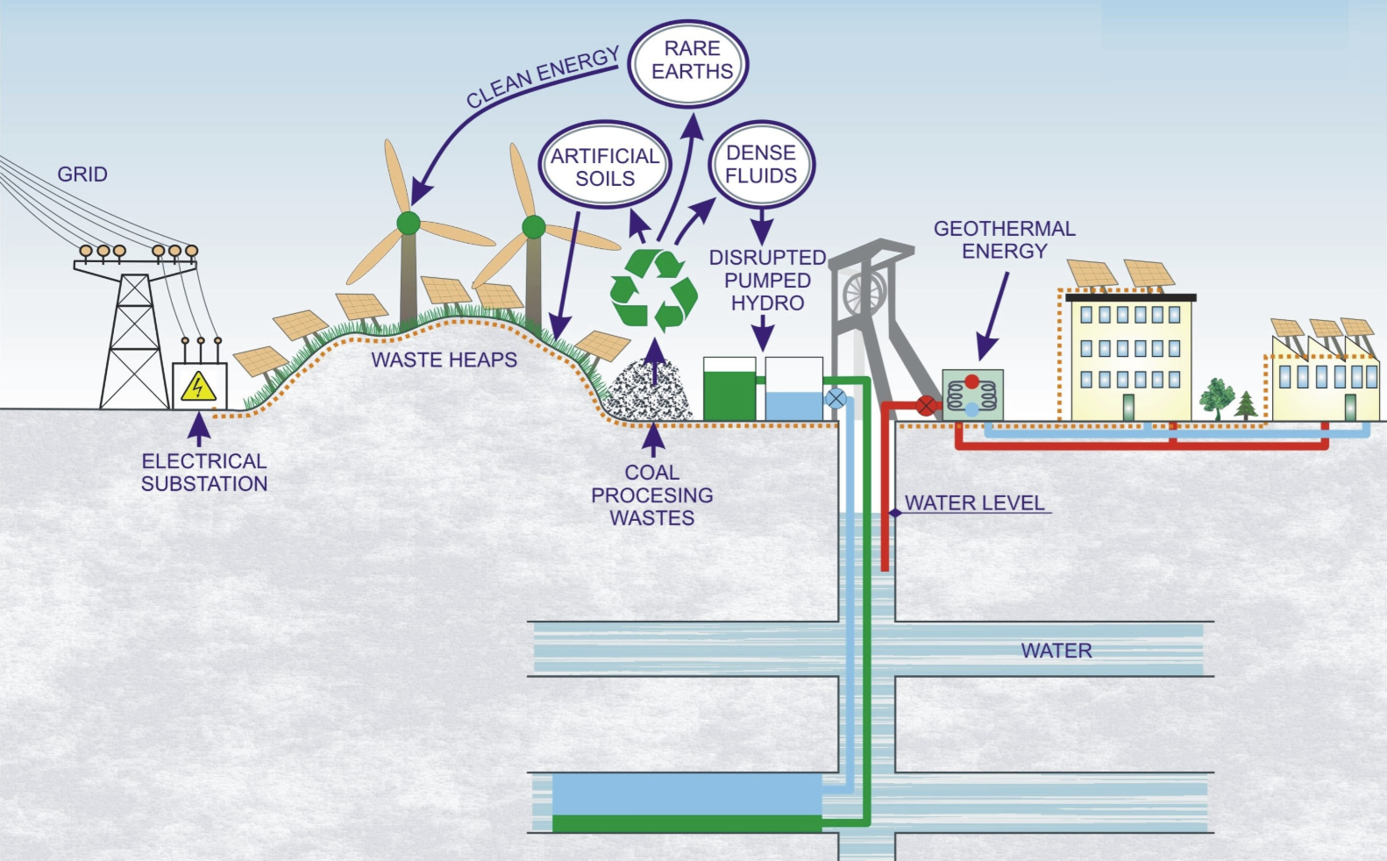
Repurposing end-of-life underground coal mines by deploying emerging renewable energy and circular economy technologies to promote sustainable local economic growth and maximize the numer of green, quality jobs
RFCS GreenJOBS Project
20th SESSION OF THE GROUP OF EXPERTS ON COAL MINE METHANE AND JUST TRANSITION I 24-25 March 2025 I Palais des Nations I Geneva

Slide 12
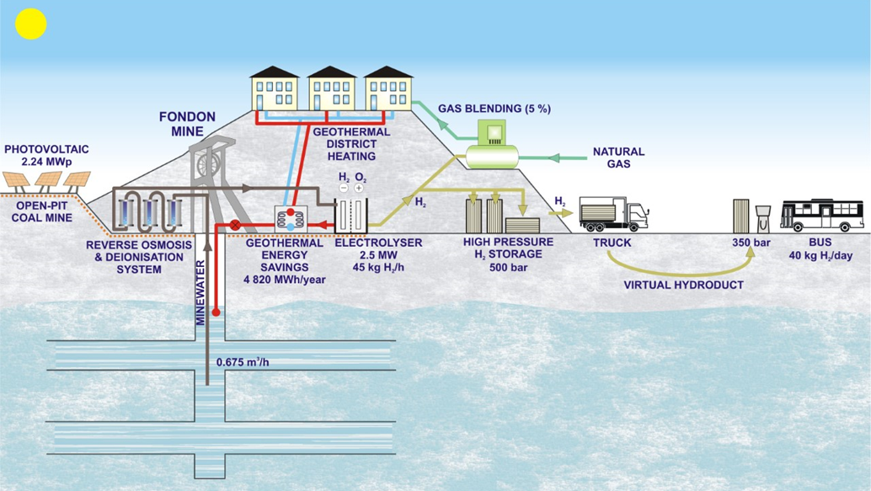
Repurposing end-of-life underground coal mines by deploying emerging renewable energy and circular economy technologies to promote sustainable local economic growth and maximize the numer of green, quality jobs
20th SESSION OF THE GROUP OF EXPERTS ON COAL MINE METHANE AND JUST TRANSITION I 24-25 March 2025 I Palais des Nations I Geneva

Slide 13
THANK YOU
"The views expressed are those of the presenter and do not necessarily reflect the views of the United Nations"
20th Session of the Group of Experts on
Coal Mine Methane and Just Transition
Safe Operations and Closure of Coal Mines Session

